Slide 1

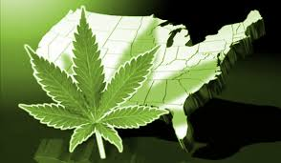



marijuana legalization? Potential Public Health and safety impacts
John F. Kelly, PhD
March 30, 2016

Slide 2
The Drug problem …
“For every complex problem there is a solution that is clear, simple, and wrong”
–Henry L. Mencken

Slide 3
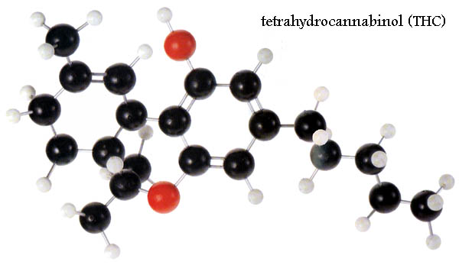
What is MJ?
Is the common name for the cannabis sativa plant which contains Psychoactive effects through a variety of cannabinols, notably Delta-9 THC, and cannabidiol
Most commonly inhaled through the lungs, It produces mild euphoria, mood enhancement, relaxation; higher/regular use produces intoxication, slowed cognition/memory impairment(Short-term memory/working memory) increased anxiety/paranoia/psychosis, hallucinations, addiction
Can increase the likelihood of accidents/MJ-related deaths but Unlikely to produce od related mortality directly
May be neurotoxic in higher doses; developing teen brain appears more susceptible to negative impacts than older adult users

Slide 4
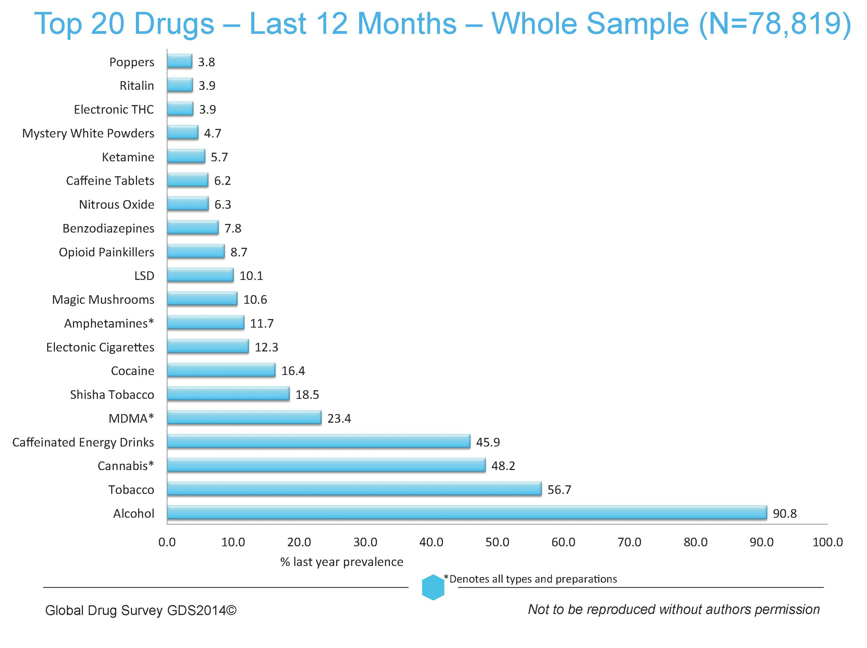
MJ is popular around the world
…

Slide 5
…and in the USA Second only to alcohol…

Slide 6
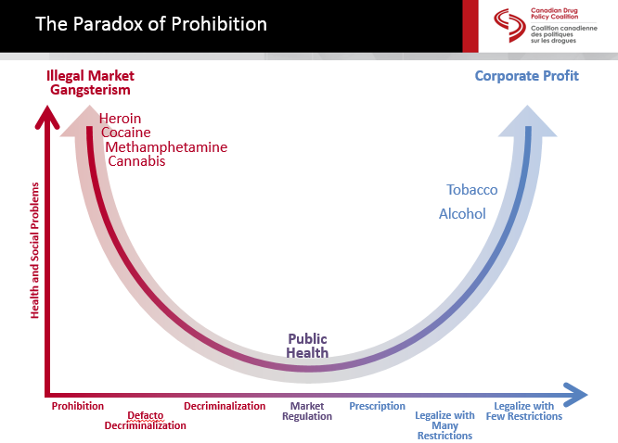
Degree of Problems Associated with Various Policy Approaches to Addressing the Drug Problem
Source: Canada Drug Policy Coalition, 2015

Slide 7

Legalization? How did we get here?

Slide 8
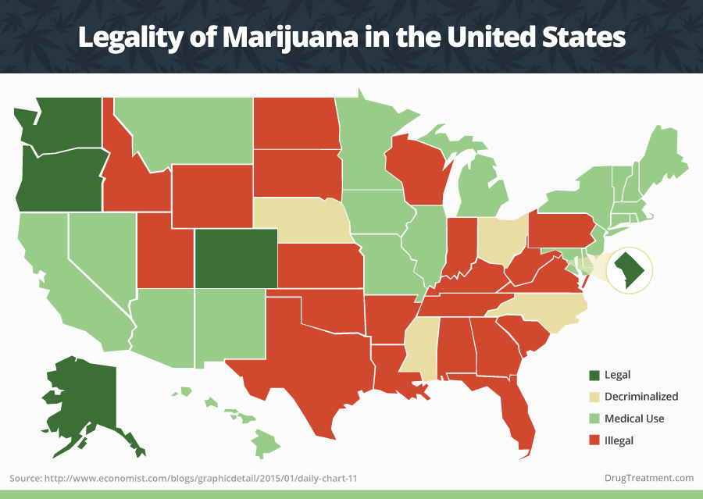

Slide 9

“medical marijuana”…

Slide 10
For which conditions might marijuana/THC have a therapeutic benefit?
Up to 259 conditions including:
Alzheimer’s disease
Anorexia
HIV/AIDS
Arthritis
Cachexia
Cancer
Crohn’s Disease
Epilepsy
Glaucoma
Migraines
Multiple Sclerosis
Nausea
Pain
Spasticity
Wasting Syndrome
ProCon.org: http://medicalmarijuana.procon.org/view.resource.php?resourceID=000884

Slide 11
CANNABIDOIDS HAVE DOCUMENTED THERAPEUTIC POTENTIAL…
THC Administration & FDA Approved THC-based medications
Compound | Administration | FDA Status | Approved Locations | Purposes
Dronabinol (Marinol) | Oral capsule | FDA-approved (1985) | USA, Germany | Nausea & vomiting related to cancer chemotherapy and wasting associated with AIDS
Nabilone (Cesamet) | Oral capsule | FDA-approved (1985) *Marketed in the US in 2006 | USA, Canada, UK, Mexico | Nausea & vomiting related to cancer chemotherapy
Nabiximols (Sativex) | Oromucosal spray | Almost FDA-approved; late-stage clinical trials | Canada, UK, other European countries | Multiple sclerosis spasticity, cancer pain, neuropathic pain
Marijuana Site Reclamation and Restoration Cost Analysis.” U.S. Department of Interior, National Park Service. December 9, 2010 (unpublished data). http://www.whitehouse.gov/ondcp/frequently-asked-questions-and-facts-about-marijuana#difference
Notes:
Nabilone is an analog to Dronabinol. Differences are primarily related to dosing:
Dronabinol: 5 mg/m2 orally four to six times per day. May increase in 2.5mg/m2 increments up to 15 mg/m2 per dose. Schedule III controlled substance
Nabilone: 1 to 2 mg orally twice daily; maximum of 6 mg per day. Schedule II controlled substance

Slide 12
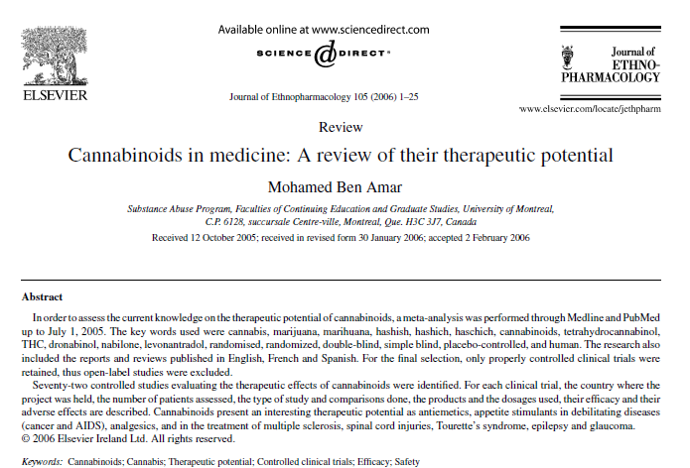

Slide 13
Controlled studies evaluating the therapeutic effect of THC by administration type
Ben Amar, M. (2006). Cannabinoids in medicine: A review of their therapeutic potential. Journal of ethnopharmacology, 105(1), 1-25.
Notes:
Author’s conclusions: “…based on the available data, oral cannabinoids should not be used as first-line anti-emetics. They may, however, prove effective to treat refractory emesis and have their place as adjuvants to other antiemetic medications. There is insufficient evidence on the efficacy of cannabis and its derivatives to control epilepsy. Further clinical trials, well-designed, carefully executed and powered for efficacy, are essential to clearly define the role of cannabinoids as appetite stimulants, as well as in the treatment of multiple sclerosis, spinal cord injuries, Tourette’s syndrome and glaucoma. For each pathology, it remains to be determined what type of cannabinoid and what route of administration are the most suitable to maximize the beneficial effects of each preparation and minimize the incidence of undesirable reactions”

Slide 14
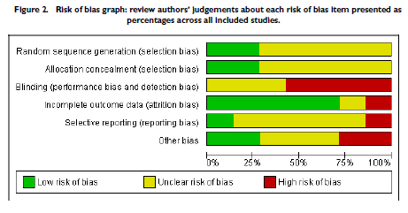
Issues with blinding in medical marijuana RCTs
More than 50% of studies are considered at high risk for unblinding
The use of cannabis and rapidly acting cannabinoids pose considerable challenges for blinding, as the psychoactive effects are expected to be quickly discernible to study participants, particularly those who have been previous users of such products.
Lutge, E. E., Gray, A., & Siegfried, N. (2013). The medical use of cannabis for reducing morbidity and mortality in patients with HIV/AIDS. status and date: New, published in, (4).
Notes:
Results: A total of seven relevant studies were included in the review, reported in eight publications. All were randomised controlled studies, with four utilising a parallel group design, two a within-subject randomisation and two a cross-over design. All of the studies were of a fairly short duration, ranging from 21 days to 84 days. In only four papers (in effect, three studies) were sequence generation and allocation concealment judged to be adequate. The use of cannabis and rapidly acting cannabinoids posed considerable challenges for blinding, as the psychoactive effects are expected to be quickly discernible to study participants, particularly those who have been previous users of such products. Dronabinol was expected to be more easily blinded. The outcomes measured were variable, including change in weight, change in body fat (measured as a percentage of total body weight), change in appetite (measured on a visual analogue scale), change in caloric intake (measured in kcals/kg/24hr), change in nausea and vomiting (measured on a visual analogue scale), change in performance (measured by Karnofsky performance score or specific tests for memory and dexterity) and change in mood (measured on a visual analogue scale).The evidence for substantial effects on morbidity and mortality is currently limited. Data from only one relatively small study (n=139, of which only 88 were evaluable), conducted in the period before access to highly-active antiretroviral therapy (HAART), showed that patients administered dronabinol were twice as likely to gain 2kg or more in body weight (RR 2.09), but the confidence interval for this measure (95% CI 0.72 - 6.06) included unity. The mean weight gain in the dronabinol group was only 0.1kg, compared with a loss of 0.4kg in the placebo group. However, the quality of sequence generation and allocation concealment in this study, in which participants were randomised by centre, could not be assessed.
Author’s Conclusions: Despite dronabinol being registered by at least some medicines regulatory authorities for the treatment of AIDS-associated anorexia, and some jurisdictions making allowances for the "medical" use of marijuana by patients with HIV/AIDS, evidence for the efficacy and safety of cannabis and cannabinoids in this setting is lacking. Such studies as have been performed have been of short duration, in small numbers of patients, and have focused on short-term measures of efficacy. Long-term data, showing a sustained effect on AIDS-related morbidity and mortality and safety in patients on effective antiretroviral therapy, has yet to be presented. Whether the available evidence is sufficient to justify a wide-ranging revisiting of medicines regulatory practice remains unclear.

Slide 15
Why should MJ be illegal?
Why should it be legalized?

Slide 16
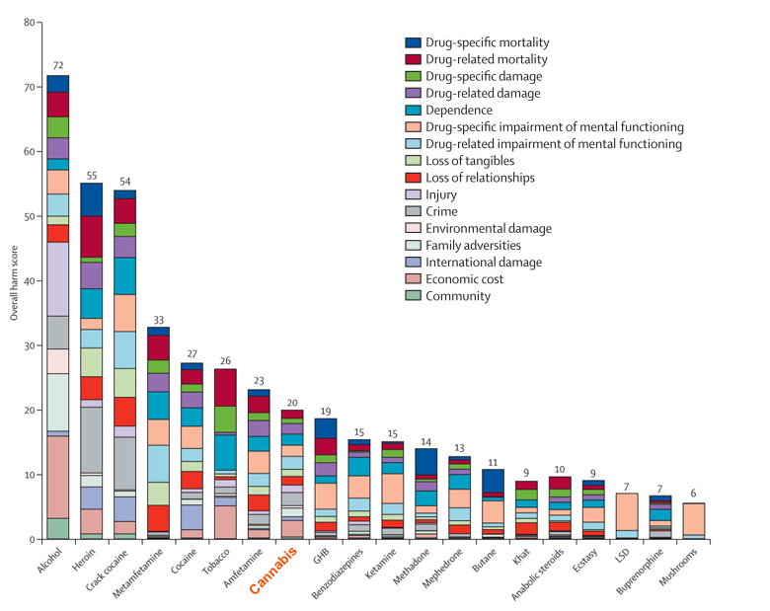
Health
(and societal) risks of smoked marijuana
20 drugs ranked by overall harm along 16 criteria
Nutt, D. J., King, L. A., & Phillips, L. D. (2010). Drug harms in the UK: a multicriteria decision analysis. The Lancet, 376(9752), 1558-1565.

Slide 17
Arguments for cannabis legalization
“War on drugs” has failed
5% of world’s population -25% of world’s prisoners
2.5 Million locked up; about 500,000 of whom are there for drugs
Racial disparities in incarceration rates at same prevalence of use
Legalization would reduce arrests/criminal justice costs (2013- 41% of all illicit drug-related violations were MJ possession; 6% for MJ Sale/manufacturing
Demand is high- “gonna do it anyway” so why not regulate it and make it safe?
IT’s not Bad/as bad as alcohol/tobacco -Even good for you (medicinal)
Tax it and bring in revenue for states

Slide 18
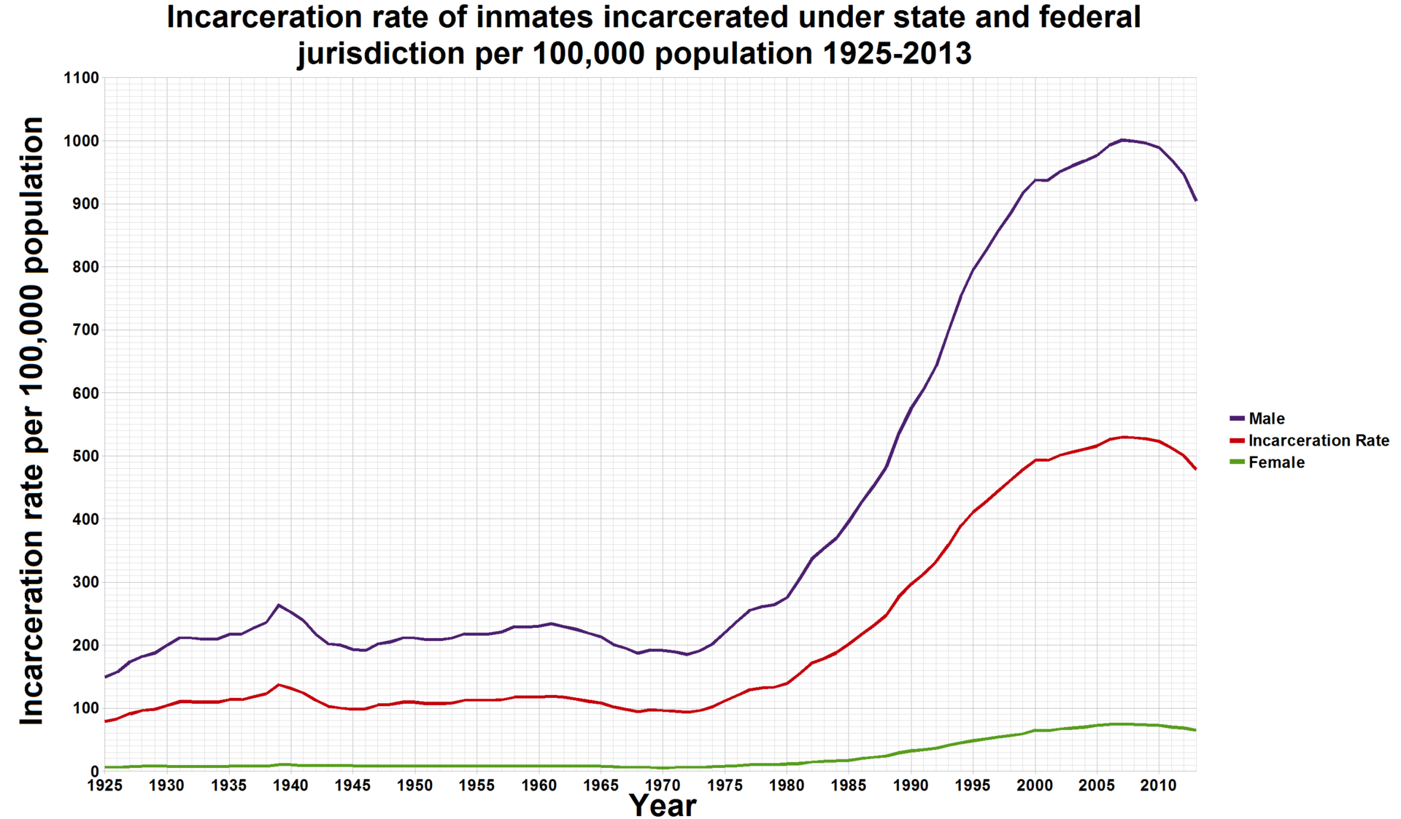
The War on Drugs
With 5% of the world’s pop, the US has 25% of its prisoners.
Avg US cost per prison inmate = (2010) = $31K (range 14K-60K); about $16 Billion for the 500,000 drug-related prisoners (20% of all prisoners)

Slide 19
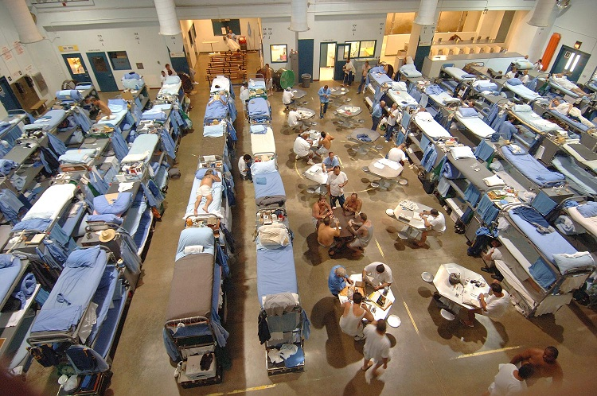
Prisons overcrowding: 20% (500,000) of US prisoners are in prison due to drug offences; the majority of inmates meet criteria for substance use disorder/psych illlness

Slide 20
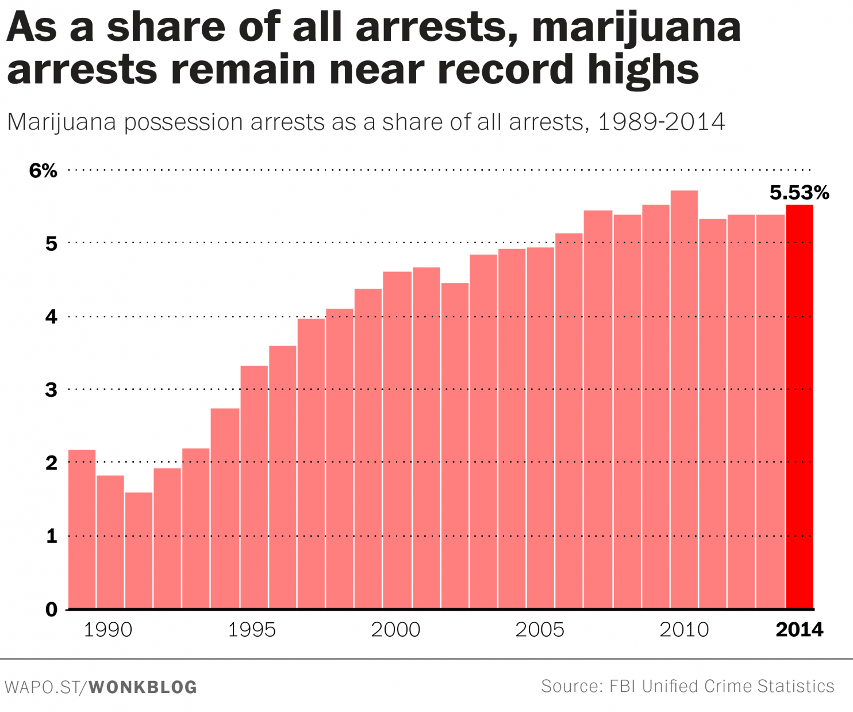

Slide 21
So, legalize?
Of the 2.5 million prisoners in US about 500,000 are there due to drug law violations, but only about 40,000 of these are MJ
This would be justification for decriminalization NOT legalization but even so, to “end the war on drugs” by legalization of MJ won’t do it
What will happen is the reduction on the arrests annually (FOR POSSESSION) in the US – about 700,000 reduction in arrests annually
How to legalize? Industry – majority of market is heavy users/ADDICTED–(80% of volume used is by 20%)
If we make it more available and accessible, cheaper, remove social stigma and legal penalties and have industry aggressively advertising it, use will increase
Possible mj could have subtractive effect on alc use? Don’t know. Could use both?

Slide 22
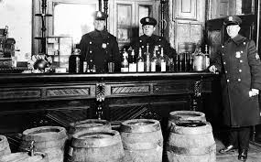
“Prohibition doesn’t work- everybody knows that!”
Notes:
Well, prohibition does have many positive effects – this argument is made for why should legalize “drugs”. Yes, it’s much harder to prohibit a legalized and culturally and historically embedded drug like alcohol than it is to keep a drug illegal that has not been legal (for a century).

Slide 23
So, legalize, regulate, tax, educate (“just like alcohol”)
Legalize
Regulate
Educate
Tax

Slide 24
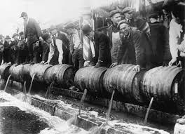
Just like alcohol …
21st amendment repealed alcohol Prohibition… and virtually ended our alcohol problems (???)

Slide 25
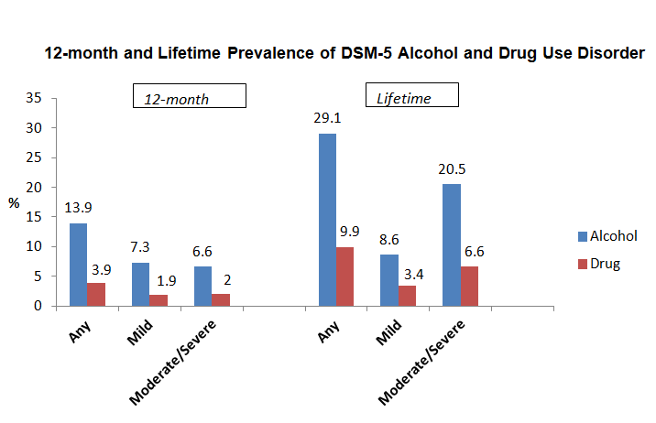
DSM-V Lifetime and 12-Month Prevalence of Alcohol and Drug Use Disorder
3-3.5x more addiction cases for alcohol in the past year/lifetime than ALL illicit drugs combined

Slide 26
…Did alcohol re-legalization put an end to our alcohol problems?
Alcohol = addictive drug - Majority of addicted individuals in US are addicted to alcohol
Alcohol = level I carcinogen – known to cause cancer
40 million individuals drink at risky/harmful levels
100,000 deaths due to alcohol annually – 3rd leading cause preventable death
10,000 killed each year on roads in alcohol-related accidents - Hundreds of thousands more injured
Alcohol-related crashes cost taxpayers $100 billion; overall economic burden $250 billion (fed/state/local combined tax revenue from alcohol sales = $15 Billion)
3 Million alcohol-related arrests annually (e.g., liquor violations; underage sales; drunk and disorderly/violence/domestic violence); Nearly 1.4 million arrested for DUI
If “prohibition doesn’t work” it’s hard to make the case that Legalization is the solution…

Slide 27
Alcohol and harm
On alcohol containers, Why don’t we have “alcohol may cause addiction” or “alcohol causes cancer”?

Slide 28
HOW COULD INCREASED USE OF MJ CAUSE HARM TO PUBLIC HEALTH AND PUBLIC SAFETY?
Toxicity, Intoxication, and Addiction
Patterns of use
Average volume
intoxication
Toxic Effects
Addiction
Chronic Disease
Accidents/injuries (acute disease)
Acute social problems
Chronic Social problems
Source: Babor et al, 2010

Slide 29


Slide 30
Addictiveness of marijuana
“Adolescents, especially troubled ones, and people with psychiatric disorders (including substance abuse) appear more likely than the general population to become dependent on marijuana… ”
-- Institute of Medicine
Anthony, J.; Warner, L.A.; and Kessler, R.C. Comparative epidemiology of dependence on tobacco, alcohol, controlled substances, and inhalants: Basic findings from the National Comorbidity Survey. Exp Clin Psychopharmacol 2:244–268, 1994;
Hall, W.; and Degenhardt, L. Adverse health effects of non-medical cannabis use. Lancet 374:1383–1391, 2009;
Hall, W. The adverse health effects of cannabis use: What are they, and what are their implications for policy? Int J of Drug Policy 20:458–466, 2009

Slide 31
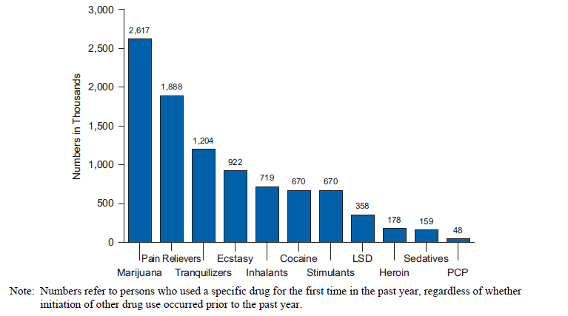
Past year initiates of specific drugs UNITED STATES

Slide 32
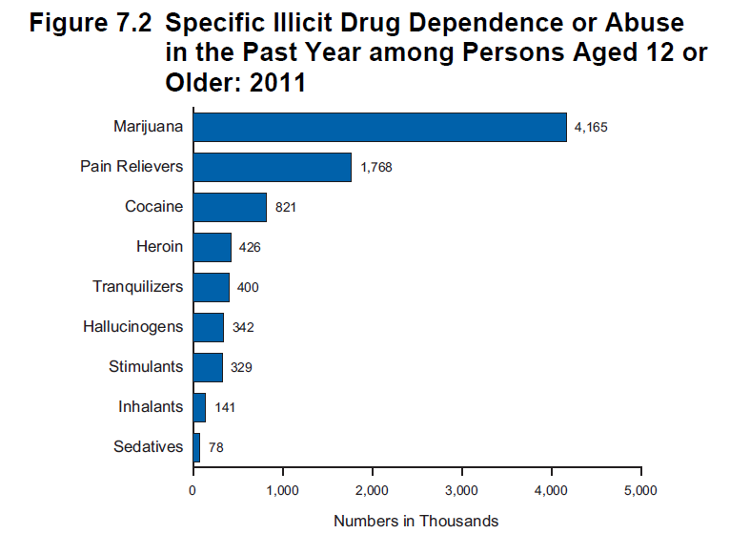

Slide 33
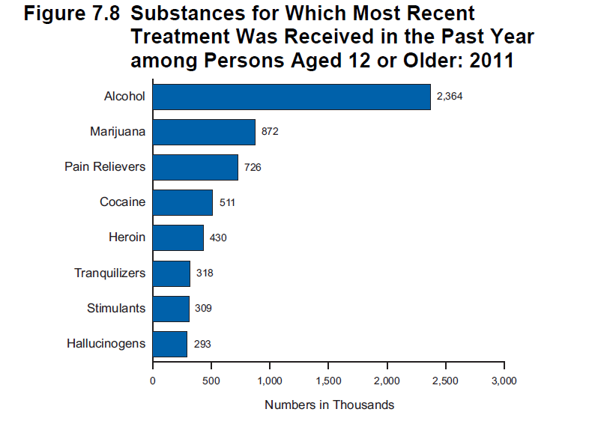

Slide 34
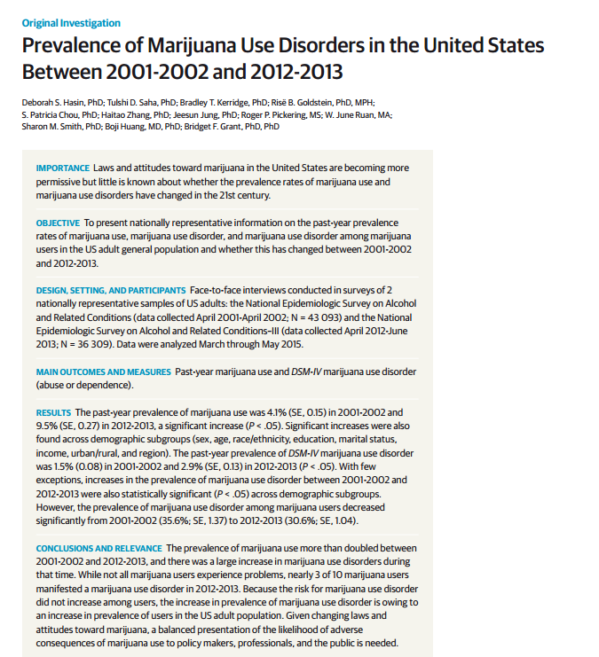

Slide 35
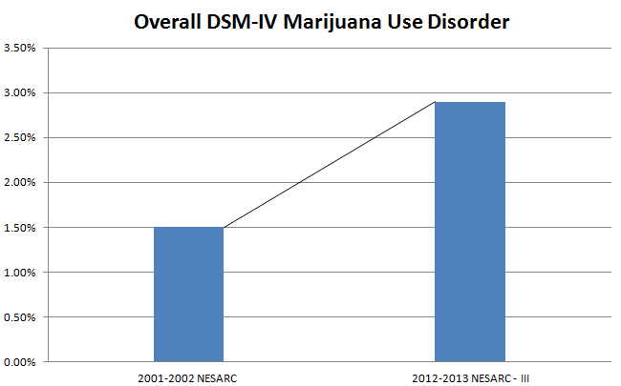
Past Year DSM-IV Marijuana Use Disorder
Notes:
Prevalence of DSM-IV marijuana use disorder nearly doubled between 2001-2002 and 2012-2013.

Slide 36


Slide 37
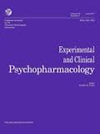
1. First Analysis (k=33)
Results: Neurocognitive deficits in most domains of functioning present early during abstinence
2. Second Sub-Analysis (k-13)
Results: Not present after 25 or more days of abstinence

Slide 38
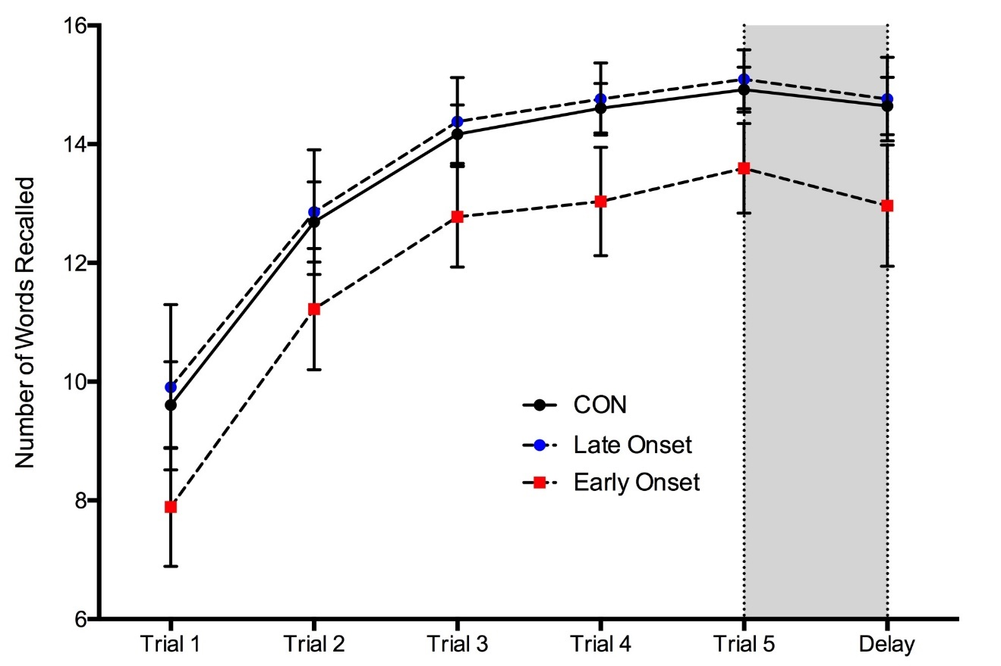
Marijuana Users Show Worse Performance on a Memory Test
MJ users, particularly early-onset users (<16), show impaired learning compared to non-users
Could mean students using MJ regularly could have difficulty attending to and learning new information

Slide 39
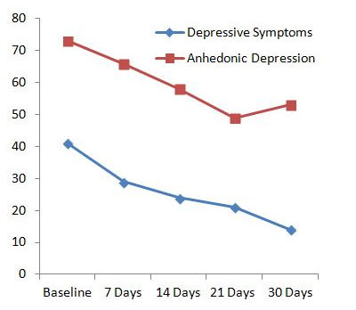
What Happens After 30 days of Abstinence?
Psychiatric
  Improvement in mood
Cognition
  ↑ attention
  ↑ executive functions

Slide 40
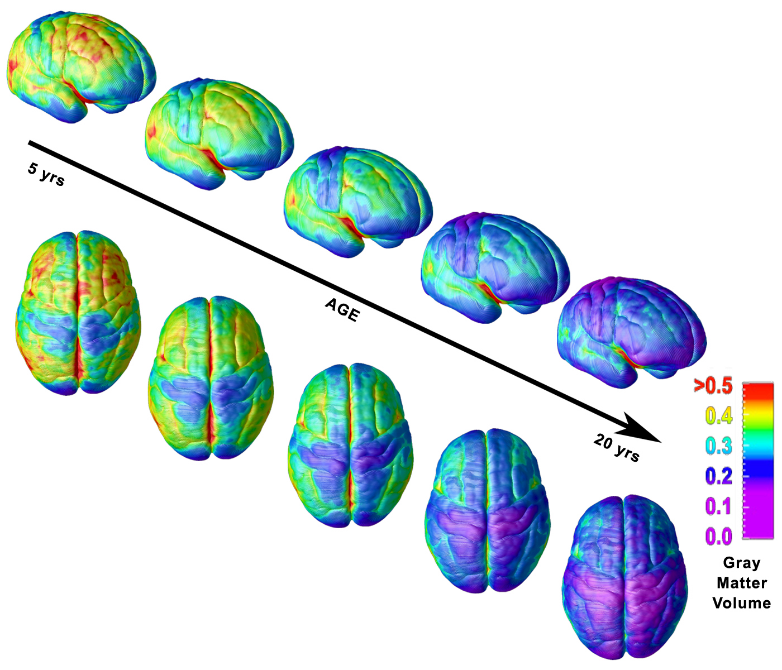
Pre-frontal cortex associated with weighing pros/cons, impulse control, judgment, abstract reasoning, planning last to develop…
There are “critical” periods in brain development wherein substances can have more profound developmental effects…

Slide 41
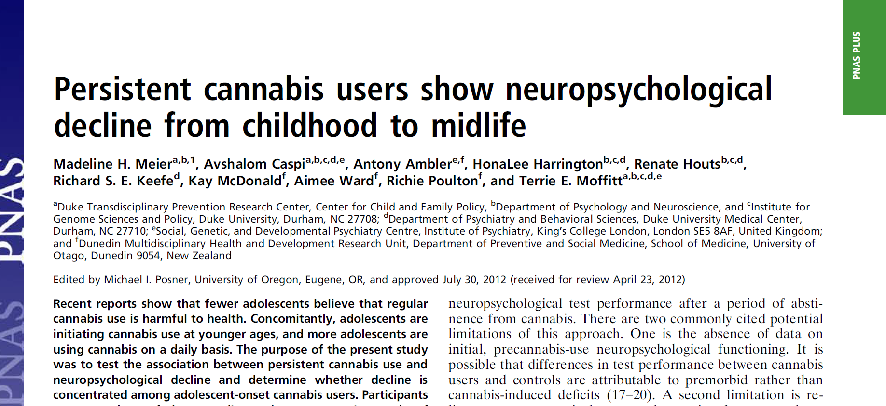

Slide 42
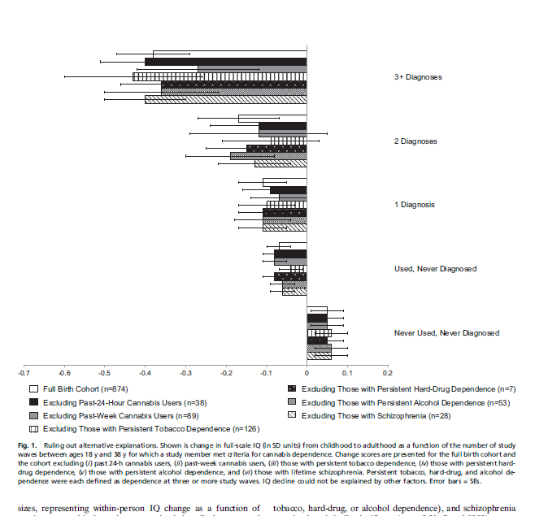
Even when recent MJ use was taken into account along with other confounds heavy use during teen years was associated with an 8 point drop in IQ

Slide 44
MJ use during adolescence may affect
Brain development through two pathways:
Alters synaptic pruning (via disrupting glutamate
Transmission) leading to greater disinhibition in prefrontal
regions leading to psychotic symptoms
2. Decreased myelination altering development of white matter
leading to cognitive-emotional impairments

Slide 45
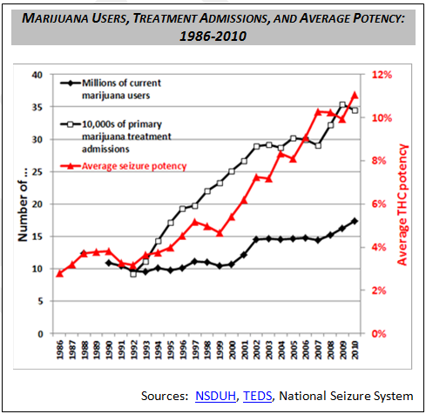
What will be the effects of higher potency MJ?
That study was done when MJ potency was lower…. Increased potency in past 20 years

Slide 47
Positive moderately strong correlation
across states, between higher rates of teenage use
and legalization and “medicalization” of MJ

Slide 48
Positive moderately strong correlation
across states, between less perceived harm and legalization and “medicalization” of MJ

Slide 49
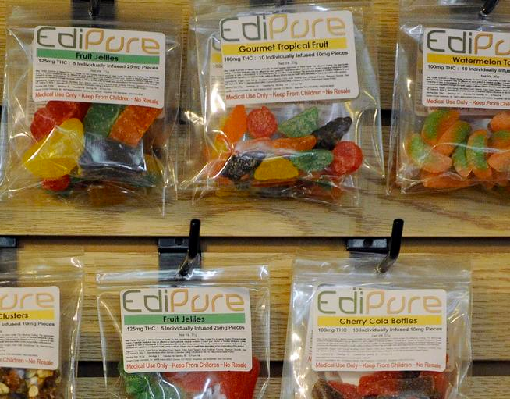
Impact of Edibles?

Slide 50
National Poisoning system data show that MJ exposure among kids <6yrs rose 148% from 2006-2013, particularly in states where Med MJ is legal

Slide 51
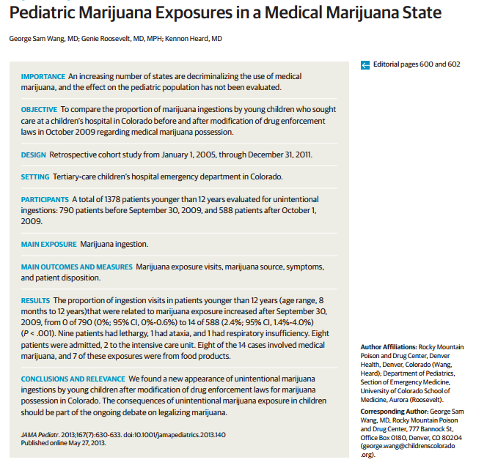

Slide 52
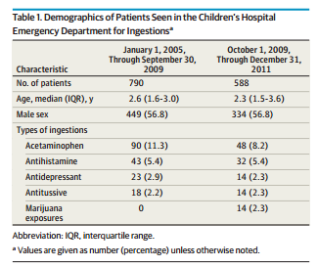
New increase in unintentional marijuana ingestions by young children
Opposite trend to all other toxic ingestions
Notes:
New increase in unintentional marijuana ingestions by young children after modification of drug enforcement laws for marijuana possession in Colorado.

Slide 53
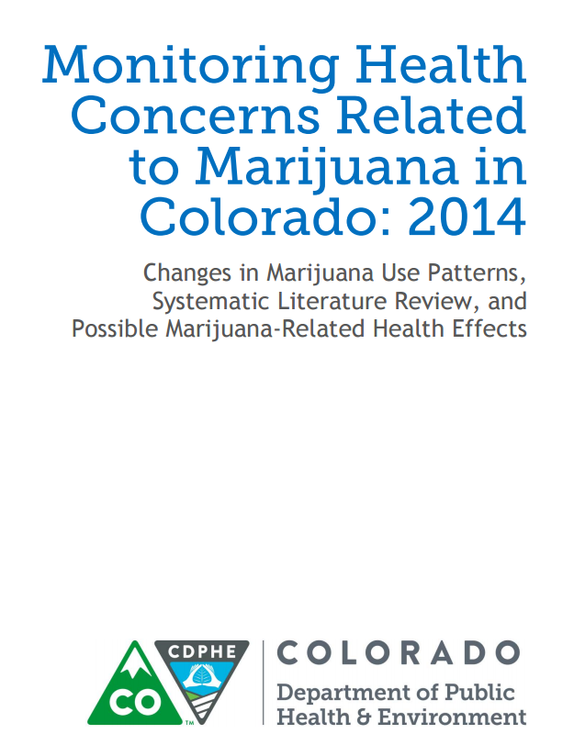

Slide 54
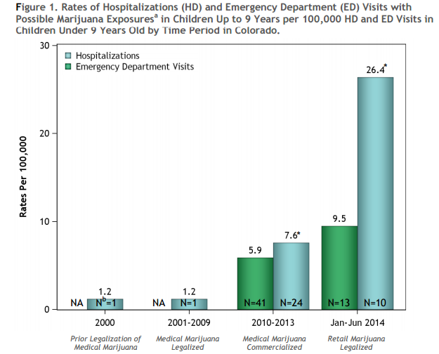

Slide 55
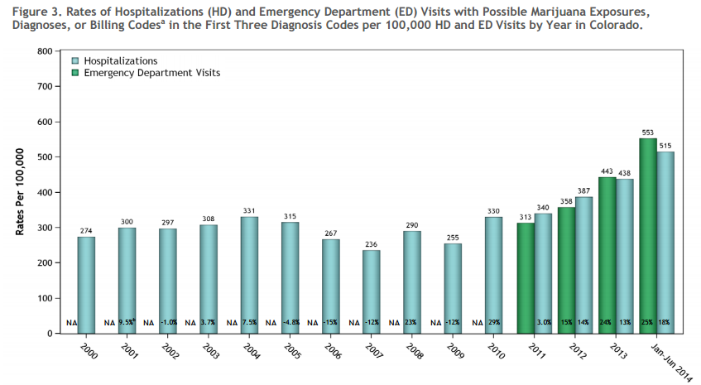
After retail marijuana was legalized, increasing trend in the amount of hospitalizations and ED visits…
Notes:
After retail marijuana was legalized, there is an increasing trend in the amount of hospitalizations ad emergency department visits.

Slide 56

Does MJ affect:
Neuro-cognition?
Motivation?
Psychosis?

Slide 57
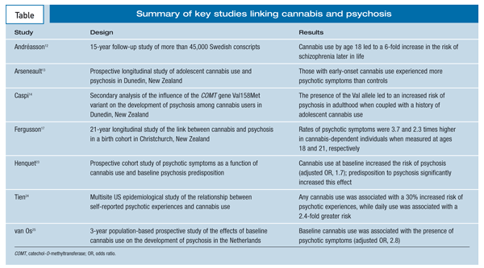
What about Psychotic symptoms and Schizophrenia?
Notes:
References
1. United Nations Office on Drugs and Crime (UNODC). World Drug Report 2010. Vienna: United Nations; 2010.
2. Koskinen J, Löhönen J, Koponen H, et al. Rate of cannabis use disorders in clinical samples of patients with schizophrenia: a meta-analysis. Schizophr Bull. 2010;36:1115-1130.
3. Iversen LL. The Science of Marijuana. 2nd ed. New York: Oxford University Press; 2008.
4. Ameri A. The effects of cannabinoids on the brain. Prog Neurobiol. 1999;58:315-348.
5. Pertwee RG. The diverse CB1 and CB2 receptor pharmacology of three plant cannabinoids: delta9-tetrahydrocannabinol, cannabidiol and delta9-tetrahydrocannabivarin. Br J Pharmacol. 2008;153:199-215.
6. Eggan SM, Lewis DA. Immunocytochemical distribution of the cannabinoid CB1 receptor in the primate neocortex: a regional and laminar analysis. Cereb Cortex. 2007;17:175-191.
7. Szabo B, Siemes S, Wallmichrath I. Inhibition of GABAergic neurotransmission in the ventral tegmental area by cannabinoids. Eur J Neurosci. 2002;15:2057-2061.
8. Murray RM, Morrison PD, Henquet C, Di Forti M. Cannabis, the mind and society: the hash realities. Nat Rev Neurosci. 2007;8:885-895.
9. Morrison PD, Murray RM. From real-world events to psychosis: the emerging neuropharmacology of delusions. Schizophr Bull. 2009;35:668-674.
10. Moore TH, Zammit S, Lingford-Hughes A, et al. Cannabis use and risk of psychotic or affective mental health outcomes: a systematic review. Lancet. 2007;370:319-328.
11. McLaren JA, Silins E, Hutchinson D, et al. Assessing evidence for a causal link between cannabis and psychosis: a review of cohort studies. Int J Drug Policy. 2009;21:10-19.
12. Andréasson S, Allebeck P, Engström A, Rydberg U. Cannabis and schizophrenia. A longitudinal study of Swedish conscripts. Lancet. 1987;2:1483-1486.
13. Arseneault L, Cannon M, Poulton R, et al. Cannabis use in adolescence and risk for adult psychosis: longitudinal prospective study. BMJ. 2002;325:1212-1213.
14. Caspi A, Moffitt TE, Cannon M, et al. Moderation of the effect of adolescent-onset cannabis use on adult psychosis by a functional polymorphism in the catechol-O-methyltransferase gene: longitudinal evidence of a gene X environment interaction. Biol Psychiatry. 2005;57:1117-1127.
15. Lachman HM, Papolos DF, Saito T, et al. Human catechol-O-methyltransferase pharmacogenetics: description of a functional polymorphism and its potential application to neuropsychiatric disorders. Pharmacogenetics. 1996;6:243-250.
16. Bilder RM, Volavka J, Lachman HM, Grace AA. The catechol-O-methyltransferase polymorphism: relations to the tonic-phasic dopamine hypothesis and neuropsychiatric phenotypes. Neuropsychopharmacology. 2004;29:1943-1961.
17. Fergusson DM, Horwood LJ, Swain-Campbell NR. Cannabis dependence and psychotic symptoms in young people. Psychol Med. 2003;33:15-21.
18. Bowers MB Jr, Mazure CM, Nelson JC, Jatlow PI. Psychotogenic drug use and neuroleptic response. Schizophr Bull. 1990;16:81-85.
19. Linszen DH, Dingemans PM, Lenior ME. Cannabis abuse and the course of recent-onset schizophrenic disorders. Arch Gen Psychiatry. 1994;51:273-279.
20. Rabin RA, Zakzanis KK, George TP. The effects of cannabis use on neurocognition in schizophrenia: a meta-analysis. Schizophr Res. 2011;128:111-116.
21. Zuardi AW, Crippa JA, Hallak JE, et al. Cannabidiol, a Cannabis sativa constituent, as an antipsychotic drug. Braz J Med Biol Res. 2006;39:421-429.
22. Fadda P, Robinson L, Fratta W, et al. Differential effects of THC- or CBD-rich cannabis extracts on working memory in rats. Neuropharmacology. 2004;47:1170-1179.
23. Henquet C, Krabbendam L, Spauwen J, et al. Prospective cohort study of cannabis use, predisposition for psychosis, and psychotic symptoms in young people. BMJ. 2005;330:11.
24. Tien AY, Anthony JC. Epidemiological analysis of alcohol and drug use as risk factors for psychotic experiences. J Nerv Ment Dis. 1990;178:473-480.
25. van Os J, Bak M, Hanssen M, et al. Cannabis use and psychosis: a longitudinal population-based study. Am J Epidemiol. 2002;156:319-327.
- See more at: http://www.psychiatrictimes.com/schizophrenia/cannabis-psychosis-link/page/0/3#sthash.rhb5egtj.dpuf

Slide 58


Slide 59
Risk of motor vehicle accident increase about 2x after
smoking MJ.
Critical tracking tasks, reaction times
Divided-attention tasks, lane-position variability all show MJ-induced
Impairments. Dose dependent. Even among more tolerant regular users, impairments persist.

Slide 60
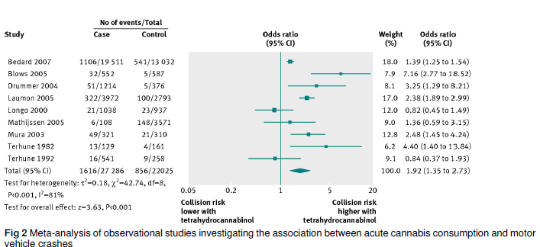
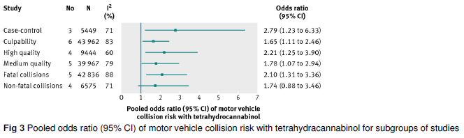
Public Health risks of marijuana
Motor vehicle collision risk over all studies
Motor vehicle collision risk
by type of study
Asbridge, M., Hayden, J. A., & Cartwright, J. L. (2012). Acute cannabis consumption and motor vehicle collision risk: systematic review of observational studies and meta-analysis. BMJ: British Medical Journal, 344.

Slide 61
Method: Online survey of of past month MJ users in WA and CO states (N=865)
Results: Prevalence of past-yr driving under influence of MJ was 44%
Prevalence of driving within 1 hour of using MJ 5+ times in past month = 24%
69% lower odds of driving if perceived risky
37% lower odds of driving if had knowledge of MJ DUI laws

Slide 62
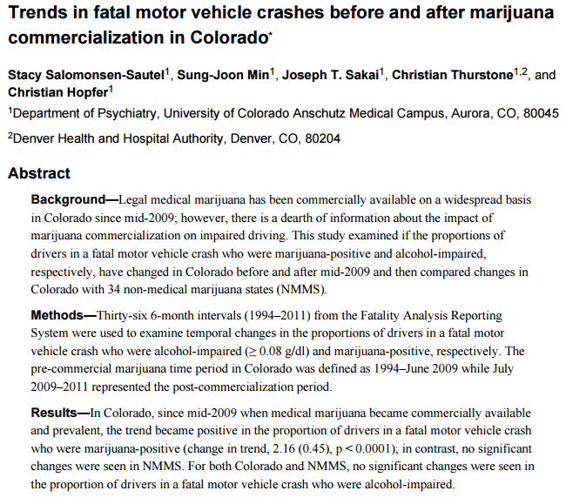

Slide 63
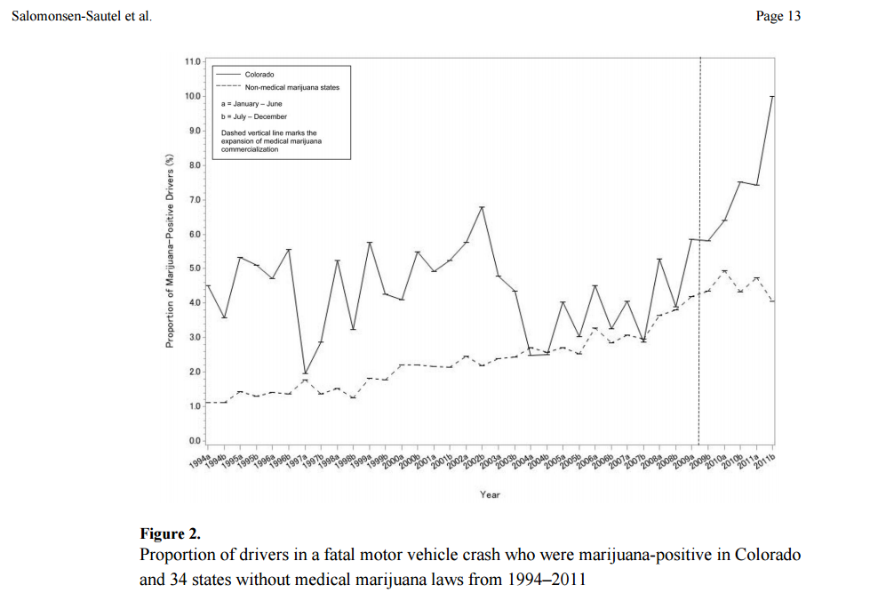
Commercialization of
medical MJ in CO
Notes:
Dashed line marks the expansion of medical marijuana commercialization

Slide 64
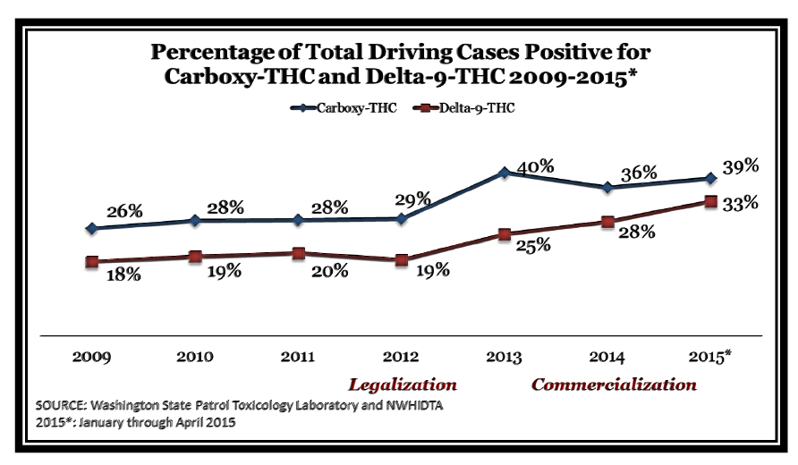
Washington State Report
Notes:
Delta-9-THC represents the compound in marijuana responsible for the psychoactive ‘high’ users’ experience.
Carboxy-THC is the second stage metabolite of THC – it stays in an individual for a period of time and is not taken into account for DUI but in this case is used to show past use in an individual.

Slide 65
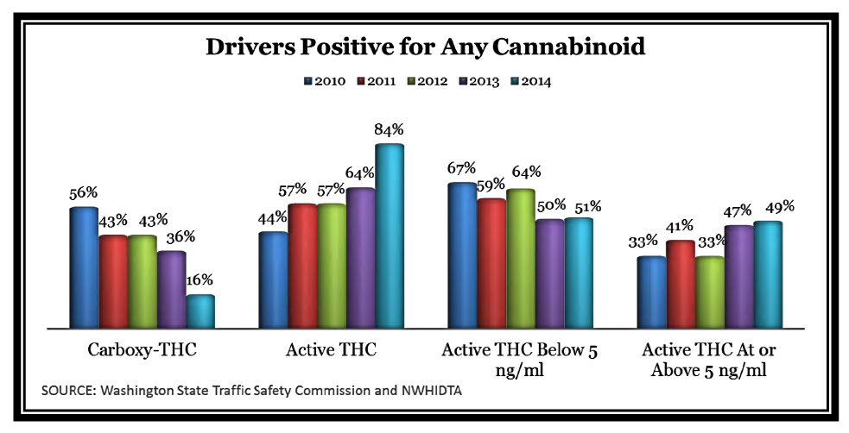
Notes:
This graph above shows the changes in cannabinoid profiles for marijuana positive drivers. In 2010, only 44% of drivers tested positive for Active THC but by 2014, you have 84% of drivers marijuana-positive (this is a 40% increase in only 4 years)
2014- year that commercialization of marijuana really began in Washington

Slide 66
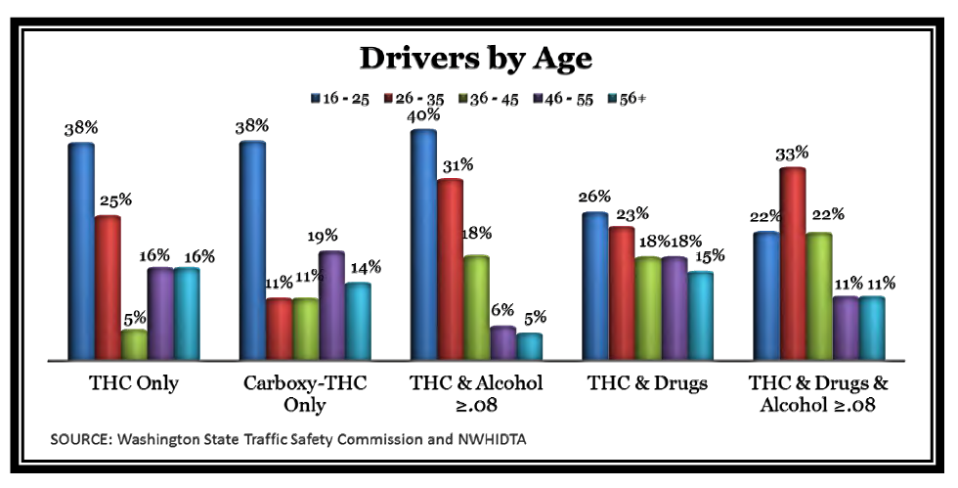
Notes:
Graph shows the amount of individuals involved in a fatal car accident by age. Highest percentage of drivers who were positive for THC, carboxy-THC ad TCH & Alcohol were people between the ages of 16-25.

Slide 67
Summary
POTENTIAL PROS
  Legalization means improvements in product quality control
  eradication of arrests to due to possession (if 21yrs +)
  Minimization/eradication of black market
  Tax revenue
POTENTIAL CONS
  Public health and safety harms
  Consumption will increase
  Addiction rates will increase and harms related to acute intoxication (e.g., driving accidents) will increase
  Toxicity-related poisoning and neurocognitive effects among children and teenagers are likely to increase
  Enforcement of legalization regulations will be needed – arrests for violations (and related costs) could be high even if substantially less than alcohol
  Productivity could go down in the population as more people could miss work days/underperform at work contributing to economic increased burden

Slide 68
Summary
Degree of Problems Associated with Various Policy Approaches to Addressing the Drug Problem
Decriminalization/controlled non-commercialized legalization –best middle ground options
If legalized - It matters how you do it – full commercialization “like alcohol” or state controlled, ban on advertising, plain packaging

