Slide 1
The Highs and Lows of Relapse and Recovery in Opioid Use Disorder
Massachusetts Family Impact Seminar
March 30, 2016
Kathleen M. Palm Reed, Ph.D.
Associate Director of Clinical Training and Research Associate Professor

Slide 2
Why do some people become addicted?
(Source: NIDA)

Slide 3
The Opioid Epidemic
↑ prescription opiate use and abuse
↑ heroin use
↑ over-dose deaths

Slide 4
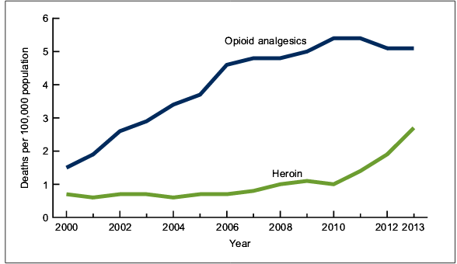
Drug-Poisoning Deaths in US
46 deaths per day
Heroin-related deaths quadrupled since 2000
Courtesy of http://www.cdc.gov/nchs/data/databriefs/db190.pdf

Slide 5
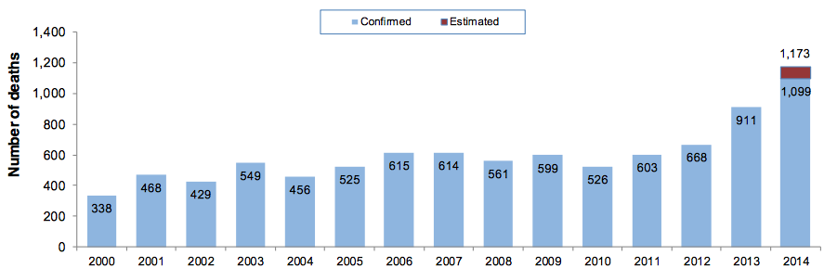
Trends in opioid-related deaths in Massachusetts: 2000-2014
Courtesy of http://www.mass.gov/eohhs/gov/departments/dph/stop-addiction/current-statistics.html

Slide 6
Reasons for increasing overdose deaths
Overall increase in heroin users
Increase in transition from prescription opiates
2010-2014, Northeast has largest increase
Varying composition / concentration of heroin
Lower tolerance after period of abstinence
Relapse = high risk for overdose

Slide 7
A Chronic, Relapsing Disease
Use/Abuse
Abstinence
Relapse

Slide 8
Relapse and Chronic Illness
Source: JAMA 284 1689-1695; 2000

Slide 9
Hypothetical Example
Source: McLellan et al., 2002

Slide 10
What Leads to Relapse: What patients in detox say…
Stressful life events, Craving. Physical discomfort
Combination of negative and positive emotions
“I feel a lot of guilt, and then at the same time you feel excited, because you’re gonna get your love back, the boy, you know, or the girl. And you feel shamed, you feel sneaky, you feel like you’re getting over and you’re really not, you’re only hurting yourself. And sometimes you’re almost happy, because you’re back in your element again.”
(Source: Armstong & Palm Reed, 2016)

Slide 11
What Leads to Relapse: What patients in detox say…
“I'll get like, big rushes of excitement before I know I'm going to do it, and then maybe like, even waves of nausea, because I know it's a bad decision, and I just can't stop myself, once the seed has been planted, it's planted, and it doesn't get uprooted. It doesn't come out. It goes until it dies”

Slide 12
Understanding Relapse
Risk Factors | Protective factors
Age of initiation | Education; Limit availability
Early recovery | More residential treatment
Co-occurring health problems – psychiatric, trauma, chronic pain | Evidence-based treatment addressing whole person
Unemployment | Vocational services
Exposure to triggers | Drug-free social support; More residential treatment

Slide 13
A Roadblock to Recovery: Stigma
Treatment engagement
Retention
Health
Public perception
System of care
Healthcare providers
Internalized stigma

Slide 14
Public Perception
(Source: Screenshot from media campaign, created by MA (YouTube))

Slide 15
Systems of Care: Institutionalized Stigma
Lack of coordinated care
Daily, lengthy collections of methadone
Limited methadone collection times
Lack of privacy
Using drug screens to “catch” patients and throw them out of treatment

Slide 16
Healthcare Providers
Majority lack formal education in substance use disorder treatment
Language can be stigmatizing
“Substance abuser” vs. “person with a substance use disorder”
“Clean” vs. “dirty” urine
Lack of trust
Burnout

Slide 17
Internalized Stigma
I’m not happy with myself, that I’m back, again. But yet I’m grateful, to be back, … I’m very disappointed with my, my choices and my actions …If somebody put me down the way I put my own self down, and remind myself of all the things I've done, that's like a tape player in my head, ugh, “I can't believe you did that, I can't believe you did that, again, what's wrong with you?”
(Source: Armstong & Palm Reed, 2016)

Slide 18
Policy Recommendations
Aftercare services and exposure to drug-free support networks.
Specific recommendations by physicians to pursue peer support programs
Relocating drug treatment services to mainstream health centers.
Improved training, support, and increasing the number of treatment providers
Educational campaigns

Slide 19
The High and lows of relapse and recovery in opioid use disorder
Kathleen Palm Reed, Ph.D.
kpalm@clarku.edu

