Slide 1
Some Paths to (and not to) Pursue to Reduce Childhood Obesity in Oregon
Craig Gundersen
University of Illinois
Soybean Industry Endowed Professor of Agricultural Strategy, Department of Agricultural and Consumer Economics

Slide 4
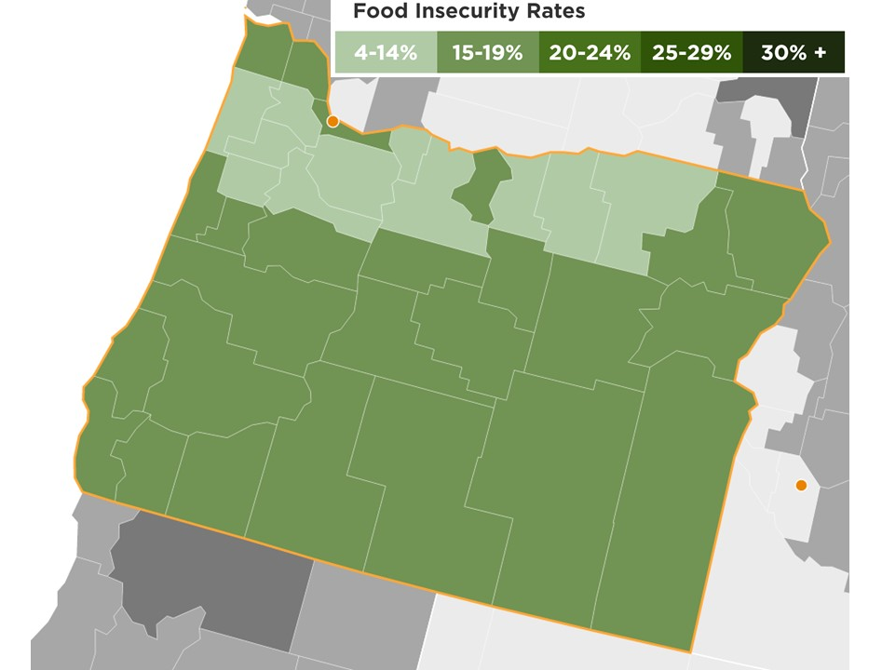
Food Insecurity Rates

Slide 5
Key Objectives
Reduce childhood obesity
Ensure that interventions do not cause harm over other dimensions

Slide 6
Soda Taxes
Do they lead to reductions in soda consumption?
Yes
standard economic theory
Will they generate increased revenues for Oregon?
Yes
standard economic theory
Do they lead to improvements in health?
No evidence in support of this
Do they lead to reductions in obesity
No
e.g., Fletcher et al., 2010; Fletcher et al., 2014
Will they lead to increases in food insecurity?
Yes
e.g., Gregory et al., 2013; Courtemanche et al., 2015

Slide 7
Supplemental Nutrition Assistance Program (SNAP)
Primary goal is to alleviate hunger
Benefit levels
function of income and family size
maximum benefit level is $649 for a family of four
average benefit level is about $300 for a family of four
Size of program
serves almost 45 million persons
total cost is about $80 billion per year
Eligibility criteria
gross income test
income less than 185% of the poverty line in Oregon – $3,738 for a family of four
net income test
income less than the poverty line (after deductions) - $2,021 for a family of four
asset test
not binding in Oregon

Slide 8
SNAP and Obesity
Majority of evidence is that, in comparison to SNAP eligible children, SNAP recipients are either
no more likely to be obese
less likely to be obese
for review, see Gundersen, 2015
Recent evidence shows that higher SNAP benefits are associated with lower probabilities of obesity
Almada and Tchernis, 2015

Slide 9
Restrictions on SNAP Purchases
Will this lead to increases in obesity among children?
Maybe
Will this lead to increases in food insecurity?
Yes
Declines in SNAP participation
Stigma
Transactions costs
for review, see Gundersen, 2015
Increases in food prices

Slide 10
Better Approaches to SNAP and Obesity
Resist block granting
Would sharply restrict SNAP’s ability to work as a safety net
Encourage increased participation rates
Albeit, already high in Oregon
Recognize benefits over multiple dimensions
Support even higher benefit levels
Recognize benefits over multiple dimensions

