Slide 1
Hallie E. Ford Center for Healthy Children and Families
College of Public Health and Human Sciences
Oregon Family Impact Seminar

Slide 2

School-Based Approaches to Obesity Prevention
Is Oregon Ahead of the Curve?
Kathy Gunter, PhD, FACSM
Associate Professor
College of Public Health and Human Sciences, Oregon State University

Slide 3
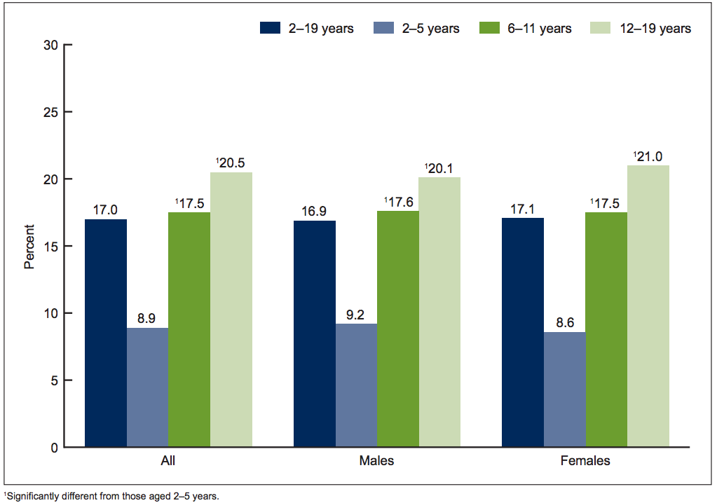
Obesity Prevalence of U.S. Youth by age (2-19 yrs.) and sex
Ogden et al, 2015; SOURCE: CDC/NCHS, National Health and Nutrition Examination Survey, 2011-2014

Slide 4
Obesity Prevalence in Oregon:
Rural Elementary Students (N=2006); Spring 2013
*
*
*
*
*
Gunter et. al., 2015
*Grades 2 through 6 had significantly higher obesity prevalence compared to grade K; P<0.05
Notes:
Reference: Gunter, KB, Abi-Nader*, P, John DH. Physical Activity Levels and Obesity Status of Oregon Rural Elementary School Children. Preventive Medicine Reports, [On-line first], 2015 Available at: http://www.sciencedirect.com/science/article/pii/S2211335515000510.

Slide 5
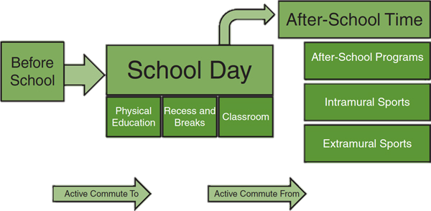
Childhood Obesity: Focus on Schools
60 min/d
6-7 hrs/d
2-3 hrs/d
Institute of Medicine, Educating the Student Body. 2013
Beets, 2012. Reprinted with permission from Michael Beets.

Slide 6
Physical Activity Guidelines for Youth
What is included in that 60 minutes?
  Aerobic Activity
    Mostly moderate
    Vigorous on > 3 d/wk
  Muscle Strengthening
    > 3 d/wk
  Bone Strengthening
    > 3 d/wk

Slide 7
Benefits to Regular Participation in Physical Activity at School
Health and Fitness
  Healthy weight
  Strong bones
  Decreased risk of developing obesity and related conditions such as diabetes and heart disease
  Reduced anxiety and depression and better mental health
Academic Performance
  Higher standardized test scores and grades
  Increased attention on academic tasks
  Improved recall and memory
  Reduced inappropriate behavior
Notes:
For example – a study of 24 elementary schools showed that adding sessions of PA to the curriculum improves academic performance. Schools randomly assigned to the active PA lessons of moderate intensity improved overall performance on a standardized test of academic achievement by 6% compared to a decrease of 1% for controls (p<0.02). Body mass index increased less from baseline to 3 years in students with greater than 75 minutes of PAAC lessons per week (1.8 BMI) compared to students with less than 75 minutes/100 goal of PAAC per week (2.4 BMI), p<0.00.
Two, 10-minute lessons per day across a variety of lessons determined by teachers. Accrual of bouts lasting at least 5 minutes are associated with improved BMI and waist circumferences
References:
Donnelly JE, Lambourne K. Classroom-based physical activity, cognition, and academic achievement. Prev Med. 2011;52 (Suppl 1):S36-S42.
Willis EA, Ptomey LT, Szabo-Reed AN, Honas JJ, Lee J, Washburn RA, Donnelly JE. Length of moderate-to-vigorous physical activity bouts and cardio-metabolic risk factors in elementary school children. Prev. Med. 2015 Apr (73):76-80. Available at: https://www.ncbi.nlm.nih.gov/pmc/articles/PMC4455886/

Slide 8

How much PA do Oregon elementary students get during the school day?

Slide 9

Oregon Children’s PA at School
Measured over a 6.5 Hour School Day, Fall 2013 (N=1482)
MVPA Goal
60 Min/Day
MVPA Current
19 Min/Day
Total Activity = All measurable movement at school; MVPA = all activity of at least moderate intensity. Gunter et al., 2015.
Notes:
These data include nearly 1500 children grades 1 through 6 measured in fall 2013, from 6 rural Oregon elementary schools. The degree to which PE is provisioned in each of the schools varies dramatically. In fact, one of the schools offers daily PE and at least one of the schools has no PE (delivered by a PE specialist). None of these schools provide enough PE to meet the 150-minute minimum/week. [This is for the elementary school level. For middle schools, the minimum mandate is 225 min/week.]
In fact, if we take the average amount of activity that kids do at an intensity that is of AT LEAST moderate but including vigorous intensity (MVPA) across a week – the TOTAL MVPA (which includes PE, recess, and all other active time) is still under the minimum. (20x5=100 minutes MVPA/week).
Note: If someone asks the question - the actual measured average MVPA was 19.4 (+ 8.5) minutes.

Slide 10
Effective School-Based
Obesity Prevention Policies/Programs
Strategies
Challenges
Physical Education
Classroom-Based PA
Active Recess
Active Transportation
After School Programs
Funding
Training/Commitment
Training/Commitment
Feasibility
Feasibility
Physical Activity at school is a win-win for students and teachers!
Notes:
Based on the available evidence – the most effective approaches to increasing children’s PA at school – that are also associated with better BMI profiles and the other benefits listed on the previous slide include…
These are listed in order of effectiveness based on meta-analyses and reviews.
Optimized PE may have the greatest positive impacts and on average provides about 23 minutes/day of PA at school; Better BMI,
CBPA, when implemented throughout the day contributes ~ 19 minutes/day;
Research around Recess provides more variable data with differences apparent by sex. Boys are more active during recess. In general children spend between 15% and 68% of recess time being active. Thus the critical component is ensuring they have adequate recess time. Studies suggest at least 20 min/day is needed to allow for meaningful accrual of PA during recess. Further, studies that included strategies such as training teachers and playground aids to provide structured opportunities, engage in play and encourage safe active play indicate these practices help to increase the % of active time during recess. Better classroom behavioral outcomes
Active transportation provides 10-24 minutes on average (more for walking versus biking); but is influenced by environmental Constraints (sidewalks, safe streets, crime, distance (rural).
Emerging data show things like parent’s self-efficacy in being able to implement WB2S impacts children’s efficacy and consequently behavior. And – that awareness/promotion/persuasion of AT programs by schools does not seem to predict whether kids participate to the same extent that parent and child efficacy (which are entangled) – predict participation. There are data showing that kids (I believe only girls) had significantly better cognitive performance on tasks of verbal, numeric and reasoning abilities.
After School Programs: Characteristics of ASP programs such as available indoor versus outdoor space important, but not as important as to how that space is utilized. When the outdoor spaces are used, children spend more time in MVPA and less time in sedentary pursuits. Programs’ inability to provide transportation home is a major barrier to participation for a large proportion of students.
References:
Bassett et al. 2013. Estimated energy expenditures for school-based policies and active living. American Journal of Preventive medicine. 42(2), 108-113.
Hatfield, D.P. & Chomitz, V.R. Increasing children’s physical activity during the school day. Curr Obes Rep (2015) 4: 147.
Active Living Research. Increasing Physical Activity Through Recess. Research Brief, January, 2012. Available at: http://activelivingresearch.org/files/ALR_Brief_Recess.pdf.
Barros RM et al. School Recess and Group Classroom Behavior. Pediatrics 2009; 123:431-436
Martinez-Gomez D et al. Active Commuting to School and Cognitive Performance in Adolescents. Arch Pediatr Adolesc Med 2010; E1-E6.
Beets, M. W., Wallner, M., & Beighle, A. (2010). Defining standards and policies for promoting physical activity in afterschool programs. Journal of School Health, 80(8), 411-417.
Active Living Research. Active Education: Growing Evidence on Physical Activity and Academic Performance. Research Brief, 2015. Available at: http://activelivingresearch.org/sites/default/files/ALR_Brief_ActiveEducation_Jan2015.pdf

Slide 11
What is Oregon Doing?
Oregon House Bill 3141
  Promoting PE Best Practice
    Minute-per-week minimums (150; 225)
    Minimum % time in MVPA (50%)
    Promoting PE Inclusion

Slide 12

Some Paths to (and not to) Pursue to Reduce Childhood Obesity in Oregon
Craig Gundersen
University of Illinois
Soybean Industry Endowed Professor of Agricultural Strategy, Department of Agricultural and Consumer Economics

Slide 15
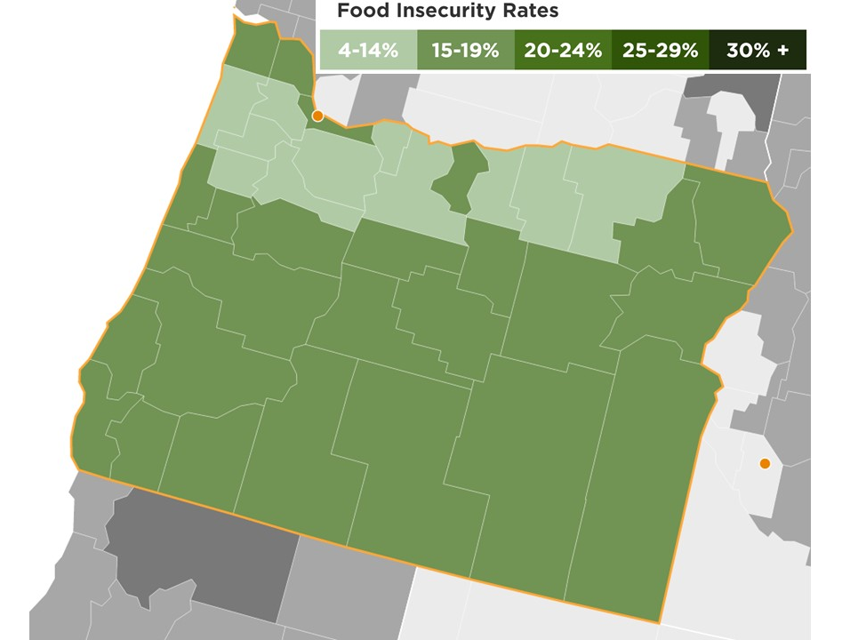
Food Insecurity Rates

Slide 16
Key Objectives
Reduce childhood obesity
Ensure that interventions do not cause harm over other dimensions

Slide 17
Soda Taxes
Do they lead to reductions in soda consumption?
  Yes
    standard economic theory
Will they generate increased revenues for Oregon?
  Yes
    standard economic theory
Do they lead to improvements in health?
  No evidence in support of this
Do they lead to reductions in obesity
  No
    e.g., Fletcher et al., 2010; Fletcher et al., 2014
Will they lead to increases in food insecurity?
  Yes
    e.g., Gregory et al., 2013; Courtemance et al., 2015

Slide 18
Supplemental Nutrition Assistance Program (SNAP)
Primary goal is to alleviate hunger
Benefit levels
  function of income and family size
  maximum benefit level is $649 for a family of four
  average benefit level is about $300 for a family of four
Size of program
  serves almost 45 million persons
  total cost is about $80 billion per year
Eligibility criteria
  gross income test
    income less than 185% of the poverty line in Oregon – $3,738 for a family of four
  net income test
    income less than the poverty line (after deductions) - $2,021 for a family of four
  asset test
    not binding in Oregon

Slide 19
SNAP and Obesity
Majority of evidence is that, in comparison to SNAP eligible children, SNAP recipients are either
  no more likely to be obese
  less likely to be obese
    for review, see Gundersen, 2015
Recent evidence shows that higher SNAP benefits are associated with lower probabilities of obesity
    Almada and Tchernis, 2015

Slide 20
Restrictions on SNAP Purchases
Will this lead to increases in obesity among children?
  Maybe
Will this lead to increases in food insecurity?
  Yes
    Declines in SNAP participation
      Stigma
      Transactions costs
        for review, see Gundersen, 2015
    Increases in food prices

Slide 21
Better Approaches to SNAP and Obesity
Resist block granting
  Would sharply restrict SNAP’s ability to work as a safety net
Encourage increased participation rates
    Albeit, already high in Oregon
  Recognize benefits over multiple dimensions
Support even higher benefit levels
  Recognize benefits over multiple dimensions

Slide 22
Thank you.

