Slide 1
Children’s Services & Foster Care Policy & Practices that Work
Mark Testa
University of North Carolina at Chapel Hill
Family Impact Seminar
Providence, Rhode Island
May 12, 2016
School of Social Work

Slide 2
Four Parts
.
Two Questions
EBP Approach
Way Forward
Best Avaliable Evidience

Slide 3
Question One
CONSTRAINED
(Narrow Scope of Public Interest)
Safety
Should public child welfare be satisfied primarily with the safe reduction in the number of children entering foster care or should it set its sights on a diffuse array of child well-being improvements, such as fostering secure parent-child attachments, intervening when child development lags behind normative milestones, and offering post-permanency support to families who adopt or assume legal guardianship of foster youth?
Well-Being
UNCONSTRAINED
(Diffuse Scope of Public Interest)

Slide 4
Divided Opinions
CONSTRAINED
(Narrow Scope of Public Interest)
33%
33%
2010
34%
UNCONSTRAINED
(Diffuse Scope of Public Interest)
4

Slide 5
Divided Opinions
CONSTRAINED
(Narrow Scope of Public Interest)
33%
32%
2015
Gallup 9/9-13/15
http://www.gallup.com/poll/186032/role-gov-remains-key-source-party-differences.aspx
35%
UNCONSTRAINED
(Diffuse Scope of Public Interest)
5

Slide 6
Question Two
Should the primary group relationships of family, extended kinship, and voluntary association be responsible for achieving these aims largely on their own, or should the secondary structures of market institutions and state authority ultimately be held accountable for ensuring equal developmental opportunities and minimum well-being for all children?
PRIMARY GROUPS
(Particularism-Ascription)
SECONDARY SYSTEMS
(Achievement-Universalism)

Slide 7
Wicked Problems
CONSTRAINED
(Narrow Scope of Public Interest)
Safety
Alternative Response
Formal Investigation
Informal Kinship Care
Licensed Foster Care
PRIMARY GROUPS
(Particularism-Ascription)
SECONDARY SYSTEMS
(Achievement-Universalism)
Permanence
Family Preservation
Adoption
Community-Based
Institution-Based
Well-Being
UNCONSTRAINED
(Diffuse Scope of Public Interest)

Slide 8
Evidence-Based Policymaking
“If all we have are opinions,
let’s go with mine.
If we have data, let’s look at data”
― Jim Barksdale, Internet Policy Institute

Slide 9
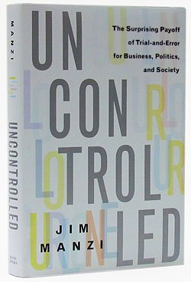
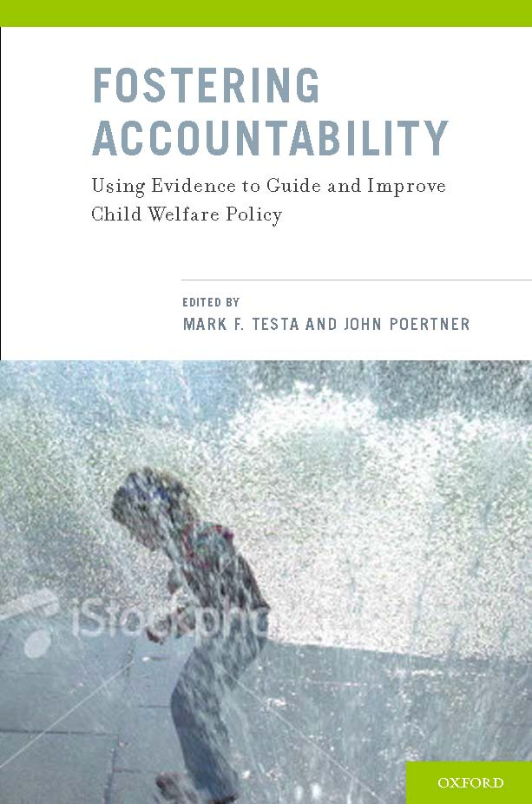
Bipartisan Consensus Builds

Slide 10
Evidence-Based Policymaking Commission Act of 2016

Slide 11
Principles of Evidence-Based Policymaking
Fund programs with the best available evidence of past success;
Invest in program implementation;
Rigorously evaluate outcomes using randomized controlled trials (RCTs) whenever possible;
Change or replace programs if the evidence shows they don’t produce the desired impacts.
http://www.brookings.edu/research/papers/2015/10/29-results-first-evidence-speaks-loudly-haskins

Slide 12
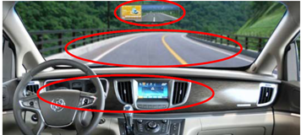
Phases of Evidence-Based Policymaking
Hindsight (Descriptive Analytics): Understand a problem, identify the intended outcomes, and describe the target population.
Insight (Predictive Analytics): Develop and test innovations that show promise in altering performance.
Foresight (Prescriptive Analytics): Evaluate what worked in altering performance and in improving outcomes.

Slide 13
Evidence Building in Child Welfare
http://www.acf.hhs.gov/sites/default/files/cb/pii_ttap_framework.pdf
Part 1- Introducing a New Framework (7 min. 54 sec.) https://www.youtube.com/watch?v=Qe6gQDYF02o&feature=youtu.be
Part 2 - Identify & Explore (10 min. 4 sec.) https://www.youtube.com/watch?v=wyeHg4aCNN0&feature=youtu.be
Part 3 – Develop & Test and Compare & Learn (10 min. 5 sec.) https://www.youtube.com/watch?v=10FdTbSEiHc&feature=youtu.be
Part 4 – Replicate & Adapt and Apply & Improve (12 min. 22 sec.) https://www.youtube.com/watch?v=ajbLMlpA2Ok&feature=youtu.be

Slide 14
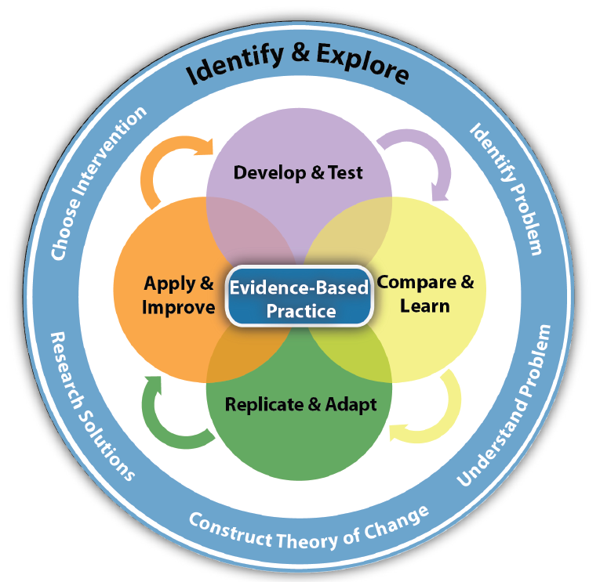
A Framework

Slide 15
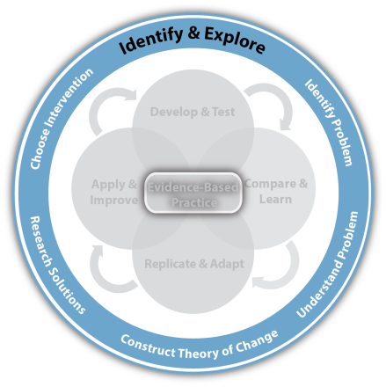
Hindsight: Descriptive Analytics
What problems, outcomes, and target populations should be the focus of change?
Descriptive Analytics: Identify & Explore

Slide 16
Rhode Island's Average Monthly IV-E Funded Caseloads
3.6 children in permanent homes for each child in substitute care
Adoption Assistance
2014:
90 Kin GAP
459 IV-E Substitute Care
1546 IV-E Adoption Assistance
2000:
743 IV-E Substitute Care
1,168 IV-E Adoption Aqssistance
Substitute Care
Kin GAP
Data Source: Division of Children and Youth Policy, Office of the Assistant Secretary for Planning and Evaluation, U.S. Department of Health and Human Services

Slide 17
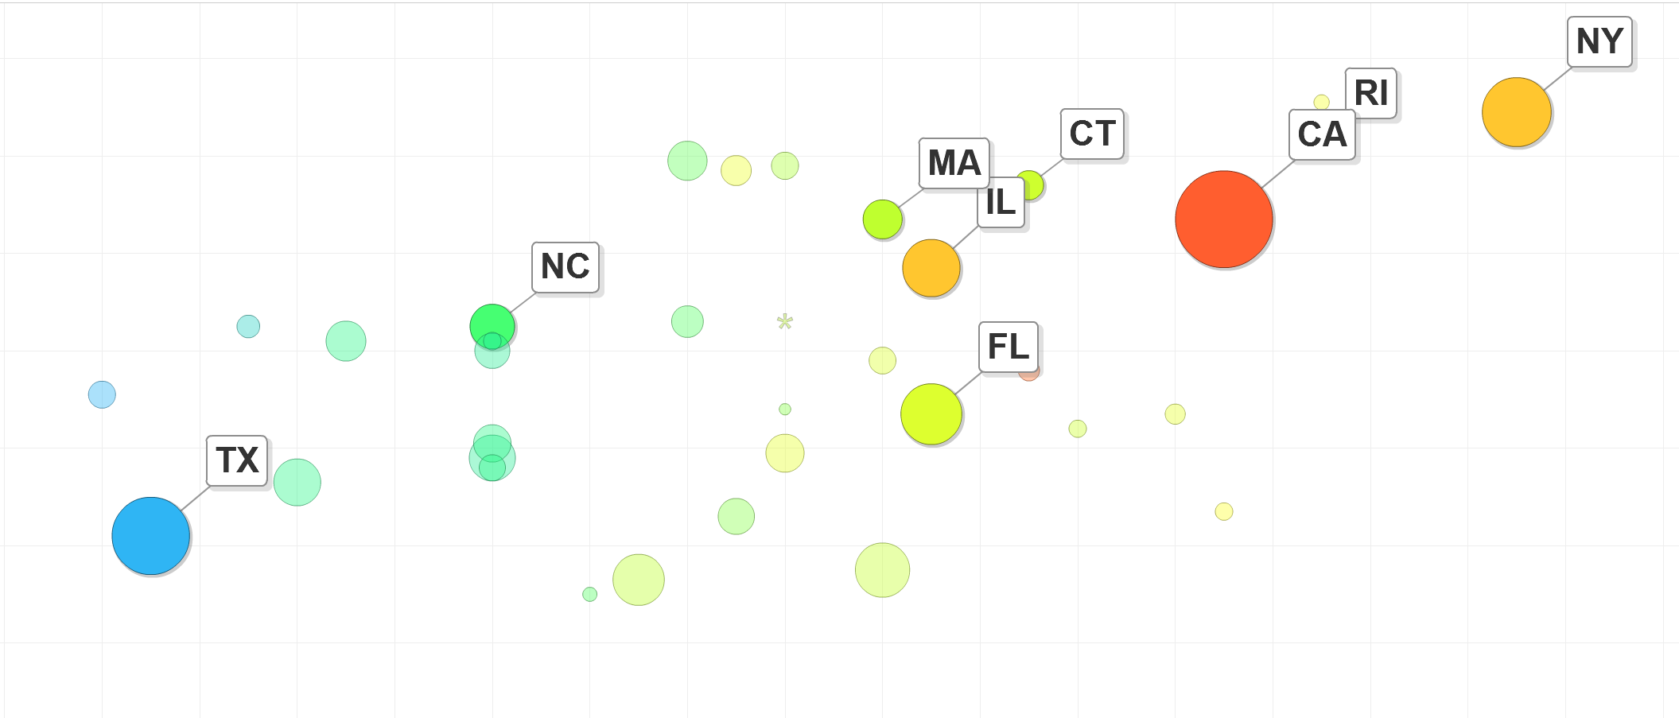
Hindsight : How Rhode Island Performed in the Past
Click here: http://bit.ly/SqZRhx
More Safe
2001
Less Time Out of Home

Slide 18
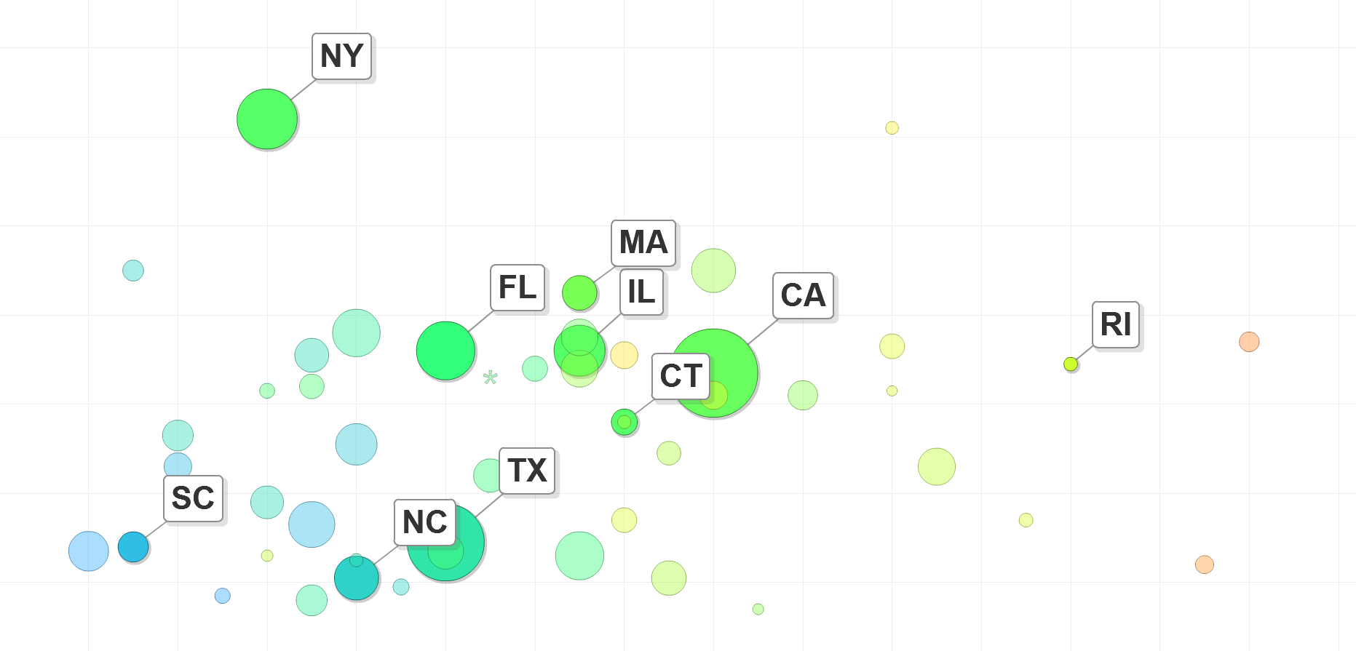
Hindsight : How Rhode Island Performed in the Past
Click here: http://bit.ly/SqZRhx
More Safe
2012
Less Time Out of Home

Slide 19
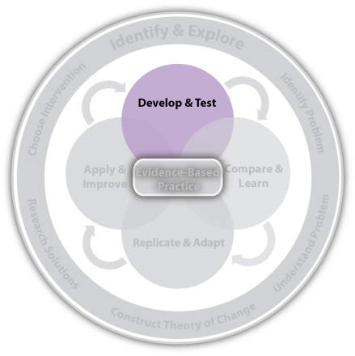
Insight: Predictive Analytics
What innovations based on past evidence, data analysis, and theory show the best potential for improving outcomes?
Predictive Analytics: Develop & Test

Slide 20
Correlation

Slide 21
Marginal Cases
When In Doubt? Preserve or Remove
Inv’gator 1
Inv’gator 2
Area of
Disagreement
Never placed
Always placed
Low Safety Risk
SR1
SR2
High Safety Risk
Strict Investigator 1 removes if SR > SR1
Lenient Investigator 2 removes if SR > SR2

Slide 22
Adverse Impact of Removal
Children at the margin of removal perform worse when they are removed from home¹:
3x Higher Arrest Rate
3x Higher Delinquency
2x Higher Teen Motherhood
40% Lower Employment
No Effects for Childhood Burns / Broken Bones;
But 3x more likely to receive well-child visits.
¹Doyle, J. J. (2007a). Child protection and child outcomes: Measuring the effects of foster care. The American Economic Review, 97(5), 1583—1610. Doyle, J. J. (2008). Child protection and adult crime: Using investigator assignment to estimate causal effects of foster care. Journal of Political Economy, 116(4), 746—770.

Slide 23
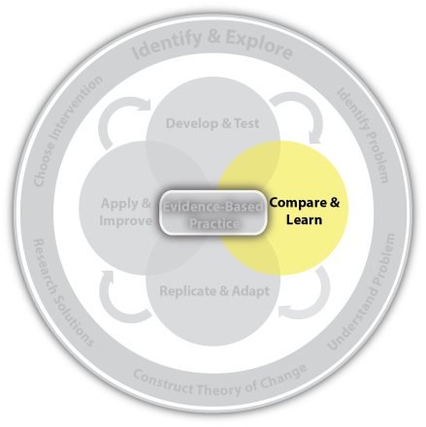
Foresight: Prescriptive Analytics
How strong is the evidence for what worked?
Prescriptive Analytics: Compare & Learn

Slide 24
Causation
Intervention Group
Unbiased allocation of population into 2 groups
= Reunification
Comparison Group

Slide 25
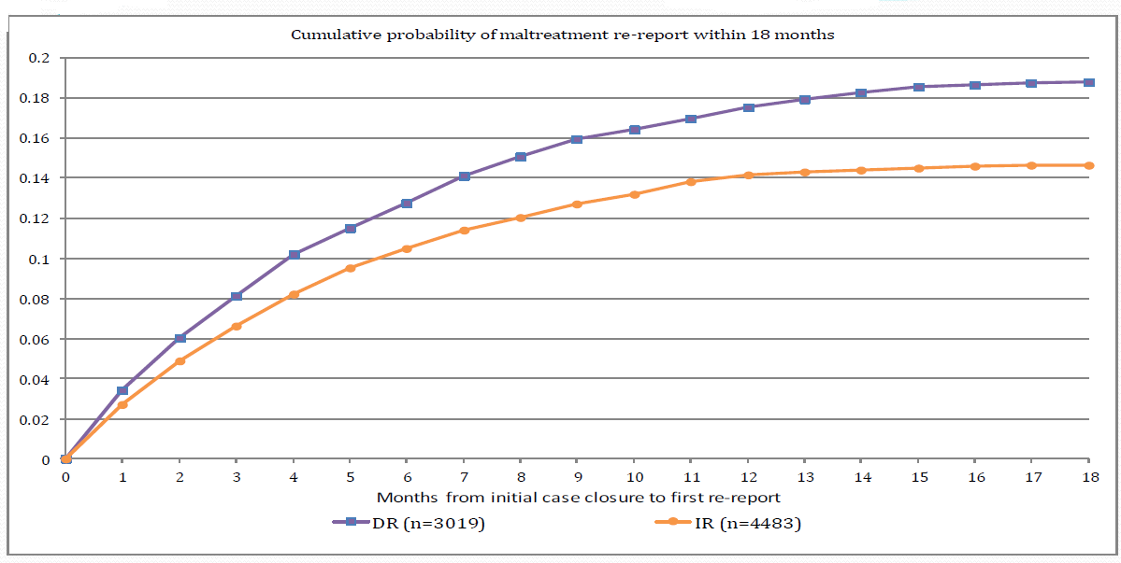
Which Response? Investigation or Alternative
Cumulative Probability of Maltreatment Re-Report within 18 Months of Case Closing
Alternative Response (Intervention Group)
Investigation Response (Comparison Group)

Slide 26
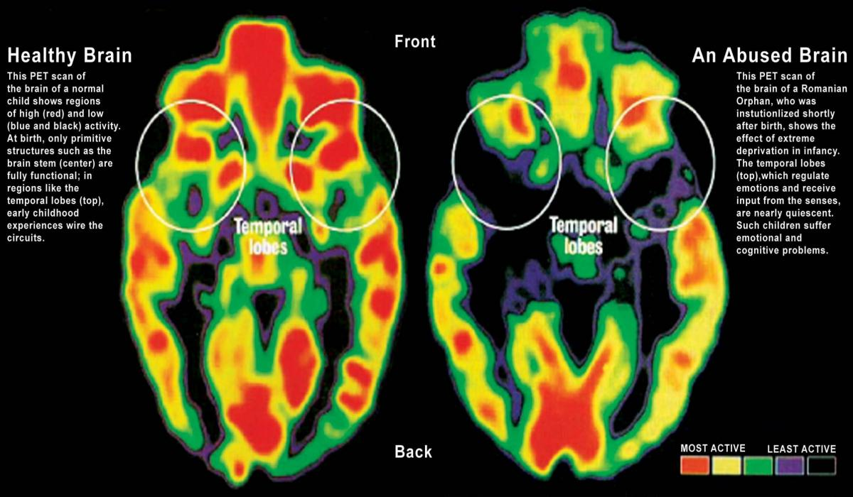
Attachment & Brain Development
Notes:
Maltreatment during infancy has effects on the developing brain that lead to biological modifications, resulting in changes in cognition and behavior and increasing vulnerability to stress, predisposing such children to the development of psychiatric illnesses throughout life (Lieberman et aL 2011; Scheeringa et aL 105). Trauma in infancy disrupts homeostasis in areas of the brain that respond to the stress and perceived threats. Clinical studies of severely
maltreated children have identified symptoms of various mental and physical responses trauma, including hyperarousal (the mammalian fight/flight response) and disassociation (the reptilian freeze/ surrender response).(Chu & Lieberman 2010; Finkelhor, rmrod, & Turner 2007).
PET is a radiographic method that involves injecting a child with a substance like glucose or oxygen that has been radio-labeled. The radioactive substance is then absorbed by the brain, with those brain regions most engaged (most active) taking up more of the substance. As the radioactivity begins to decay, positrons are emitted, and the PET scanner can reconstruct where in the brain these positrons originated. As such, it is possible to pinpoint which precise regions of the brain are most active. Fewer connections may lead to deficits/ delays in inhibitory control, emotion regulation, and other functions that are overseen by the connections between these brain areas.
Nelson, Charles A. (2014-01-06). Romania's Abandoned Children (Kindle Locations 1900-1910). Harvard University Press. Kindle Edition.
Polyvagal theory
As an overwhelming and chronic source of stress, neglectful and abusive parenting can have serious effects on the autonomic nervous system (ANS), the part of the peripheral nervous system which is fundamentally involved in automatic and unconscious regulatory processes such as breathing, heart rate, digestion and arousal. The ANS is centrally located in the brainstem and medulla oblongata. It includes three subsystems, two of which are directly involved in the stress response: the Sympathetic Nervous System (SNS) and the Parasympathetic Nervous System (PNS). The SNS is most associated with arousal activation and the ‘fight or flight’ response. Conversely, the PNS is more involved in inhibiting SNS activity and in rest responses. In healthy individuals these systems work well together to subconsciously sense threat and respond accordingly in order to maximize an individual’s chance of survival by managing the threat. However, chronic stress can lead to hyperactivity of the CNS and hypoactivity of the PNS. (Porges, 2001, 2007, 2009; Porges & Furman, 2011) .
Can we start out by illustrating how child maltreatment creates chronic stress for the child? For example, an infant expects an environment in which he or she will be feed, comforted, receive stimulation and interact with responsive caregivers. When these basic expectations are not met, the infant experiences stress that can elevate the levels of circulating glucocorticoids (for example, cortisol), which in turn can ….
One of the most important components of the PNS is the vagus nerve. This is a cranial nerve which is involved in the inhibition of the arousal responses elicited by the SNS. It may be activated during stress in order to inhibit SNS hyper-response and can be measured by examining cardiac vagal tone (Berthoud & Neuhuber, 2000). Porges’ Polyvagal Theory proposes three neural circuits comprising the vagus nerve which evolved to manage stress. The most basic of these is the primitive pathway which controls the basic ‘play dead’ defensive response, found in non-mammalian species. The second circuit also serves a defensive function of instigating the ‘fight or flight’ strategies mammals need for survival. The third circuit which evolved in humans has multiple functions but primarily deals with social communication responses, such as those needed to obtain contact and attachment with caregivers and later social interaction functions (Porges, 2003a, 2009; Porges & Furman, 2011) .
However, after age three these effects become a more permanent part of the child's psychosocial functioning and require specialized treatment (Cohen, Mannarino, & Deblinger 2006; Fisher et aL 2006; Lieberman et aL 2011; Vickerman
& Margolin 2007).

Slide 27
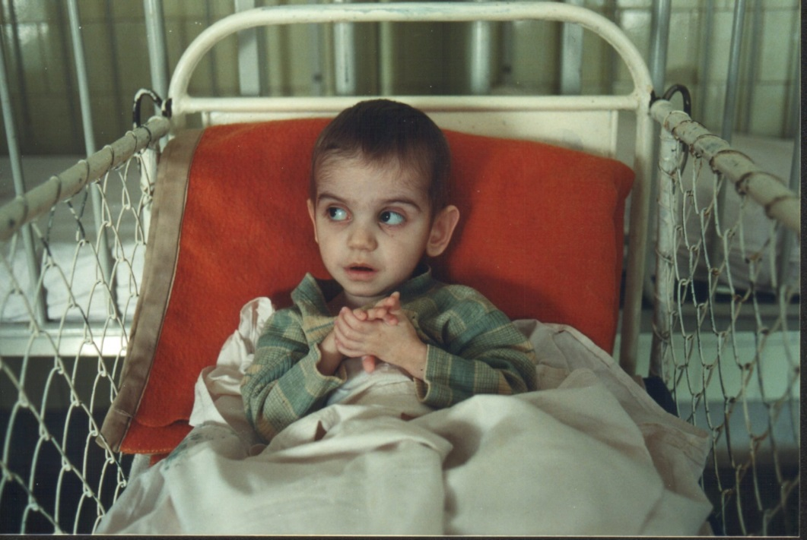
Effects of Bucharest Early Intervention Program
Cognitive development
Higher IQs
Enhanced expressive and receptive language
Physical development
Greater height and weight
Fewer stereotypies
Emotional development
More positive emotion expressed
Less anxiety and depression
Social development
Enhanced competence
More secure and organized attachments
Fewer attachment disorders
Psychopathology
Fewer psychiatric symptoms, disorders and less impairment
Humphrey et al. (October, 2015). Presentation at Wicked Problems of Child Welfare Institute. Chicago, IL
Notes:
This slide represents the significant findings through completion of the trial at 54 months of age. This is definitive proof that the children we studied fared better in families than in institutions in terms of cognitive, physical, emotional, and social development, as well as in the psychopathology—these differences cannot be accounted for risk factors other than the experience of being removed from an institution and placed with a foster family.

Slide 28
What’s More Permanent? TPR or Kinship Guardianship
Illinois
(June, 2007)
Wisconsin
(September, 2009)
Tennessee
(October, 2009)
} 6.6%
} 11.2%
}18.8%

Slide 29
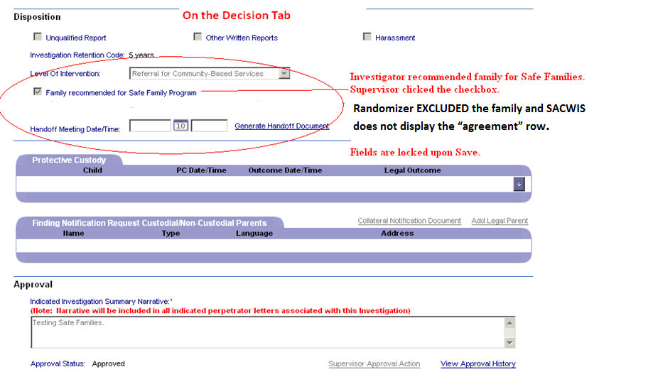
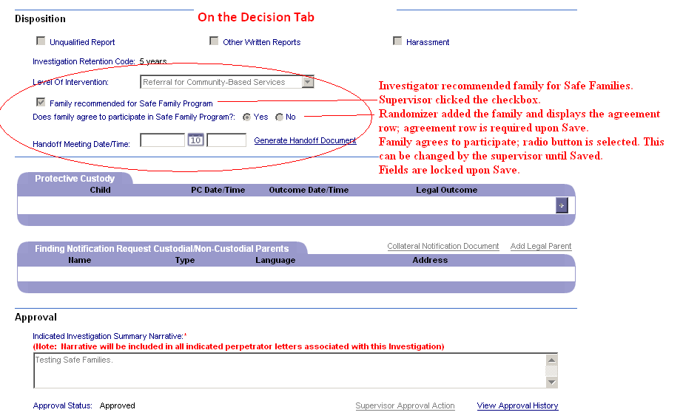
Automated Alternation Routine: Unbiased Assignment Mechanism
Comparison
Intervention

Slide 30
Challenges
Rossi’s Iron Law of Evaluation
Motivated Reasoning
When Prophesy Fails

Slide 31
Rossi’s Iron Law of Evaluation
“If there is any empirical law that is emerging from the past decade of widespread evaluation research activities, it is that the expected value for any measured effect of a social program is zero. In short, most programs, when properly evaluated, turn out to be ineffective or at best marginally accomplishing their set aims.”
Rossi, P.H. (1978) Issues in the evaluation of human services delivery. Evaluation Quarterly, 2(4), 573-599.

Slide 32
Motivated Reasoning
Motivated reasoning drives people to form beliefs about wicked problems, which reflect and reinforce their commitments to one or another idealized form of social ordering.
Motivated reasoning responds defensively to contrary evidence, actively discrediting such evidence or its source without logical or evidentiary justification.
Motivated reasoning pushes people to develop elaborate rationalizations to justify holding beliefs that evidence has shown to be wrong.

Slide 33
Results-Oriented Accountability
CONSTRAINED
(Narrow Scope of Public Interest)
AUTHORITY
Safety
LIBERTY
Substitution of legally fragile guardianships for more permanent adoptions
Tax-free, guardianship payments will swell foster care caseloads
PRIMARY GROUPS
(Particularism-Ascription)
SECONDARY SYSTEMS
(Achievement-Universalism)
Keeps extended families and sibling groups intact.
Equalizes the financial assistance package
COMMUNITY
Well-Being
EQUALITY
UNCONSTRAINED
(Diffuse Scope of Public Interest)

Slide 34
Contact Information
Mark F. Testa
Spears-Turner Distinguished Professor
mtesta@unc.edu
School of Social Work
The University of North Carolina at Chapel Hill
Tel. 919-962-6496
Fall 2016: Children’s Home + Aid
Tel: 312-424-6852

