Slide 1
Early Childhood Trauma as a Risk Factor for Youth Violence: Policy Options to Break Generational Cycles of Violence
Laurie Ross, PhD
2018 Family Impact Seminar
Mosakowski Institute

Slide 2
Victimization Perpetration Incarceration
A Cycle of Violence

Slide 3
Does the Cycle Start Here?

Slide 4
Session Topics
Forms of Violence
Violence and Child Development
Decision Framework
Local Intervention
Policy Options

Slide 5
Community Violence
75% of 7 year olds in one Philadelphia neighborhood heard gunshots in their neighborhood
10% of children in a Boston pediatric hospital clinic reported witnessing a shooting or stabbing

Slide 6
Trauma in the Home

Slide 7
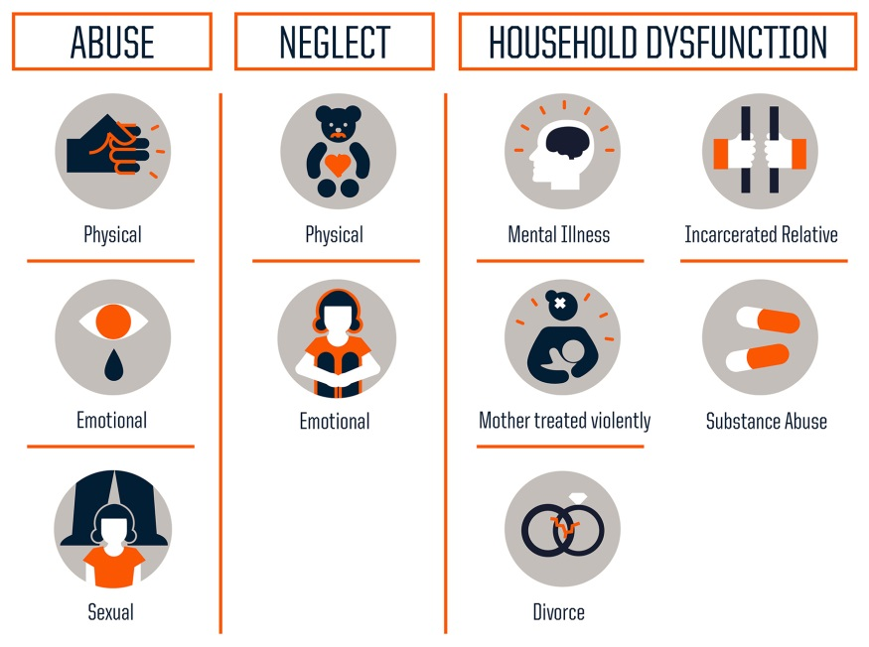
Adverse Childhood Experiences (ACEs)
Birth-17 | 0 ACEs | 1 or 2 ACEs | 3+ ACEs
United States | 54% | 35% | 11%
Massachusetts | 58% | 33% | 9%

Slide 8
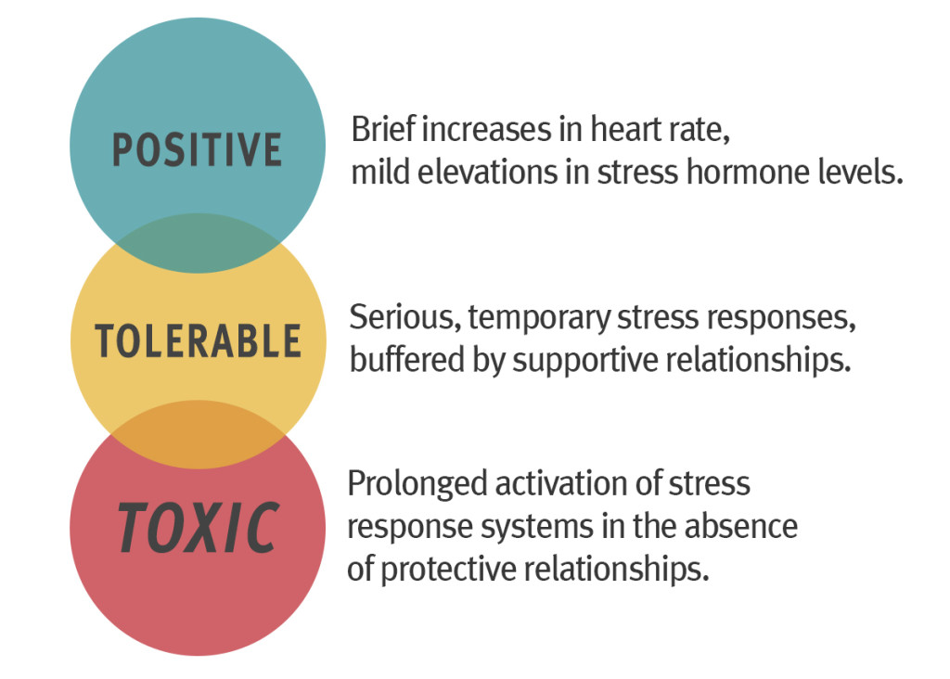
Brain Architecture & Stress
Notes:
Ok, so we have discussed various sources of violence and trauma and we have discussed prevalence rates of youth violence. But how does early exposure to community or domestic violence affect later behavior?
Positive stress response is a normal and essential part of healthy development, characterized by brief increases in heart rate and mild elevations in hormone levels. Some situations that might trigger a positive stress response are the first day with a new caregiver or receiving an injected immunization.
Tolerable stress response activates the body’s alert systems to a greater degree as a result of more severe, longer-lasting difficulties, such as the loss of a loved one, a natural disaster, or a frightening injury. If the activation is time-limited and buffered by relationships with adults who help the child adapt, the brain and other organs recover from what might otherwise be damaging effects.
Toxic stress response can occur when a child experiences strong, frequent, and/or prolonged adversity—such as physical or emotional abuse, chronic neglect, caregiver substance abuse or mental illness, exposure to violence, and/or the accumulated burdens of family economic hardship—without adequate adult support. This kind of prolonged activation of the stress response systems can disrupt the development of brain architecture and other organ systems, and increase the risk for stress-related disease and cognitive impairment, well into the adult years.
There is an abundance of research that suggests that trauma in early childhood has detrimental effects on brain development in areas that regulate fear response, impulse control, reasoning, planning, and academic learning.
These effects on the brain can cause children to have extreme reactions to seemingly low-stress incidents.
These children may misinterpret neutral facial expressions as angry; unnecessarily triggering a fight-or-flight response. Traumatized children’s hypervigilance and exaggerated reactions result from their stress response system activating more frequently and for longer periods than is necessary, causing wear and tear on their brains and bodies.
Children who live in threatening environments are more likely to respond violently (fight) or run away (flight) than children who grow up in safe, stable, and nurturing environments.
Children, particularly boys, who experience physical abuse or neglect early in their lives are at greater risk for committing violence against peers, engaging in bullying, committing teen dating violence, and perpetrating child abuse, intimate partner violence, and sexual violence later in life.
Long-term, unaddressed, accumulated traumas that trigger a toxic stress response are associated with mental and physical health disorders as well as overall shorter life expectancy as adults. When adults who developed a toxic stress response in childhood become parents they are less likely to be able to provide the stable and supportive relationships that their children need to develop healthfully.
The science is clear. When children grow up in safe and stable environments in the context of nurturing relationships with adults who can reduce stress in their lives, children learn skills that protect against violence, such as empathy, impulse control, anger management and problem-solving. For children living in conditions of toxic stress, however, early intervention with the child and family is essential and has proven to be effective.

Slide 9
ACEs and Health Outcomes
Early
Death
Disease, Disability & Social Problems
Adoption of Health-risk Behaviors
Social Emotional & Cognitive Impairment
Disrupted Neurodevelopment
Adverse Childhood Experiences
Notes:
Mechanism by which ACEs influence health and wellbeing throughout the life span
ACES have been found to have a graded dose-response relationship with 40+ outcomes to date, including cardio vascular disease, depression, substance abuse disorder, suicide, obesity,

Slide 10
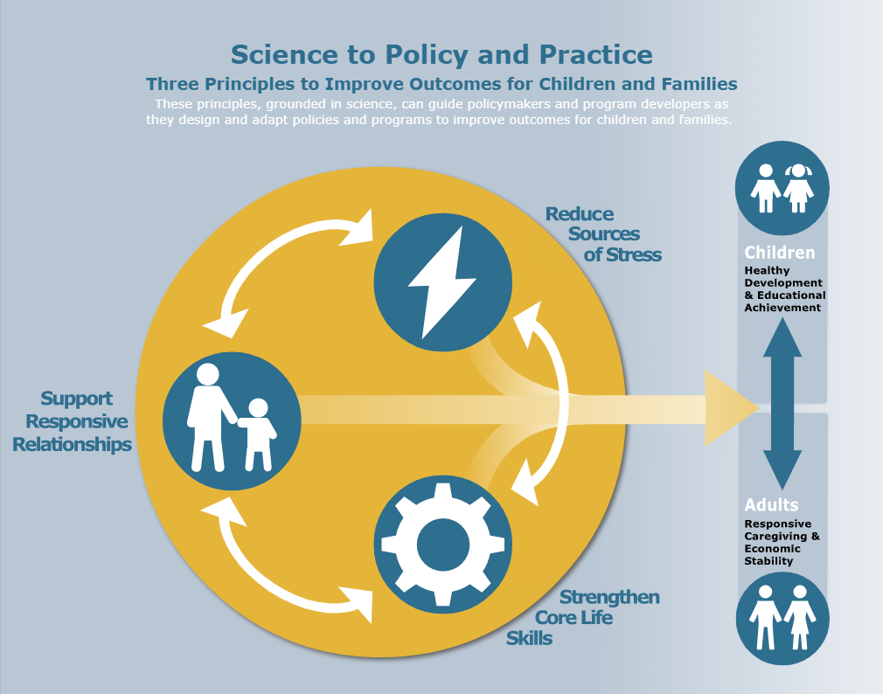
We Can Intervene

Slide 11
Local Intervention: Worcester ACTs (Addresses Childhood Trauma)
Identify
Respond
Screen/ Intervene
Treat/ Maintain
Family Resilience * Community Connection
Family
Worcester Police
YWCA
UMASS CTTC
Clark U
Center for Health Impact

Slide 12
Policy Options to Reduce Toxic Stress and Address Childhood Trauma
Support responsive relationships for children and adults.
Bill H. 320: An Act to provide targeted pre-k education to all four year old children meeting specific requirements in all Gateway Cities
Strengthen core life skills
Bill H.1969: An Act establishing a special commission on two-generation approaches to childhood education
Reduce sources of stress in the lives of children and families
Bill H. 2403: An Act to protect children's mental health services
Bill H. 2874: An Act ensuring high quality early education
S.255: An Act Relative to Early Education Funding
Bill H.2016: An Act establishing universal early education and full-day kindergarten

Slide 13
Questions and Discussion

