Slide 1
GAPS, BEST PRACTICES, AND CHALLENGES IN RESPONDING TO SEX TRAFFICKING AND COMMERCIAL SEXUAL EXPLOITATION (CSE)
Marianne Sarkis, Ph.D.
msarkis@clarku.edu

Slide 2
Today’s Presentation
Overview about sex trafficking
Vulnerabilities and drivers
Sex trafficking & commercial sexual exploitation in Massachusetts
Discuss statewide comprehensive strategies in addressing trafficking
Notes:
“Human trafficking" includes trafficking for sex or labor exploitation.
“Sex trafficking" is used interchangeably with "commercial sexual exploitation", "sex trade", and "prostitution", with or without force, fraud, or coercion.
Does not only include human smuggling
Will use sex trafficking and CSE interchangeably

Slide 3
Definitions – Trafficking in Persons (TIP)
“The recruitment, transportation, transfer, harbouring or receipt of persons, by means of the threat or use of force or other forms of coercion, of abduction, of fraud, of deception, of the abuse of power or of a position of vulnerability or of the giving or receiving of payments or benefits to achieve the consent of a person having control over another person, for the purpose of exploitation.
Exploitation shall include, at a minimum, the exploitation of the prostitution of others or other forms of sexual exploitation, forced labour or services, slavery or practices similar to slavery, servitude or the removal of organs.
Article 3, paragraph (a) of the U.N. Protocol to Prevent, Suppress and Punish Trafficking in Persons (2003)

Slide 4
The Human Trafficking Process

Slide 5
Trafficking in Persons (TIP)
One of the fastest, and most profitable, industries in the world
Surpasses gun and drugs trafficking
Fueled by demand for prostitution and engagement in illicit sex, especially with minors.
Fueled by supply-demand chain that spans the globe
Coordinated through a sophisticated cyber network
Very difficult to expose or disrupt.

Slide 6
By the Numbers
4.5 million (22%) in forced sexual exploitation.
14,500-17,500 individuals trafficked into the U.S. each year.
99% are women and girls
55% are children

Slide 7
Cost of Human Trafficking

Slide 8
By the Numbers
100,000-300,000 underage girls (12-14 years old) are at risk of being sold for sex in the U.S. every year
Boys and transgender youth enter into prostitution, on average, between the of 11 and 13 years old
Upwards of 95% of those in prostitution were sexually assaulted as children
Around 70% of sexually exploited women meet the criteria for post-traumatic stress disorder
75% have faced homelessness
80% were victims of rape and sexual assault
90% of women in prostitution want to leave immediately but feel they have little or no options

Slide 9
By the Numbers, cont.
On average, a young girl is sold more than 15 times/day.
One in three homeless children gets lured into prostitution within the first 48 hours of being alone on the streets.
18,500 runaways have been victims of child sex trafficking
86% were in the care of social services when they ran away (NCEMC)

Slide 10
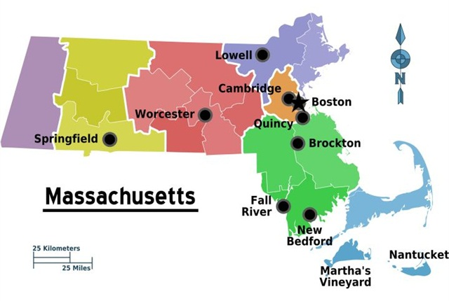
Sex Trafficking and Commercial Sexual Exploitation in Massachusetts

Slide 11
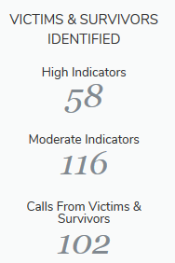
By the Numbers
Since 2007: Total Calls: 2,038
Total Cases: 490
Total Victims - Moderate: 536
Total Victims - High: 414
Jan 1-Dec 31, 2017
Source: National Human Trafficking Hotline report for Massachusetts, 2016

Slide 12
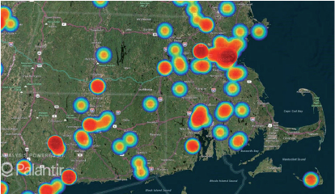
Sex Trafficking and CSE in Massachusetts
Source: National Human Trafficking Hotline report for Massachusetts, 2016

Slide 13
MA Sex Trafficking as % of all trafficking (2014-2016)
Source: The National Human Trafficking Hotline

Slide 14
Adults & Minors (2014-2016)
Source: The National Human Trafficking Hotline

Slide 15
Venues in Sex Trafficking (2014-2016)
Source: The National Human Trafficking Hotline

Slide 16
In Worcester…
97% have Substance Use Disorder (SUD)
Over 60% homeless or no stable housing
Unmet needs due to unaddressed trauma, shame, and the stigma of being a prostituted person
A majority of the women do not have a safe place to go post-incarceration, and often return to the streets, leading to dangerous and fatal results.
13 women died in last two years from fatal overdoses
Chronic recidivism – Majority arrested at least once for prostitution-related offenses, 44% were arrested 4 times or more, with one woman arrested 27 times
Common for women to be re-arrested within days of release. 10% were rearrested within a month of their release from jail, and 3% get re-arrested within a week.

Slide 17
Most challenging barriers to exit
Substance use disorder (SUD)
Chronic homelessness
Inadequate education/job skills
Lack of positive social support
Lack of knowledge about available resources
Lack of trauma-informed and appropriate programs that address all factors simultaneously
Notes:
CSE victims/survivors have difficulty succeeding in traditional substance abuse or domestic violence settings due to double stigma with their histories and they have difficulty assimilating into populations who may judgment

Slide 18
Guiding Principles
Prioritize a victim-centered approach
Inform response with data
Protect individuals and organizations actively combatting trafficking
Ensure better outcomes with cooperation and partnerships
Data reveal that victims are mostly forced to work in non-visible locations such as motels/hotels, residential brothels, or personal sexual servitude.
Efforts to address sex trafficking must address non-street-level exploitation where majority of victims are found.

Slide 19
Recommendations Summary
Massachusetts already has in place some of the below recommendations, but significant gaps remain.
Legislative Efforts: Close loopholes
Systems Coordination
Shift from Law Enforcement to Public Health
Increase funding streams
Establish Statewide coordinated response
Reduce Systemic Barriers
Monitoring and Evaluation: Better data, mandated
Victims’ Re-Entry and Re-Integration: mental health services, residential programming, and access to education and workforce development
Notes:
U.S. Department of State’s Effective Strategies to Prevent Human Trafficking - three-pronged approach in responding to human trafficking: prosecution, protection, and prevention.

Slide 20
Legislative Efforts
Expand legislative efforts to address cyber exploitation and online coordination of trafficking.
Enforce existing laws and close loopholes, including regulation of “body work” and “reflexology” businesses
Implement “Safe Haven” laws
Implement and fund diversion programs

Slide 21
Systems Coordination
Shift in Approaches
Shift from Law Enforcement to Public Health approach
Focus on reducing or eliminating Demand
Strategic Action plan needed for statewide response to human/sex trafficking. This is especially important with the opening of the MGM casinos opening in Springfield.
Implement the three essential services to sustainable recovery: mental health services, residential programming, and access to education and workforce development
Survivors with lived experience must lead and be fully engaged in training or outreach. Compensation is essential.

Slide 22
Systems Coordination
Funding Streams
Provide access and funding for comprehensive victim supports (detox, housing, education, workforce development)
Create a sustainable funding stream for services for victims, especially housing and substance abuse treatment
Empower Community Based Organizations through increased funding and technical assistance for effective outreach and advocacy

Slide 23
Systems Coordination
Coordinated Responses
Collaboration and sustainable partnerships with multiple stakeholders, including private and public
Strengthen coordinated response among all relevant entities including law enforcement, child protective services, health providers, schools, and the criminal justice system.
Partnerships and trainings with health care providers
Coordinated trauma-informed wrap-around victim support/services and case management
Measures that can be responsive to victims’ emergency needs and short-term/long-term needs

Slide 24
Systems Coordination
Reduce Systemic Barriers
Alleviate the factors that contribute to vulnerability (employment, education, community safety, and poverty)
Address root causes and social determinants

Slide 25
Monitoring and Evaluation
Make public all statewide efforts to combat human trafficking through regular reports and websites
Establish a Centralized Resource Warehouse that includes best practices, speakers’ bureau, data reporting, and yearly or bi-yearly reports
Standardize data reporting to get a more accurate count - scientific integrity and public accountability
Mandate standardized reporting from all agencies and programs receiving funding

Slide 26
Victims’ Re-Entry and Re-Integration
Interventions need to be appropriate to needs and heterogeneity of population
Create leadership opportunities for survivors
Reduce systemic barriers to re-integration and self-sufficiency, such as CORI
Expunge criminal records of victims committed while being trafficked
Ensure that all programs for prevention, intervention, and support are evidence-based and trauma-informed

Slide 27
Acknowledgments and Thank Yous
Sara Conroy for helping with the research for this report/presentation
Denise Hines and Jim Gomes for organizing this series and inviting me to present
Senator Chandler, Representative Kahn, and Senator Montigny for their dedication to ending sex trafficking in Massachusetts
Nicole Bell for being a fierce advocate, an inspiration, a mentor, and a friend who taught me that survivors’ dignity, humanity, and leadership should always be at the center of any conversations on this issue. This should never be compromised or forgotten!

Slide 28
THANK YOU.
Questions? Comments?
Marianne Sarkis, Ph.D.
Program Coordinator, Henry J. and Erna D. Leir Global and Community Health Program
Department of International Development, Community, and Environment
Clark University, 950 Main Street, Worcester, MA 01610
phone: 508-421-3898
email: msarkis@clarku.edu

