Slide 1
Barriers to Mental Health Services: Narratives from Community Stakeholders
Rosalie Torres Stone, Ph.D., Sociology Department, Clark University
and Systems and Psychosocial Advances Research Center,
UMass Psychiatry Department

Slide 2
Background
Despite the existence of numerous efficacious psychosocial and pharmacological treatments for mental disorders (Wang, Demler, & Kessler, 2002) the burden of psychiatric illness remains high.
2012- an estimated 43.7 million (18.6%) adults aged 18 or older in the U.S. had a mental disorder in the past year (SAMHSA, 2012).
Immigrant and refugee populations, individuals from lower socioeconomic backgrounds, and men are less likely to receive adequate mental health care (Gonzales & Papadpoulos, 2008; Kessler et al., 2008; Snowden, 2012, Berdahl & Torres Stone, 2009).

Slide 3
Case Study: September, 2015 Worcester Community Mental Health Assessment
Part of the Worcester Division of Public Health’s (WDPH) larger, ongoing Community Health Improvement Plan (CHIP) http://www.worcesterma.gov/ocm/public-health/greater-worcester-chip
Community-based overview of:
challenges Worcester residents, providers, and Executive Directors report seeing on a daily basis
different perspectives residents hold about mental health and treatment
various approaches to coping with stress that residents demonstrate
barriers and facilitators relevant to accessing mental health services
Notes:
To fully address the mental disparities, it is important to understand the helping seeing process from how individuals conceptualize and experience mental health, attitudes and beliefs about coping with mental health challenges, and their experiences with the mental health system
The purpose of this study is to increase our community’s understanding of the perceived mental health experiences and issues faced by Worcester residents.

Slide 4
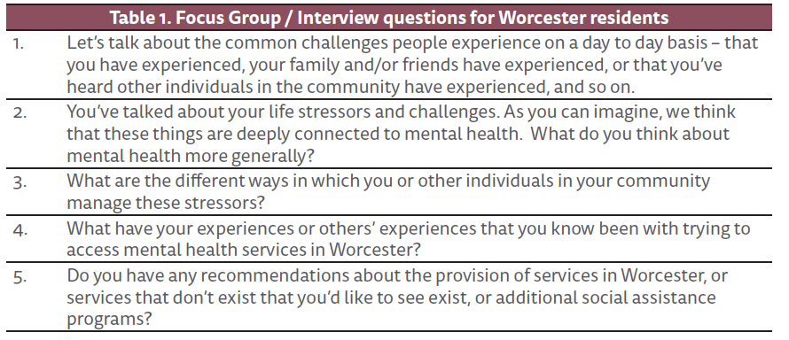
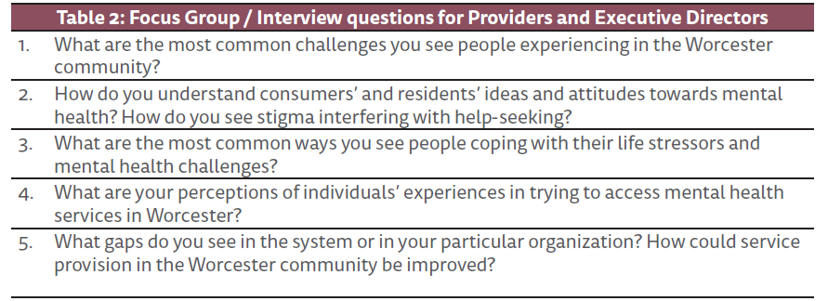
Research Methods
Notes:
Individuals participated in either a focus group or an individual interview with research staff. To fully address the mental disparities, it is important to understand the helping seeing process from how individuals conceptualize and experience mental health, attitudes and beliefs about coping with mental health challenges, and their experiences with the mental health system

Slide 5
Research Demographics
Study sample: 61 individuals in Worcester
Residents and/or consumers of mental health services, providers and executive directors of mental health and community-based services in Worcester.
Residents and/or consumers:
Participant age range: 24 to 74 years old, mean of 56.6.
Racial and ethnic diversity: 88% self-identify as racial/ethnic minorities and just over two-thirds as U.S. immigrants.
Sample characteristics: 58% men, 42% single, 77% had less than a college degree.
Income: Half of the sample reporting that they earned less than $10,000 per year.

Slide 6
Barriers to utilization of mental health services
Commonly experienced barriers in Worcester:
Difficulties navigating the mental health system
Non-Western notions of mental health
Negative attitudes and stigma
Language and cultural barriers
Long waiting lists to see providers

Slide 7
Difficulties navigating the mental health system
Vietnamese resident:
“I have a doctor and Mass health insurance. When my doctor prescribed a medication, I took his prescription to everywhere, but no one had it. They kept telling me to go here and go there. This caused me so much stress that caused my nerves to stretch thin. I came to this place that was supposed to sell the medication, but I was sent to another place and another place. I really need help to get my medical needs met.”
Executive director:
“I think a lot of the agencies are so specialized in what they do, I think sometimes they are trying to fit a square peg into a round hole…and I think organizations need to be more client-centered, and really understand the client as a unique individual…I can’t tell you how many times…the therapist will say, ‘Oh, I don’t work with that, you have to go here…clients are feeling abandoned, pushed-off’.”
Notes:
1. Participants consistently described the difficulties Worcester residents experience when attempting to navigate the complex health and mental health systems. This difficulty was often noted as particularly stark for immigrant and refugee populations, many of whom come from countries with very different healthcare systems.
2. Many providers and Executive Directors expressed similar frustration with the complex systems. Concerns were expressed about the challenges of coordinating care across providers and between organizations. The absence of any system to facilitate coordination of care was noted expressly by many providers.

Slide 8
Non-Western notions of mental health
Several providers noted that community residents did not always recognize symptoms of stress as psychological in nature and possibly treatable.
One mental health provider commented on culturally sanctioned belief systems:
“So I work with refugees and immigrants from Vietnam, so many of the individuals don’t know about mental health issues. And their mindset on it is that it’s either a demon in control of things. There’s some sort of supernatural force that’s making you act this way, see these things, hear these things or even a ghost inside you. And there are cures for it at temple ceremonies.”
Religious pastor, in reference to experiences of trauma:
“They don’t know that they have trauma. It’s our responsibility to direct them to Worcester services but we have to be careful how we do it…we have to build trust with the mother and the child first.”
Notes:
1. Similarly, a mental health provider who worked with immigrant and refugee populations noted that many of these individuals struggle with the effects of pre-immigration trauma, but are not familiar with Western notions of mental health and illness, and so focus on physical symptoms. He stated:

Slide 9
Negative attitudes and stigma
Most common for immigrants, refugee groups, military veterans
Mental health consumer:
“There is a lot of stigma in Worcester… Employers don’t want to hire individuals with mental illness [because] they think we’re crazies who won’t be able to do the job right.”
Non-mental health provider:
“There is a lot of stigma – once they are settled – they are still in contact with each other. They feel like they have worked so hard to get to the United States that they can’t have a problem. They can’t be looked down upon. They don’t want to get help with any of their symptoms because they don’t want to be labeled as mentally ill.”
Notes:
1. When asked about attitudes towards mental health, stigma emerged as a common theme across residents, providers, and executive directors. As one mental health consumer stated:
2. Of note, interviewees suggested that mental health stigma is much more pronounced in immigrant and refugee populations, many of whom equate mental illness with “being crazy” and as being inherently shameful. As one non-mental health provider described about some of her clients who are served by her organization:

Slide 10
Stigma for military veterans
Provider who works with military veterans:
“Veterans, particularly if they remain an active service member in the Guard or Reserves, are willing to tell us about their mental health issues but don’t want us to document it on their records because the military has access to their medical records. You get mixed messages from the military: on the one hand, you are encouraged to disclose your mental health condition but everything changes after that. Sometimes disclosure limits their ability for promotion and changes their career path.”
Notes:
Military veterans were a group for whom stigma posed unique challenges. In addition to having the general stigma about mental health challenges, many veterans worry about the consequences to their military career if they were to seek help. One provider who works with military veterans noted

Slide 11
Lack of culturally and linguistically competent care
Vietnamese resident:
“My difficulties are in daily activities, especially as an elder. I find that because we are an Asian, as a Vietnamese, we speak Vietnamese only and now live in American society, the most difficult is the language barrier. When you go to agencies, some do provide translation but most of them do not. So that will create obstacles when you try to communicate. Even if they have translators, it’s still difficult. But most places do not have translators.”
Mental health provider:
“In some cultures, parents have a hard time – once we engage them they see it differently but care has to be done in a certain way – cultural matching helps tremendously; someone who is trained appropriately – leads to good engagement...if people don’t feel validated they don’t come back.”
Mental health provider who works with military veterans:
“There are veterans who don’t want to get services in the community and prefer to be treated at the VA. The community providers don’t understand veteran culture. They feel better understood around other veterans.”
Notes:
1. A Vietnamese resident noted the difficulties inherent in trying to communicate with providers. He noted…
Providers who worked with communities of color and special populations (veterans) consistently articulated the need to deliver services in a culturally responsive way. This includes understanding the political histories and culture of immigrant and refugee populations, and ideally, being proficient in the language of the consumers.
2. Engaging patients in care, however, especially the immigrant and refugee population, has to be done in a culturally responsive way. As one mental provider stated:
3. Providers who worked with military veterans identified them as another group that has unique needs and preferences, and so acquiring understanding and skill in working with this population is essential. One provider noted that:

Slide 12
Long waiting lists
Mental health provider:
“I think the most common challenge is, I think, lack of resources. When people decide – especially we see that in the public sector, psychiatry, definitely…When people decide they need services or they try to seek services, there’s a number of waiting lists, you know. And people, sometimes – especially with the Latino community, which is the community that I work with, people sometimes look for services when they really needed it yesterday, so there is a certain urgency that goes with looking at, getting the services. And, what happens is that many times there are waiting lists among the providers in town, and then either the crisis gets resolved or they have to suffer through it, end up in the hospital. You know, that I think is, access, I think is one of the biggest challenges.”
Notes:
1. Many participants expressed frustration with the difficulties in scheduling appointments with mental health providers. This frustration was expressed regarding both psychiatric and psychotherapeutic services, and it was noted as particularly concerning for communities of color.

Slide 13
Removing barriers to mental health services
Commonly identified needs in Worcester:
Patient navigators
Greater network/community among providers
Coordinated care
Mental health literacy education

Slide 14
Patient navigators
Patient navigation can identify and target specific barriers to treatment engagement (e.g., Druss et. al., 2010).
Mental health provider who works with military veterans:
“I crave for my clients a patient, experienced coordinator. Someone who is comparable and analogous to an articulate, well-educated person who has the time to help navigate what might feel like a daunting, complicated, intimidating system – private or VA. People do better with someone who is in the room, who [will] help them talk to their doctor when they’re anxious about all the things that they’re dealing with – to debrief after the appointment, follow up appointments, prepare for the next appointment. The experience would be much more productive.”
Non-mental health provider:
“We need more health navigators and outreach workers who are focused on specific populations like the Burmese and Vietnamese population. It’s very hard to have different people come to their homes who don’t understand their background situation. We need to include different agencies to help bridge the gap between primary care, housing and mental health.”
Notes:
1. One mental health provider who works with military veterans acknowledged how complicated and daunting the system can be for patients. She yearned for a facilitator who could help patients with the inevitable challenges, stating:
2. This desire for a facilitator or patient navigator was articulated by many providers in different ways. One non-mental health provider described this need for South Asian populations:

Slide 15
Greater network/community among providers
Desire was articulated for greater network and community among providers, both within and across agencies, e.g., the Worcester Provider Alliance
Case studies have shown that inter-organizational networks have been linked to stronger levels of cooperation across organizations that improve cost containment without compromising the quality of patient care (Proven, 1998, 2004).

Slide 16
Mental health literacy
Many people, especially recent immigrants and cultural minorities, lack knowledge of what mental illness is, how to recognize early signs, what treatments are available and how and when to seek professional help (Collier et al., 2012; Jorm, 2012).
Non-mental health provider:
“We need community education for those in crisis…We don’t always know how to talk about it, mental health can range from bipolar to schizophrenia to hardly presenting at all….People think that mental health treatment is for people screaming in the stress; crazy people.”
Notes:
1. Providers, mental health consumers, and residents felt that there is a need for more mental health literacy about both mental health conditions and services offered in Worcester. Mental health literacy is linked to increased willingness to seek help from a psychiatrist or counselor.
2. As noted earlier, residents do not always recognize symptoms of stress as psychological in nature and as possibly treatable. One non-mental health provider noted:

Slide 17
Coordinated care
Linked to improvements in: clinical outcomes, compliance with medical regimes, lower total medical costs to patients, patient and provider satisfaction, and access to behavioral health care particularly for groups that are difficult to engage (Blount, 2003).
Executive Director:
“What seems to be working the most smoothly for us is when behavioral health and medical work together for a patient, whether that’s an integrated or coordinated service…when we’re both on the same page, that seems to work better for patients…so, our medical providers understand what the condition of access to behavioral health is in Worcester, so they are reasonable about distinguishing between those patients in dire need for it versus those for whom it’d be helpful...and behavioral health cooperates by finding appointments for patients who are higher priority of need.”

Slide 18
Summary of findings
Worcester residents included economic challenges and elevated rates of lifetime and current exposure to violence and trauma. In addition, substance use and medical comorbidity also emerged as common themes.
Many immigrant and refugee residents struggle with the effects of pre-immigration trauma, but are not familiar with Western notions of mental health and illness, and so focus on physical symptoms.
Stigma emerged as a common theme across residents, providers, and Executive Directors. Of note, interviewees suggested that mental health stigma is more pronounced in immigrant and refugee populations, as well as among military veterans.
Participants identified numerous barriers to utilizing mental health services, including long waiting lists, navigating the mental health system, language barriers, and several logistical barriers (i.e., hours of operation, transportation, and insurance copays).

Slide 19
Recommendations
Greater and broader coordinated care (increased integration of health and mental health services)
Increased use of case managers, patient navigators/advocates, community health workers
Mental health literacy/more mental health education
Culturally competent care
Greater network/community among providers
Address stigma related concerns
Notes:
Taken together, these results from the Worcester Community Assessment of Mental Health Needs led to the following recommendations to improve the mental health needs of the Worcester community (and can be applied to cities in the state)

Slide 20
Closing Remarks
Pastor from local church:
“We need organizations that serve as a bridge to create effective communication between services. Right now there is water, and our people can’t swim. We need this bridge to be a strong bridge to connect services and get things done – a bridge that people can trust. People are accounted for and people are accountable. We have a lot of people in the community who help but don’t have the funds to do it all. We are not asking for a hand out but a hand up!”
Notes:
Given the data suggesting that Worcester residents are experiencing numerous stressors, as well as substantive barriers to mental health care, it is imperative that the community come together to advance the cause of those most in need. As a pastor at a local church stated quite eloquently:

Slide 21
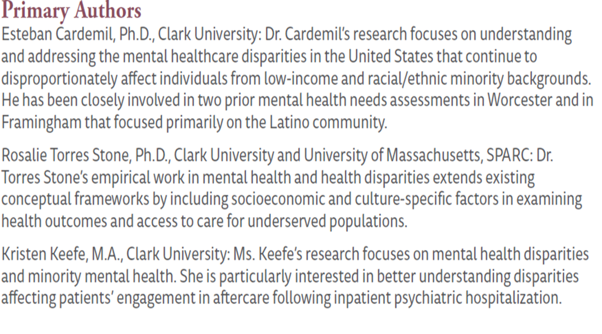
Acknowledgements
Funding for the Worcester Community Health Needs Assessment came from The Fairlawn Foundation of the Greater Worcester Community Foundation.
Project Managers
-Paige Bik, MSW, Worcester Division of Public Health -Zach Dyer, MPH, Worcester Division of Public Health

Slide 22
Thank you for coming!

