Slide 1
Financial hardship and the economic burden of health [cancer] care
Reginald Tucker-Seeley, MA, ScM, ScD
Assistant Professor of Social and Behavioral Sciences, DFCI/HSPH
04/05/2017

Slide 2
Background
Socioeconomic status is positively associated with health/health behavior
  Income, education, occupation (Adler and Newman, 2002; Braveman, et al, 2005)

Slide 3
Background
Why traditional measures of socioeconomic status in population health research may be limited:
  Variability within groups
    Individuals within SES categories (e.g. low-income) may present a range of variation in individual vulnerability to the effects of adverse socioeconomic circumstances or changes to socioeconomic circumstances

Slide 4
Background
Differential impact of SES across racial/ethnic groups
  Diminishing returns hypothesis
    Suggests that racial/ethnic minorities may not experience the same returns on increasing levels of SES as whites
  Minority poverty hypothesis
    Suggests a unique disadvantage for racial/ethnic minorities living in poverty

Slide 5
Household financial insecurity
Household financial (in)security
  17.8% report feeling economically insecure (Economic Security Index Project, Yale University);
  “More than half (52 percent) of African-American and 56 percent of Latino seniors are economically insecure” (Institute on Assets and Social Policy, Brandeis University);
  “44% of households nationally are living without a basic personal safety net”(The Corporation for Enterprise Development (CFED)).
Notes:
In a report by the Economic Security Index Project at Yale University, 17.8% of respondents reported feeling economic insecure in 2012.
In a report by the Institute on Assets and Social Policy at Brandeis, 52% of African American and 56% of Latino seniors are economically insecure (this is measuring using an index of retirement assets, household budget, healthcare expenses, home equity, and housing costs).
Given the recent Great Recession we are slowly coming out of it is also not surprising that 44% of households report that they have no personal safety net (or savings to cover three month’s worth of expenses) and are living in “liquid asset poverty.”

Slide 6
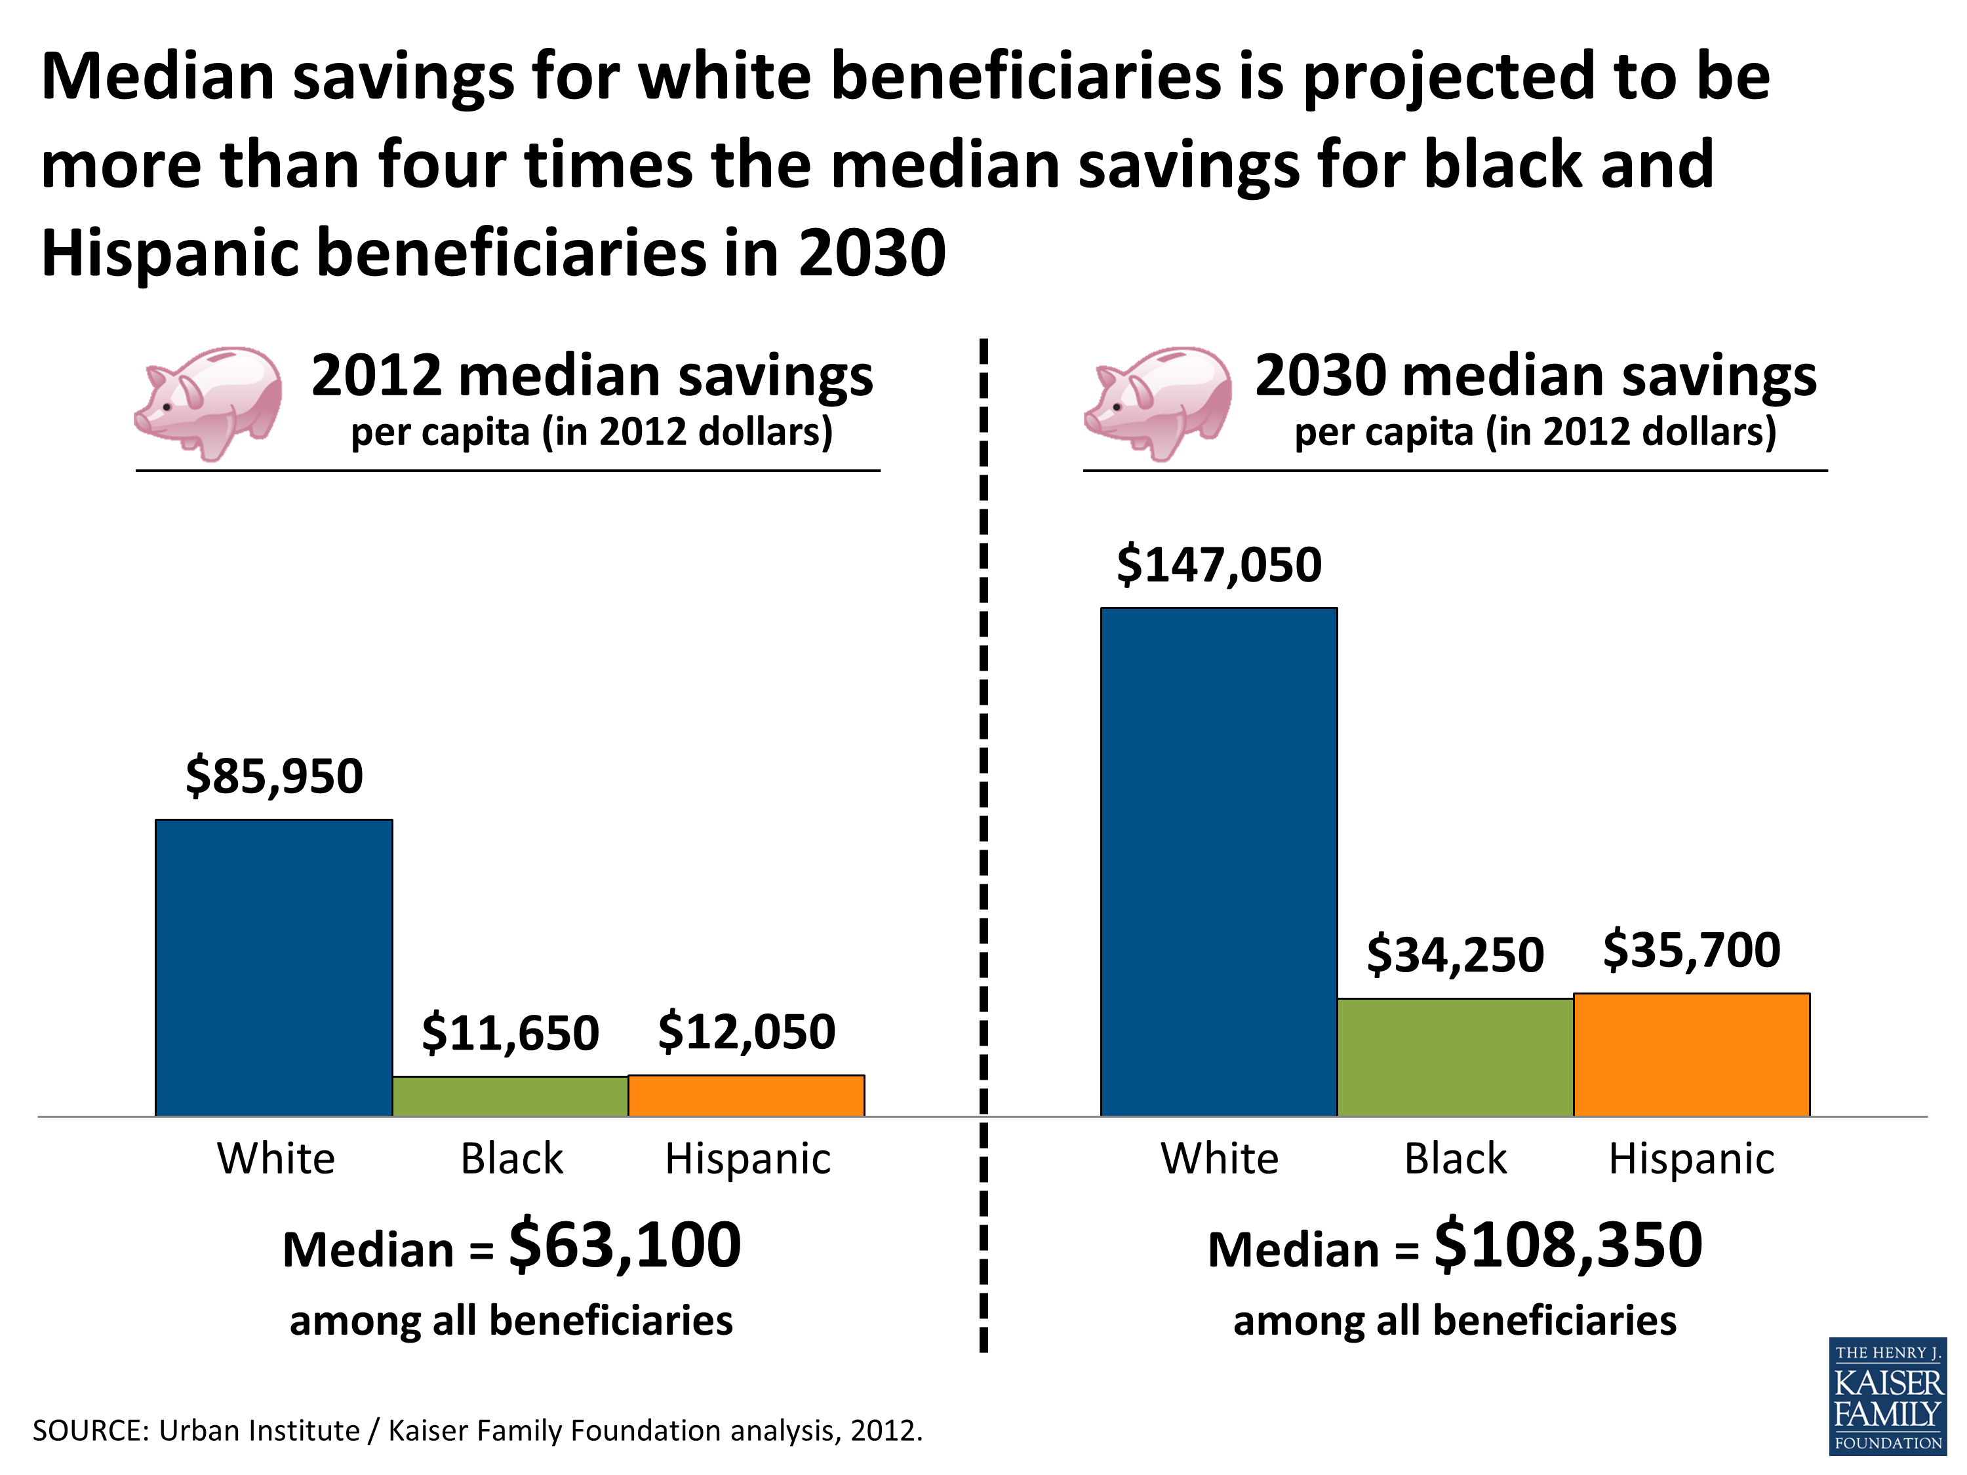
Differential savings among Medicare population

Slide 7
Background
Financial hardship has been shown to be associated with several health outcomes:
  Intensive end-of-life care (Tucker-Seeley, et al. 2014)
  Oral health (Chi and Tucker-Seeley, 2013)
  Morbidity (Tucker-Seeley, et al. 2009; Kahn and Pearlin, 2006)
  Mortality (Tucker-Seeley, et al. 2009; Szanton, et al. 2008)

Slide 8
Background
Rising cost of cancer care
  Cost of cancer rising faster than other diseases
    Total costs (direct costs of care for patient as well as the indirect costs of managing care by the household) are not usually known at the start of treatment and are not routinely discussed (IOM report, Levit, Balogh, Nass, and Ganz, 2013).
Notes:
“The cost of cancer care is rising faster than are other sectors of medicine, having increased from $72 billion in 2004 to $125 billion in 2010; costs are expected to increase another 39 percent to $173 billion by 2020.” (Levit, Balogh, Nass, and Ganz, 2013)

Slide 9
Financial hardship and cancer

Slide 10
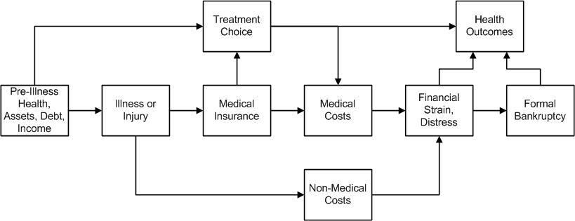
Financial Toxicity
Several terms have been used to describe the financial consequences of managing cancer, such as financial burden, financial toxicity, financial hardship, and financial stress/distress.
The relationship between cancer care and financial distress/toxicity is complex and related to a number of factors
Source: https://www.cancer.gov/about-cancer/managing-care/financial-toxicity-hp-pdq

Slide 11

The Money-Health Connection Study
R21 CA158248 (NCI funded)

Slide 12
Money-Health Connection Study
The purpose of the Money-Health Connection study is to develop a trans-disciplinary conceptual model of financial well-being (FWB) and to develop an assessment tool to measure this construct.
  Why is this necessary?
    Lack of conceptual clarity of FWB concepts
      financial hardship, financial strain, and in the cancer care context “financial toxicity” used interchangeably
    Lack of measurement clarity
      No consistent measure of these concepts

Slide 13

Financial well-being video

Slide 14
Financial hardship in the cancer care context

Slide 15
Example questions
Material Conditions
  Making ends meet
    During the past 12 months, how much difficulty have you had in paying your bills?
Psychological Response
  Financial worry
    How often do you worry about not meeting your expenses with your current income?
Behavioral Coping
  Family resource management
    In past 12 months, because of the cost of care [since diagnosis], did you take less than prescribed amount of your medication?
      Did you skip doctor’s appointments?

Slide 16
Implications for public health
Better explication of the socioeconomic factors associated with health/health care across the life course
  Identification of potential intervention and policy targets
    Material Conditions (additional financial resources for specific household expenses)
    Psychological Response (stress reduction strategies)
    Behavioral Coping (financial literacy/education)

Slide 17
Conclusion/Summary
If we are to effectively address socioeconomic disparities in health outcomes, it is critical that we improve our understanding of the material, psychosocial, and behavioral dimensions of household financial well-being that describe how individual socioeconomic circumstances are actually experienced, managed, and leveraged along the pathway to various health outcomes and health behaviors throughout the life course.
Notes:
In conclusion, If we are to effectively address socioeconomic disparities in health outcomes, it is critical that we improve our understanding of the material, psychosocial, and behavioral dimensions that describe how individual socioeconomic circumstances are actually experienced, managed, and leveraged along the pathway to various health outcomes and health behaviors

Slide 18
Acknowledgments
Funding sources
  NCI: R21 CA158248
  Dana-Farber Cancer Institute
Tucker-Seeley research lab staff:
  Vanessa Boulanger (project director)
  Catherine Duarte (former research assistant)
  Melecia Miller (former research assistant)
  Margaret Katana (current research assistant)
DF/HCC Cores
  Health Communications Core
  Survey and Data Management Core

Slide 19
Comments/Questions

