Slide 1
Venture Equity Project Year 3: Legislative Policy Analysis
Penn State University, Evidence-to-Impact Collaborative
Michael Donovan, Yoon Sun Hur, Jonathan Wright, and Gillian Sommerville
August 15th, 2024

Slide 2
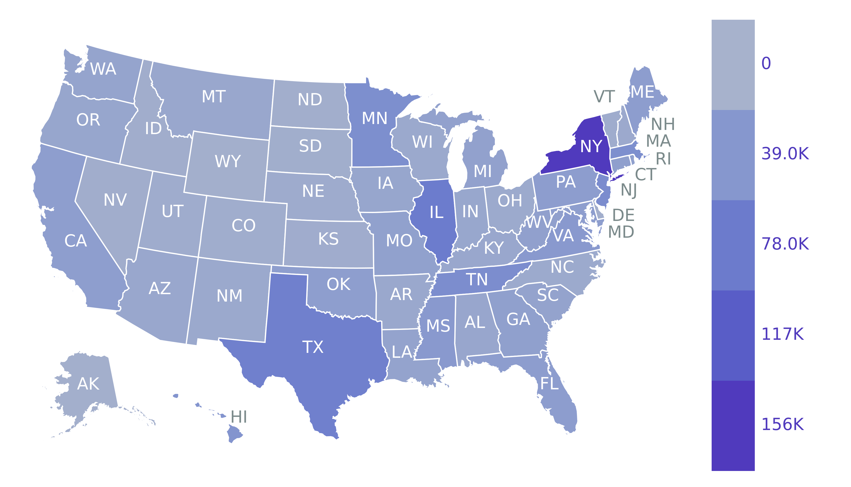
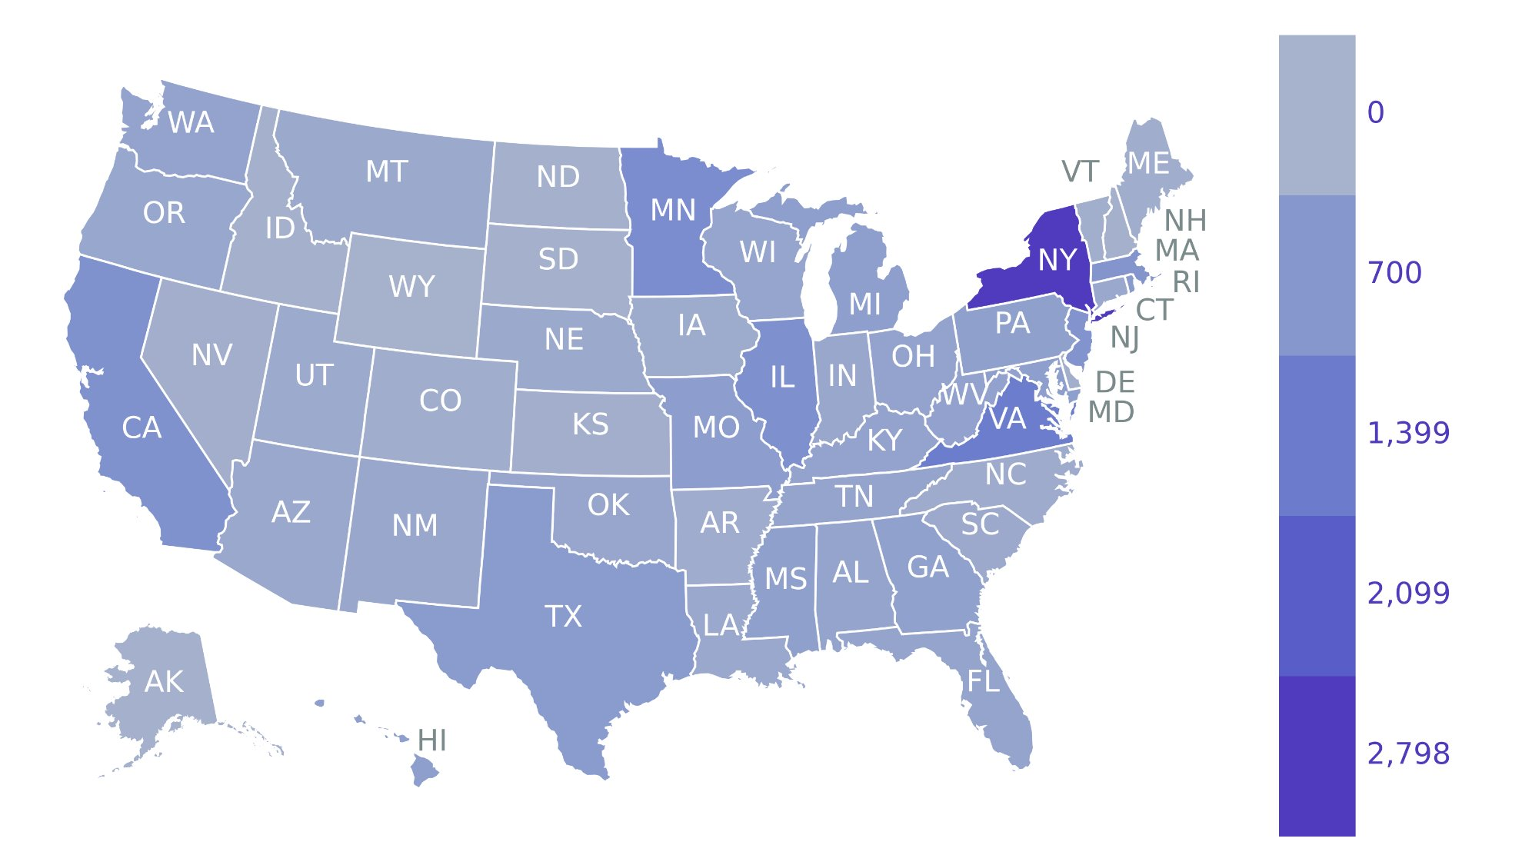
Legislative activity of the past decade: At a glance
From 2013-2023, New York introduced the most legislation overall (155919), with Illinois (76772), Texas (70765), New Jersey (54801), and Tennessee (52622) also introducing more than other states
From 2013-2023, New York introduced the most legislation that considered entrepreneurs (2798), with Virginia (1350), Minnesota (962), Illinois (886), and California (837) also introducing more than other states.
Figure 1: A heat map of all bills introduced between 2013 and 2023
Figure 2: A heat map of all entrepreneurship bills introduced between 2013 and 2023

Slide 3
Legislative activity of the past decade: Diving deeper into entrepreneurship
Over the last decade, Virginia (1350), Ohio (402), California (837), and Wisconsin (342) introduced the most entrepreneurship bills relative to all legislation that state introduced
Figure 3: The percentage of all bills that are entrepreneurship-related over the last decade (2013-2023)

Slide 4
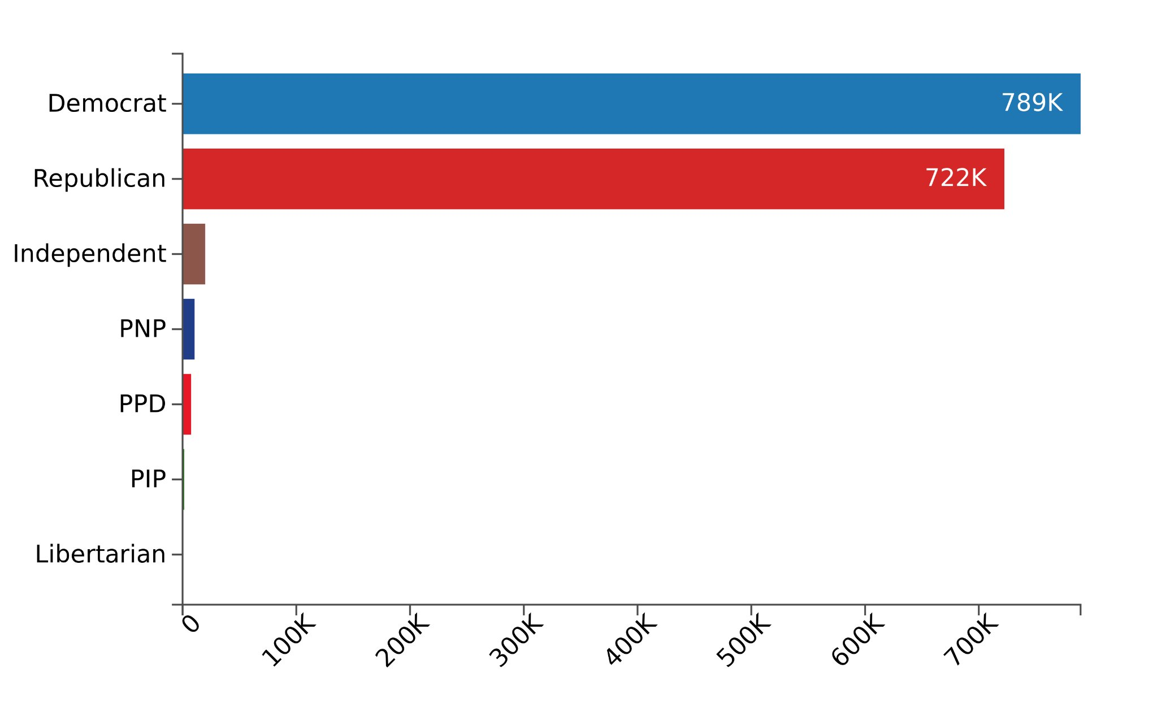
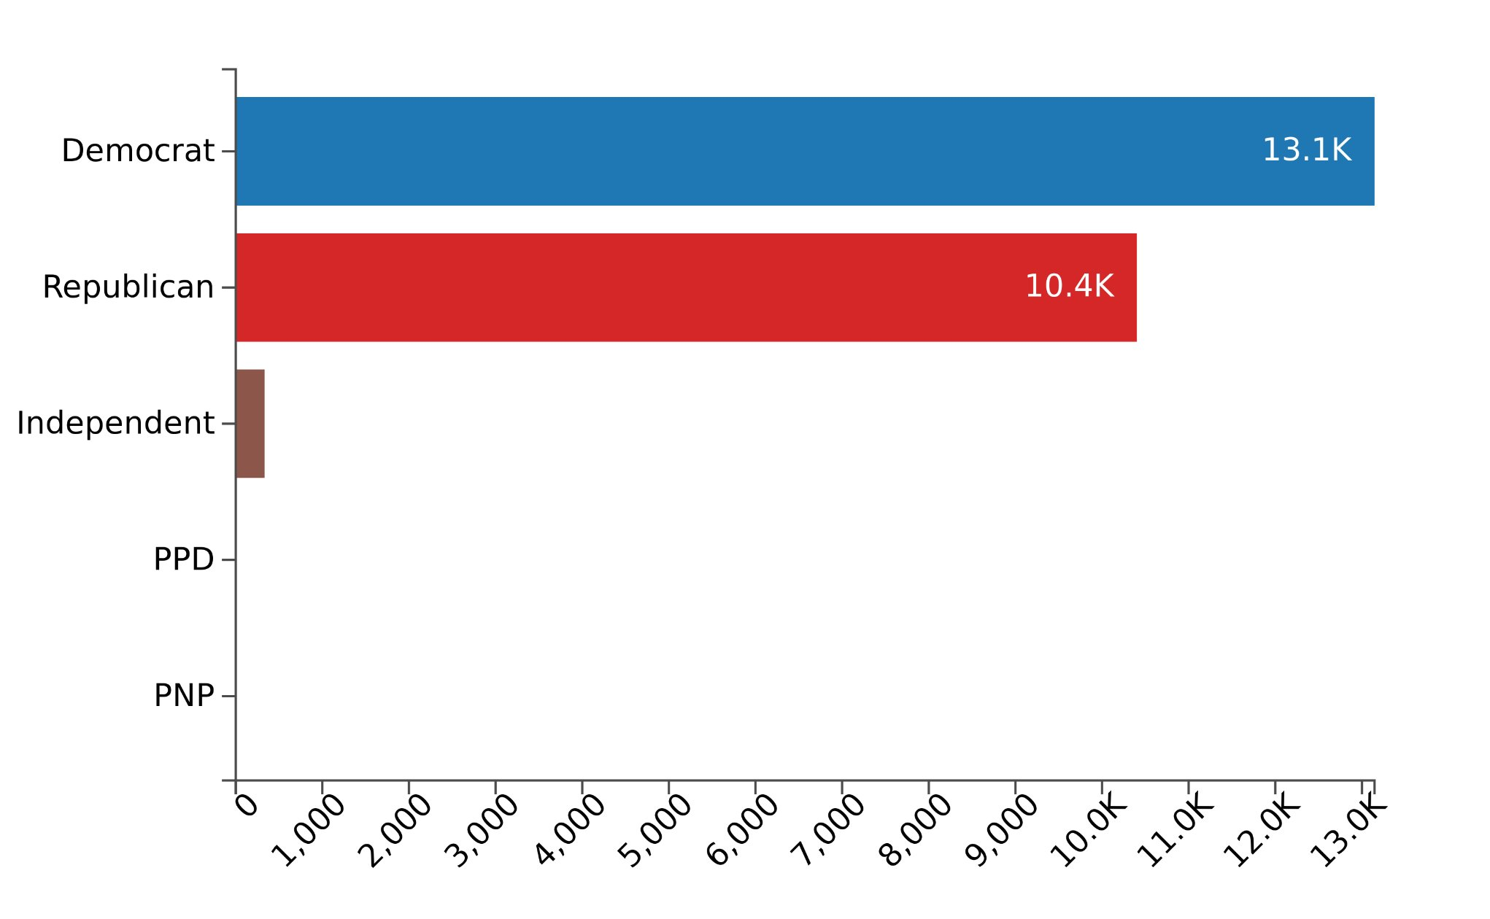
Legislative activity from the past decade: Party sponsorship
For all bills, Democrats and Republicans introduced virtually the same volume of bills. For entrepreneurship particular bills, Democrats introduced 1.2x the amount of bills Republicans did
Figure 4: All bills introduced between 2013 and 2023
Figure 5: All entrepreneurship introduced bills between 2013 and 2023

Slide 5
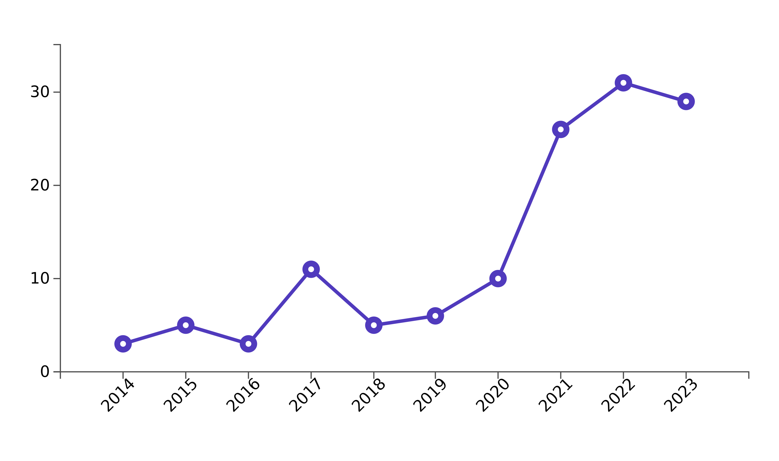
Legislative activity of the past decade: Consideration of entrepreneur race and ethnicity
Over the course of the last decade, D.C. (12), South Carolina (5), Massachusetts (14), and Minnesota (17), introduced the most legislation that considers race relative to their total volume of bills introduced in the state. Peak entrepreneur race bills were introduced in 2022 at 31 pieces of legislation.
Figure 6: The percentage of all entrepreneurship bills that consider race and ethnicity over the last decade (2013-2023)
Figure 7: The volume of entrepreneurship bills that consider race and ethnicity over the last decade (2013-2023)

Slide 6
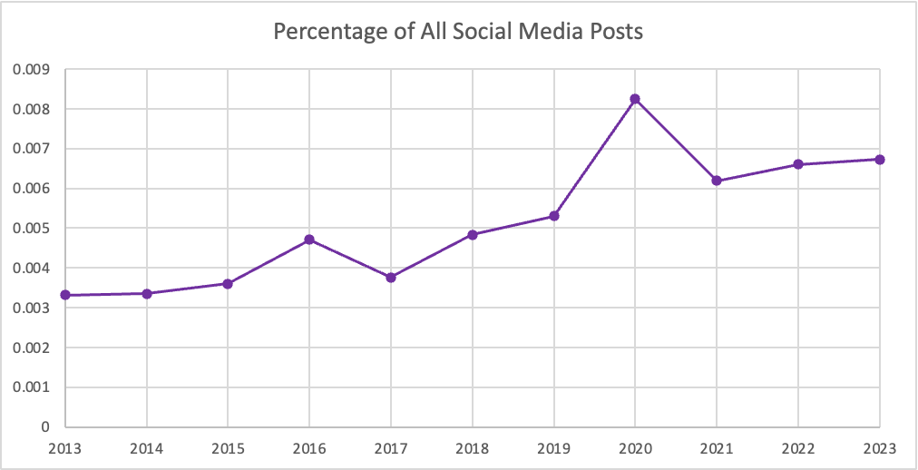
Discourse over the past decade: Social media at a glance
Over the past decade, the presence of entrepreneurship in all social media discourse has doubled from .3% to .6%
Figure 8: The percentage of all bills that are entrepreneurship-related over the last decade (2013-2023)

Slide 7
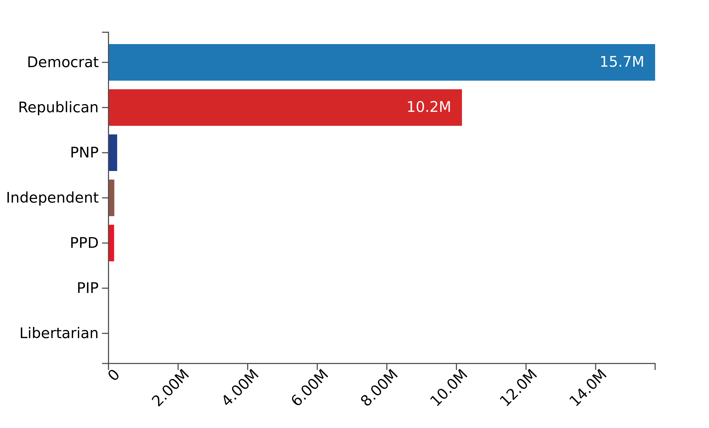
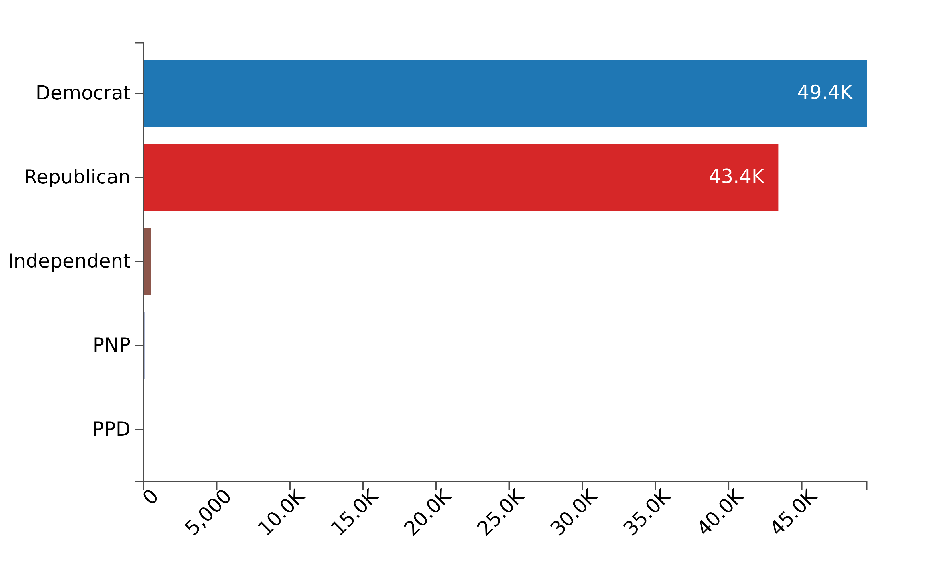
Discourse over the last decade: Social media by party
Compared to all social media activity, entrepreneurial social media discourse between political parties was fairly similar between both the Democratic and Republican parties.
Figure 9: All social media posts from the last decade (2013-2023)
Figure 10: All bills introduced between 2013 and 2023

Slide 8
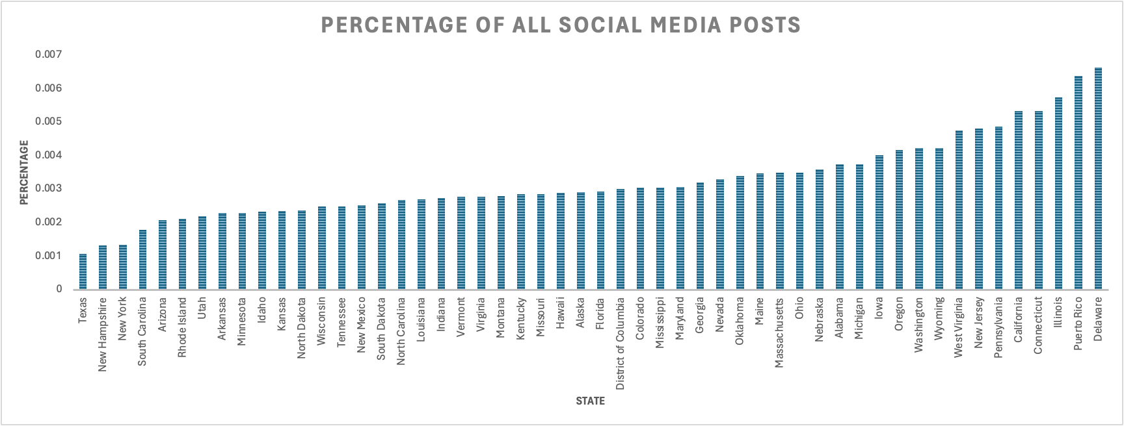
Discourse over the last decade: Social media by state
Over the course of the last decade, Delaware, Puerto Rico, Illinois, and Connecticut increased their entrepreneurship social media discourse the most
Figure 11: The percentage of social media that are related to entrepreneruship over the last decade by state (2013-2023)

Slide 9
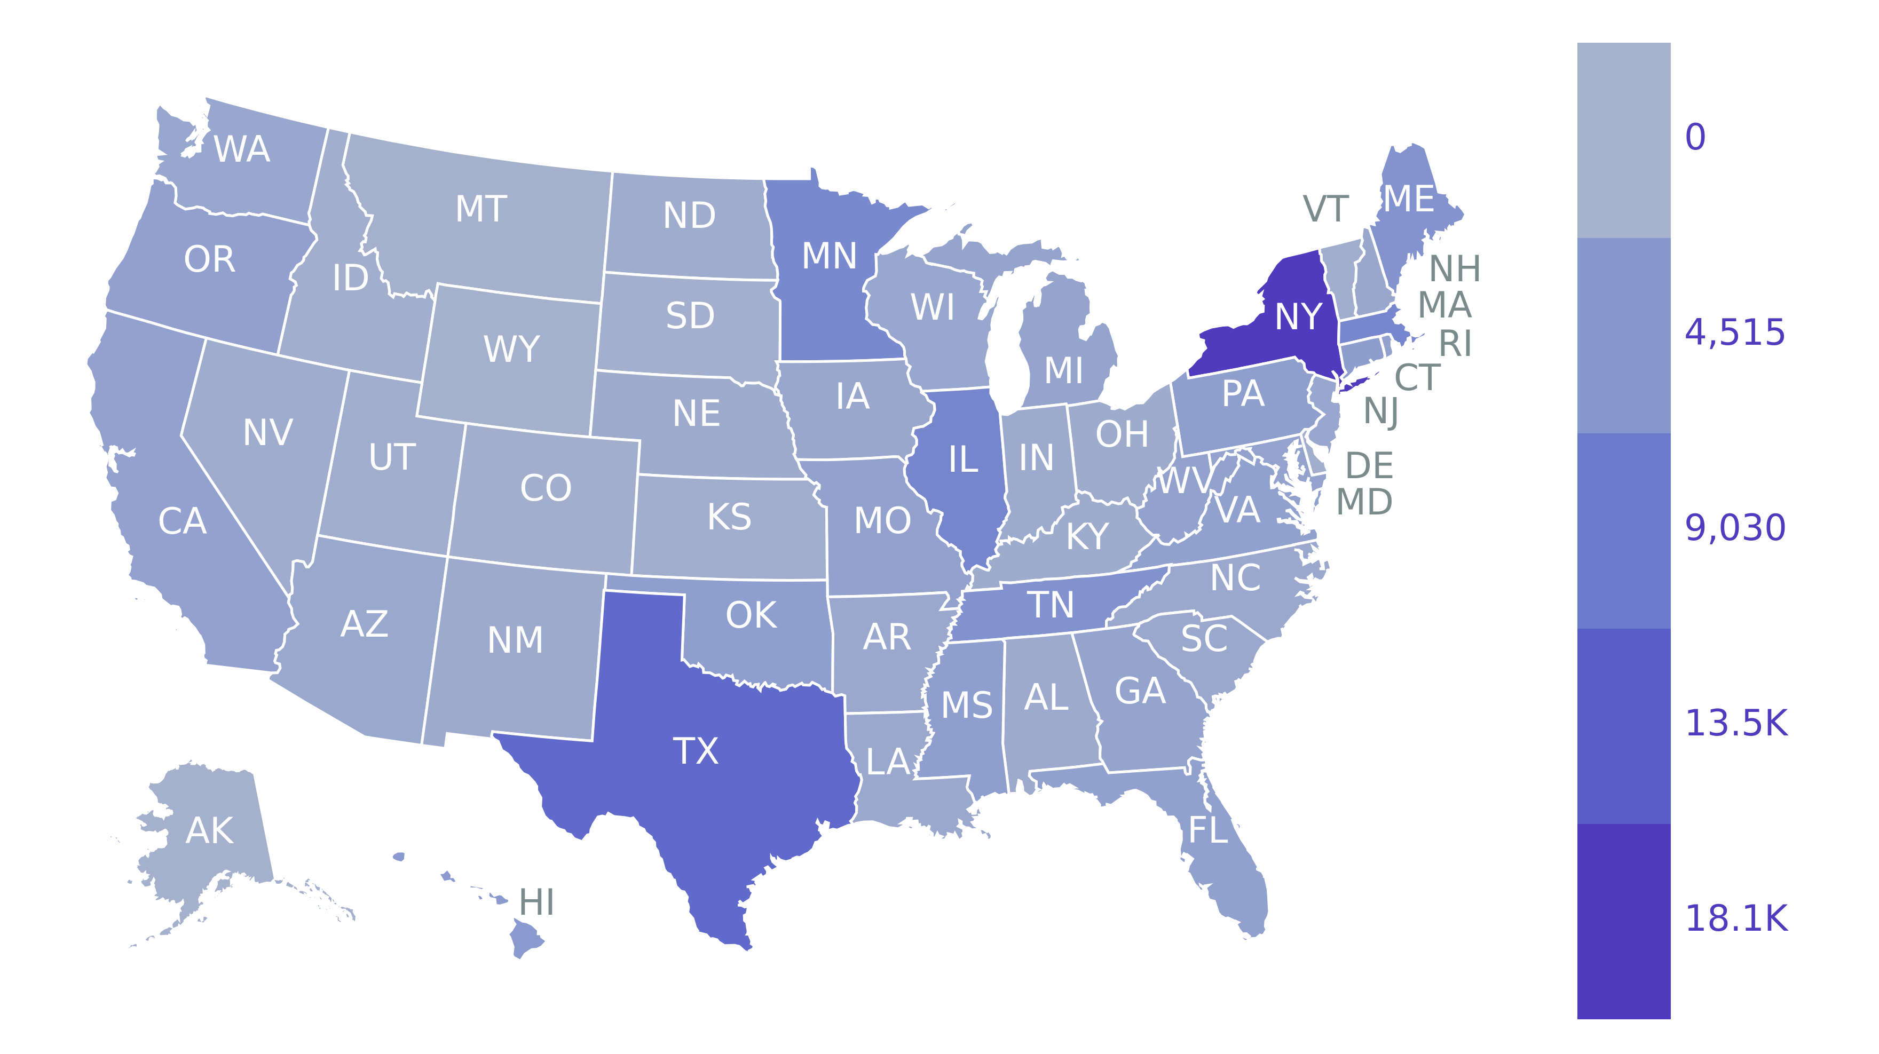
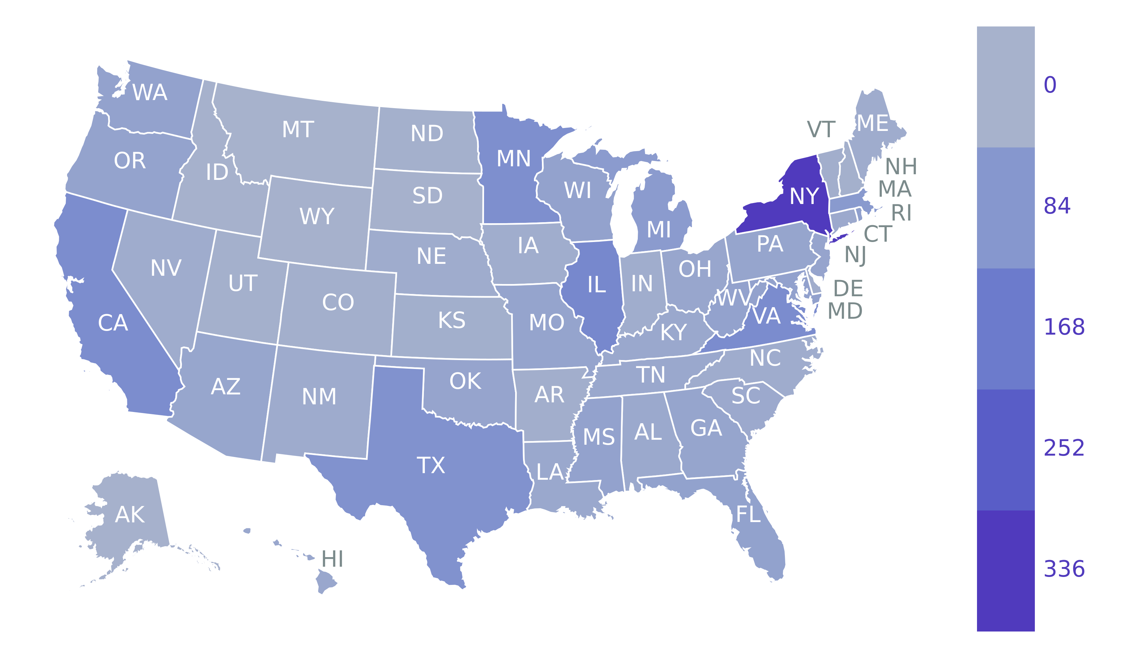
Legislative activity of the past year: 2023 at a glance
In 2023, New York introduced the most legislation overall (18059), with Texas (11552), Illinois (7264), Massachusetts (7063), and Minnesota (6774) also introducing more than other states
In 2023, New York introduced the most entrepreneurship focused legislation (336), with Illinois (129), Virginia (118), California (114), and Minnesota (108) also introducing more than other states
Figure 12: A heat map of all bills introduced in 2023
Figure 13: A heat map of entrepreneurship bills introduced in 2023

Slide 10
Legislation of the past year: 2023 context
In 2023, Washington (50), Kentucky (32), Wisconsin (49), and D.C. (31) introduced the most entrepreneurial legislation relative to all legislation the state produced in the year
Figure 14: The percentage of all bills that are related to entrepreneurship by state (2023)

Slide 11
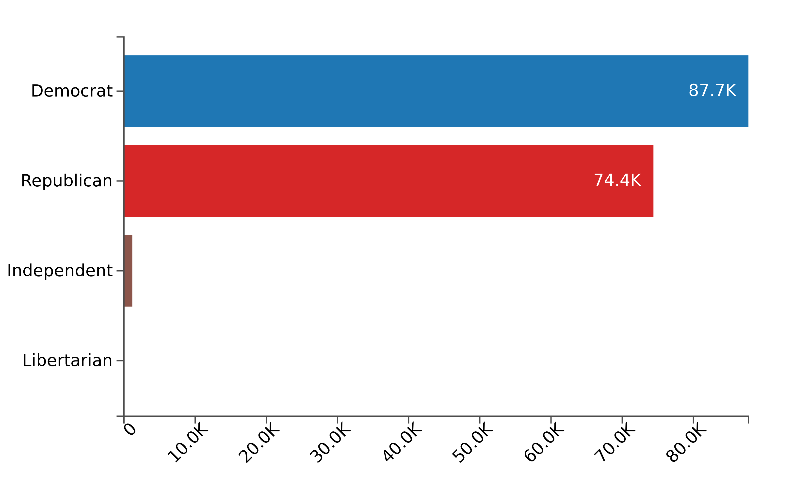
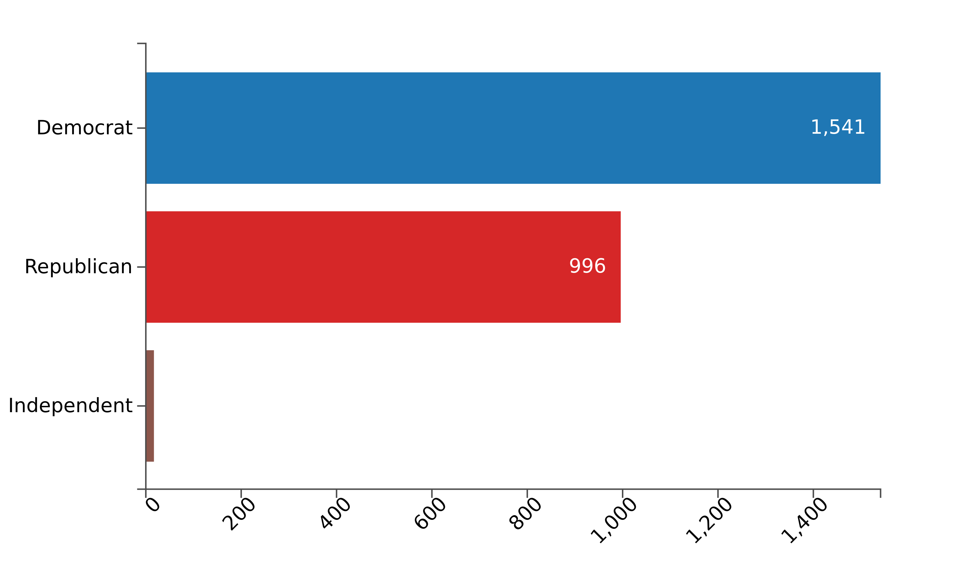
Legislative activity of the past year: 2023 party sponsorship
Party sponsorship across all bills and entrepreneurship bills in 2023 were consistent in terms of rates. This suggests that, compared to the entire decade, entrepreneurship trends as a bi-partisan issue in terms of legislation
Figure 15: Party sponsorship of all bills in 2023
Figure 16: Party sponsorship of entrepreneurship related bills in 2023

Slide 12
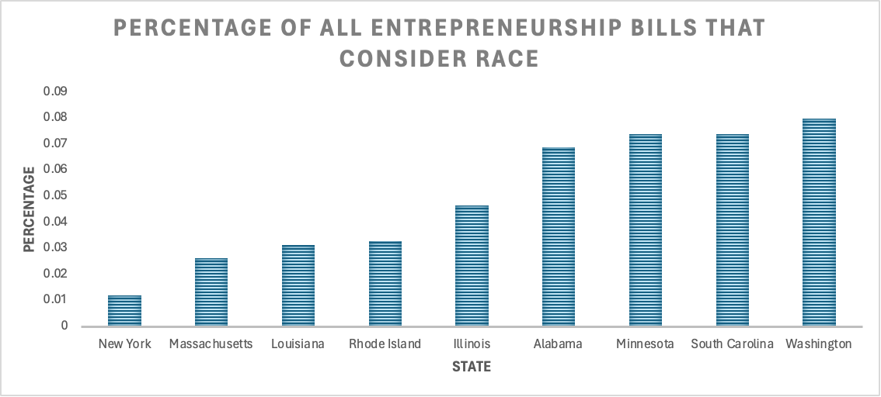
Legislative activity of the past year: 2023 consideration of race and ethnicity
In 2023, only the states on the right introduced entrepreneurial legislation that considers race or ethnicity, with 29 pieces produced overall. Washington (4), South Carolina (2), Minnesota (8), and Alabama (2) introduced the highest volume of bills that consider race and ethnicity relative to the volume of all bills that state produced
Figure 17: The percentage of all bills that considered race/ethnicity & entrepreneurship in 2023

Slide 13
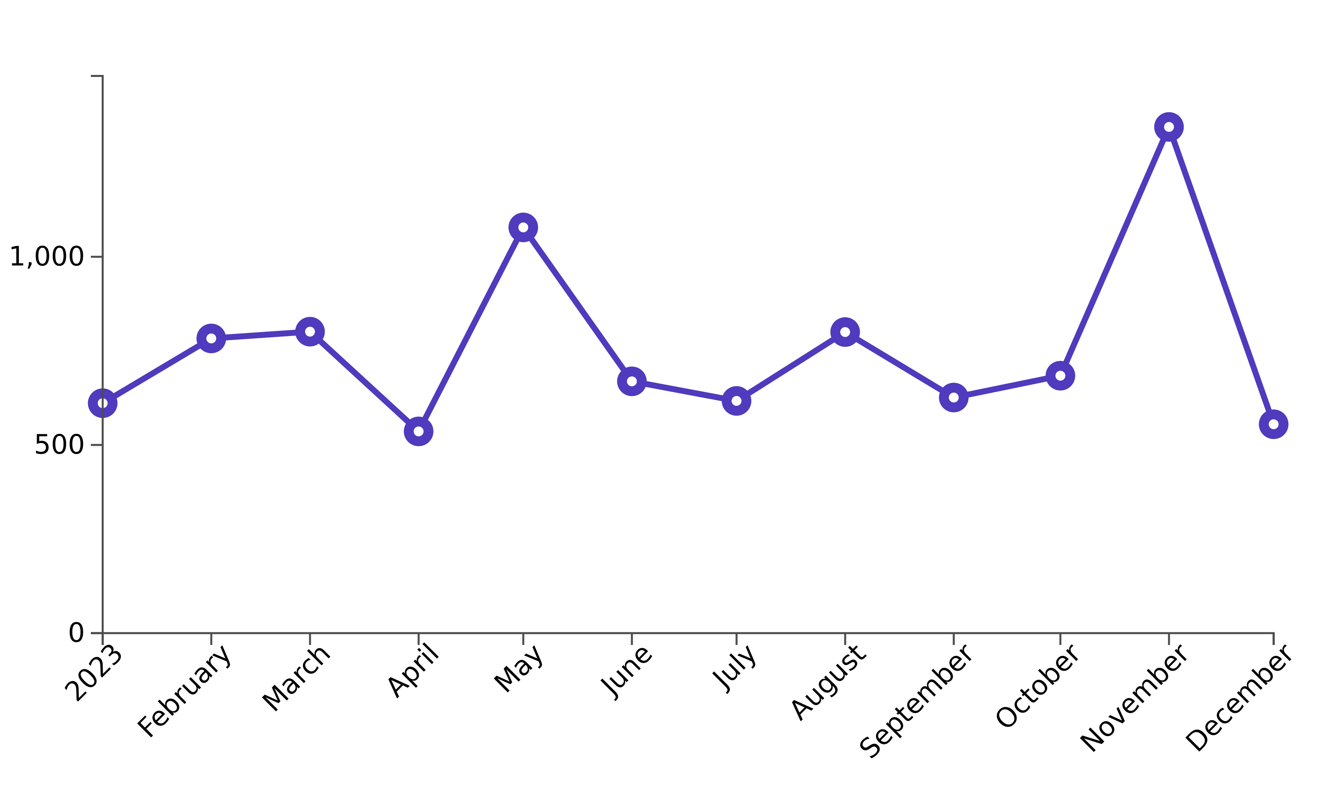
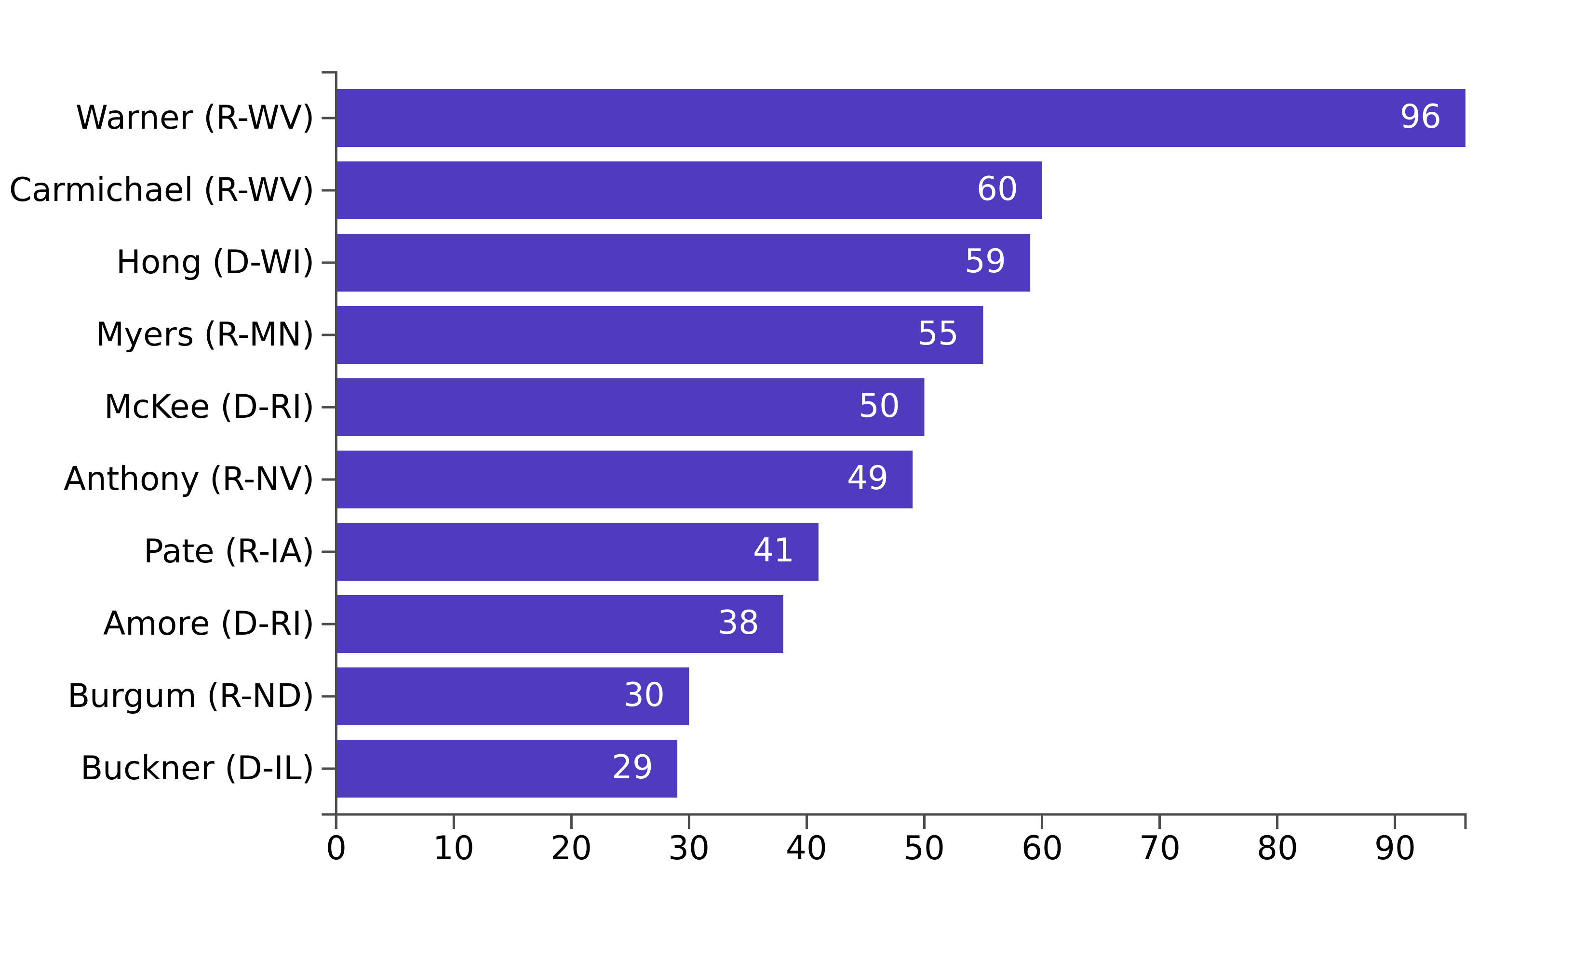
Discourse over the past year: 2023 social media at a glance
Social media activity mentioning entrepreneurship peaked in November 2023
Figure 19: All social media posts from the last year (2023)
Figure 18: The top legislators mentioning entrepreneurship in their social media activity

Slide 14
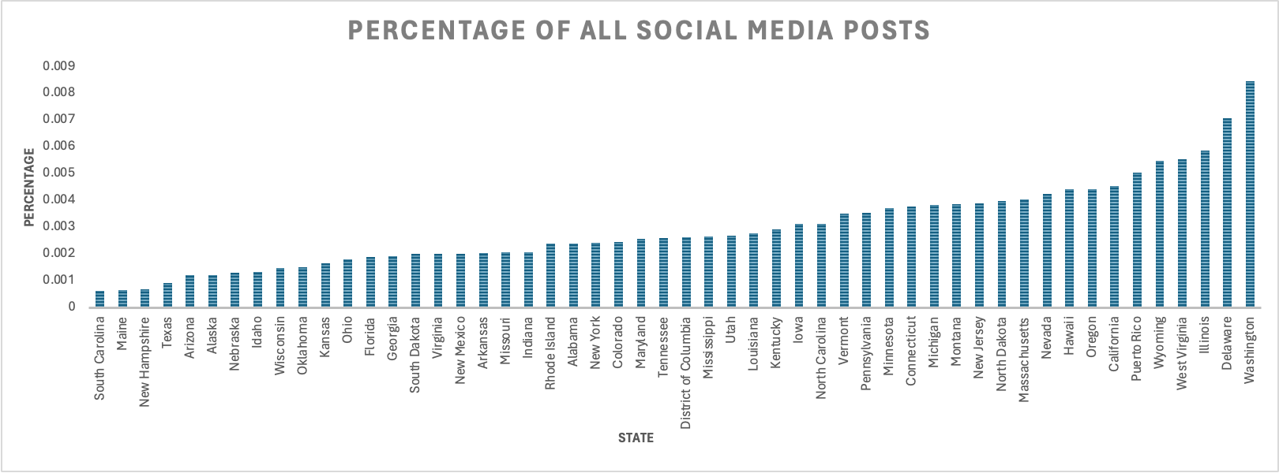
Discourse over the past year: 2023 social media by state
Legislators from Washington, Delaware, Illinois, West Virginia and Wyoming discussed entrepreneurship on social media the most in 2023
Figure 20: The percentage of entrepreneurship-related posts of state legislators in 2023

Slide 15
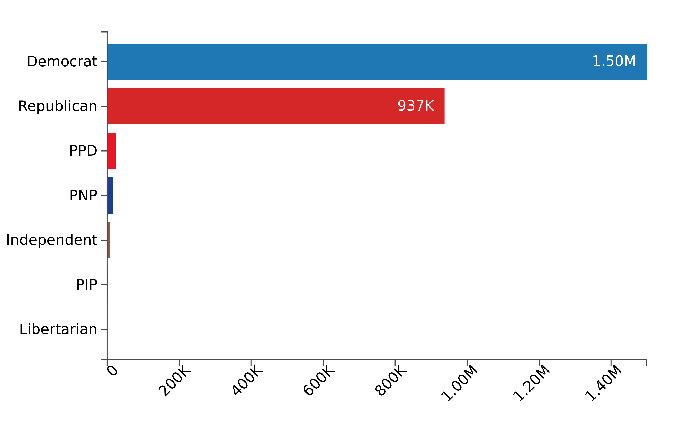
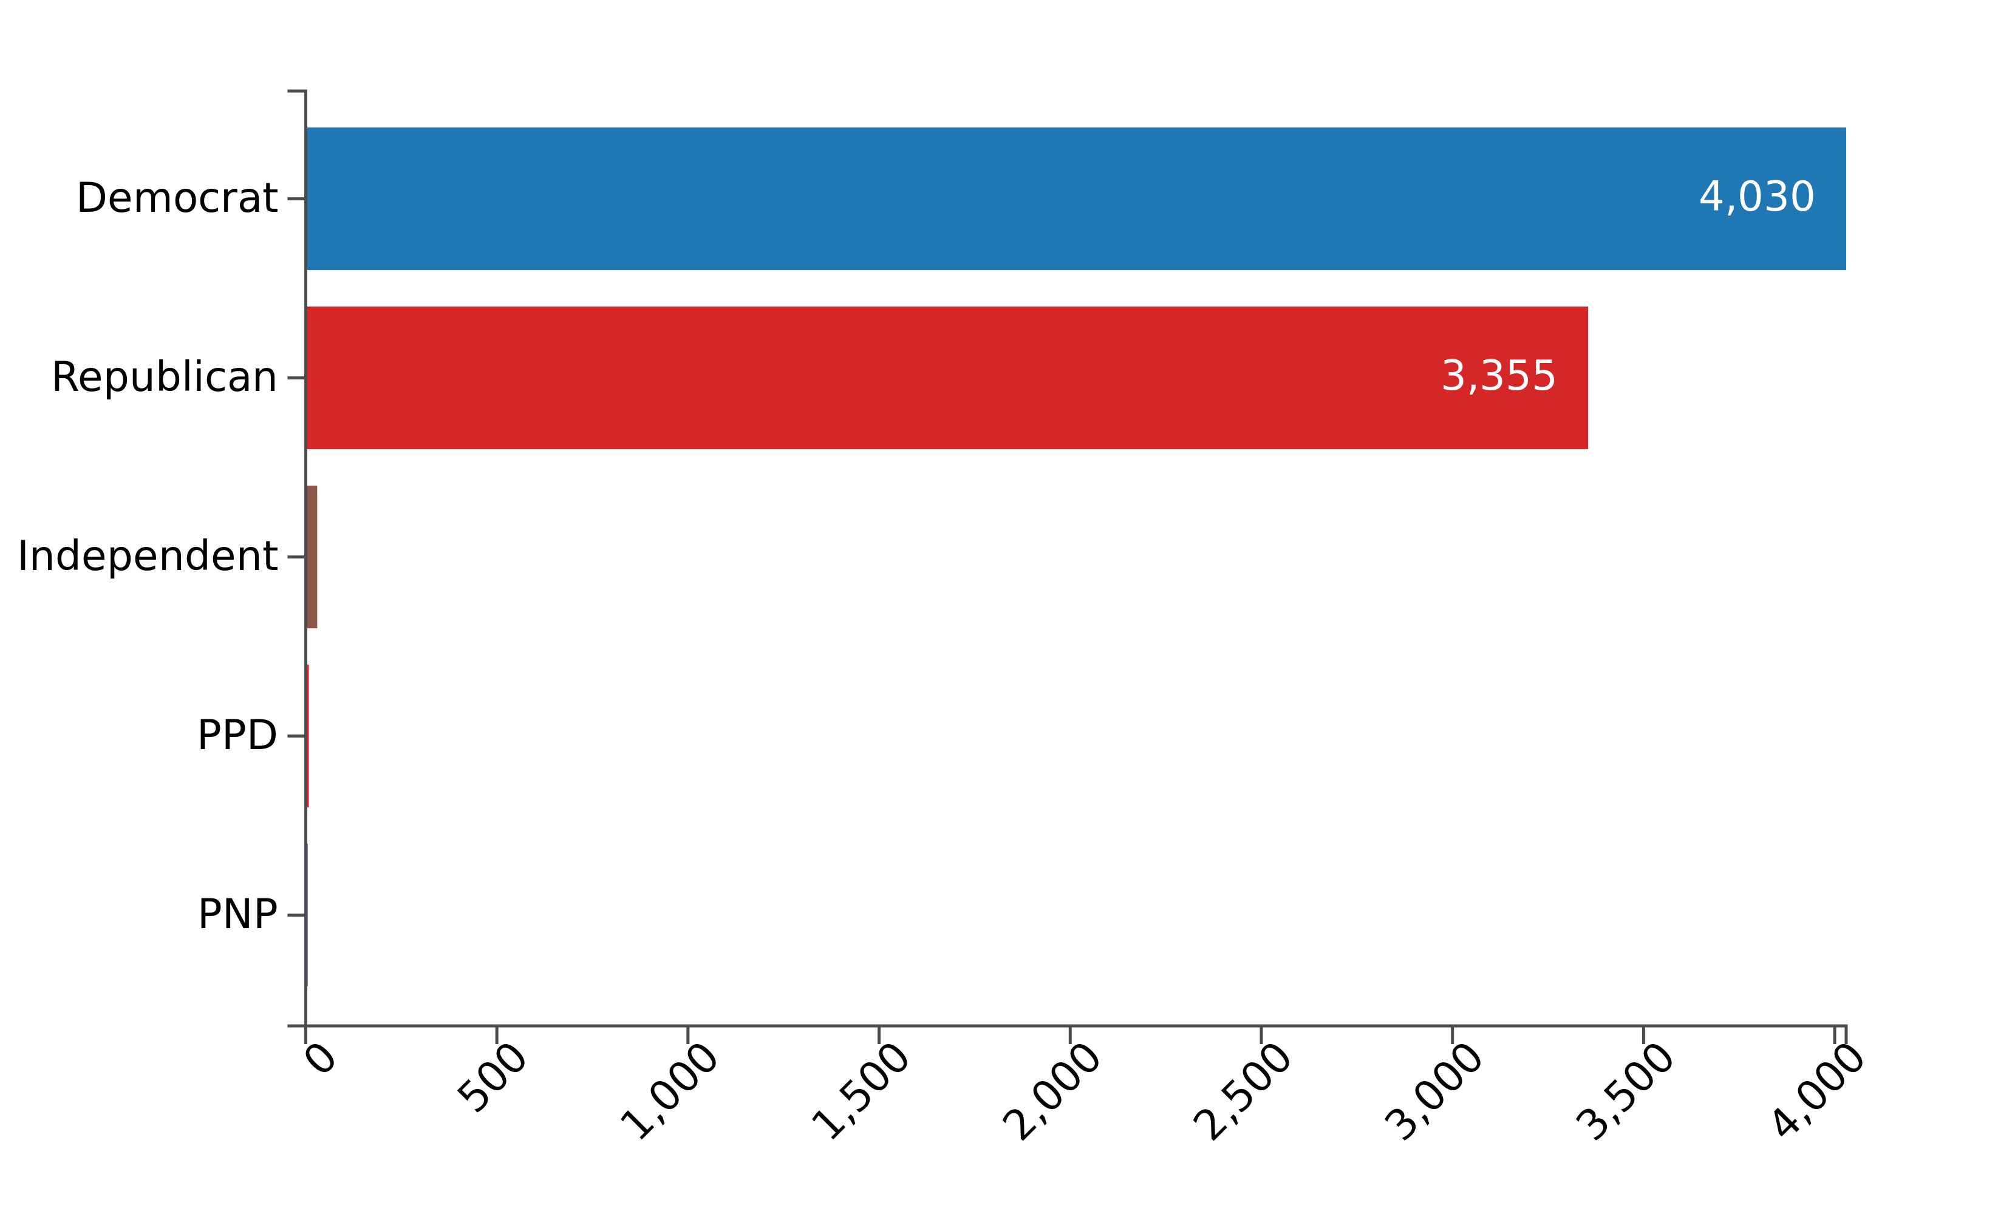
Discourse over the past year: 2023 social media by party
Democratic were more active on social media overall, but by a lesser margin in terms of entrepreneurship related posts
Figure 21: All social media posts from the last year (2023)
Figure 22: All social media posts related to entrepreneurship from the last year (2023)

Slide 16
State Intelligence

Slide 17
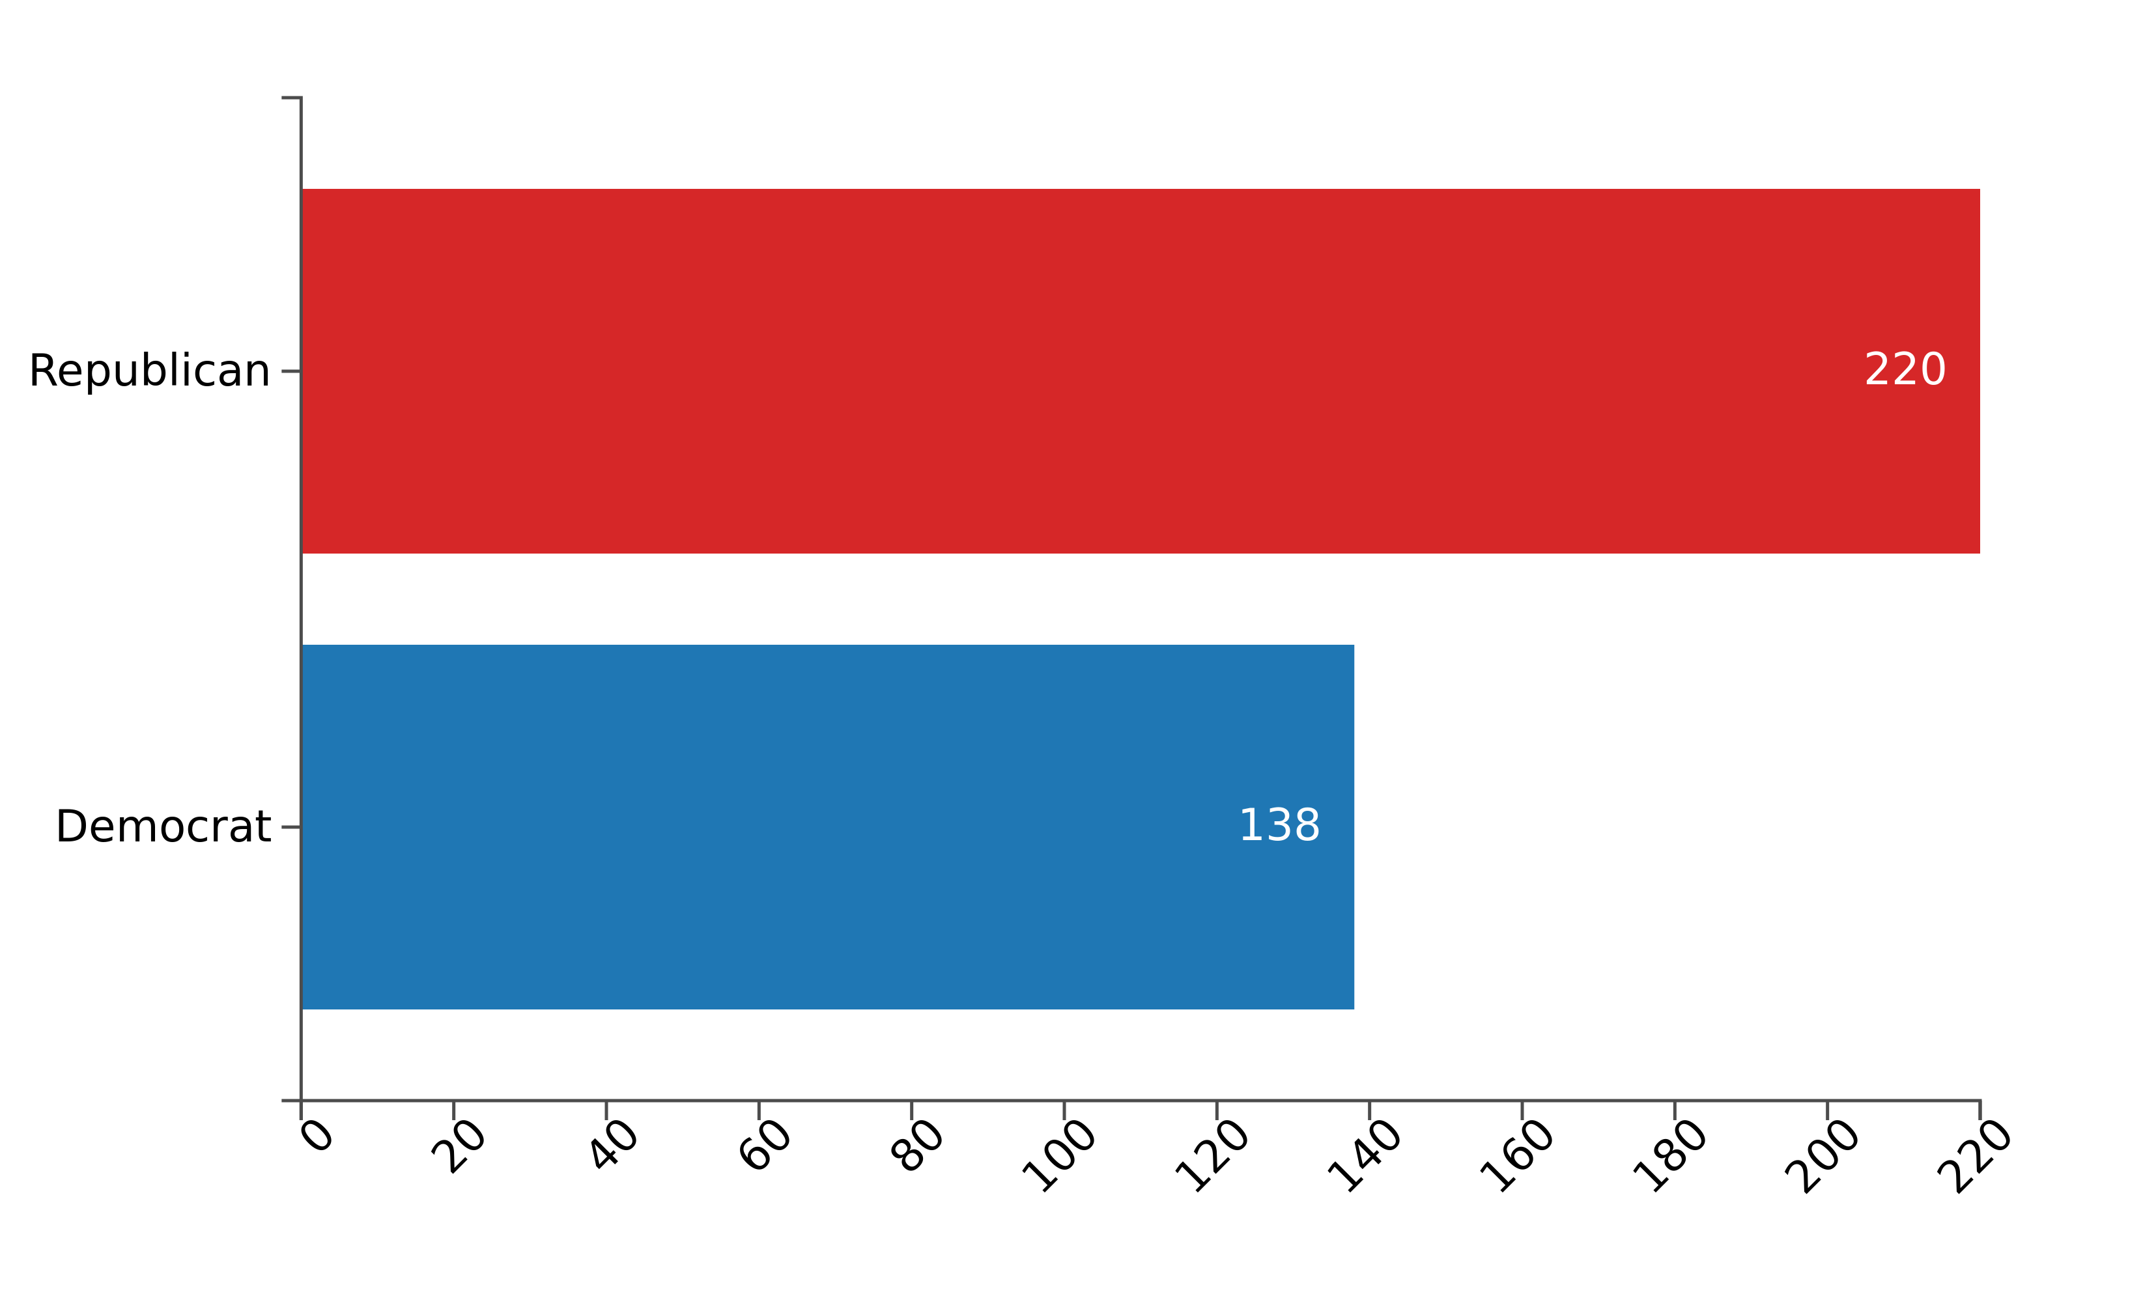
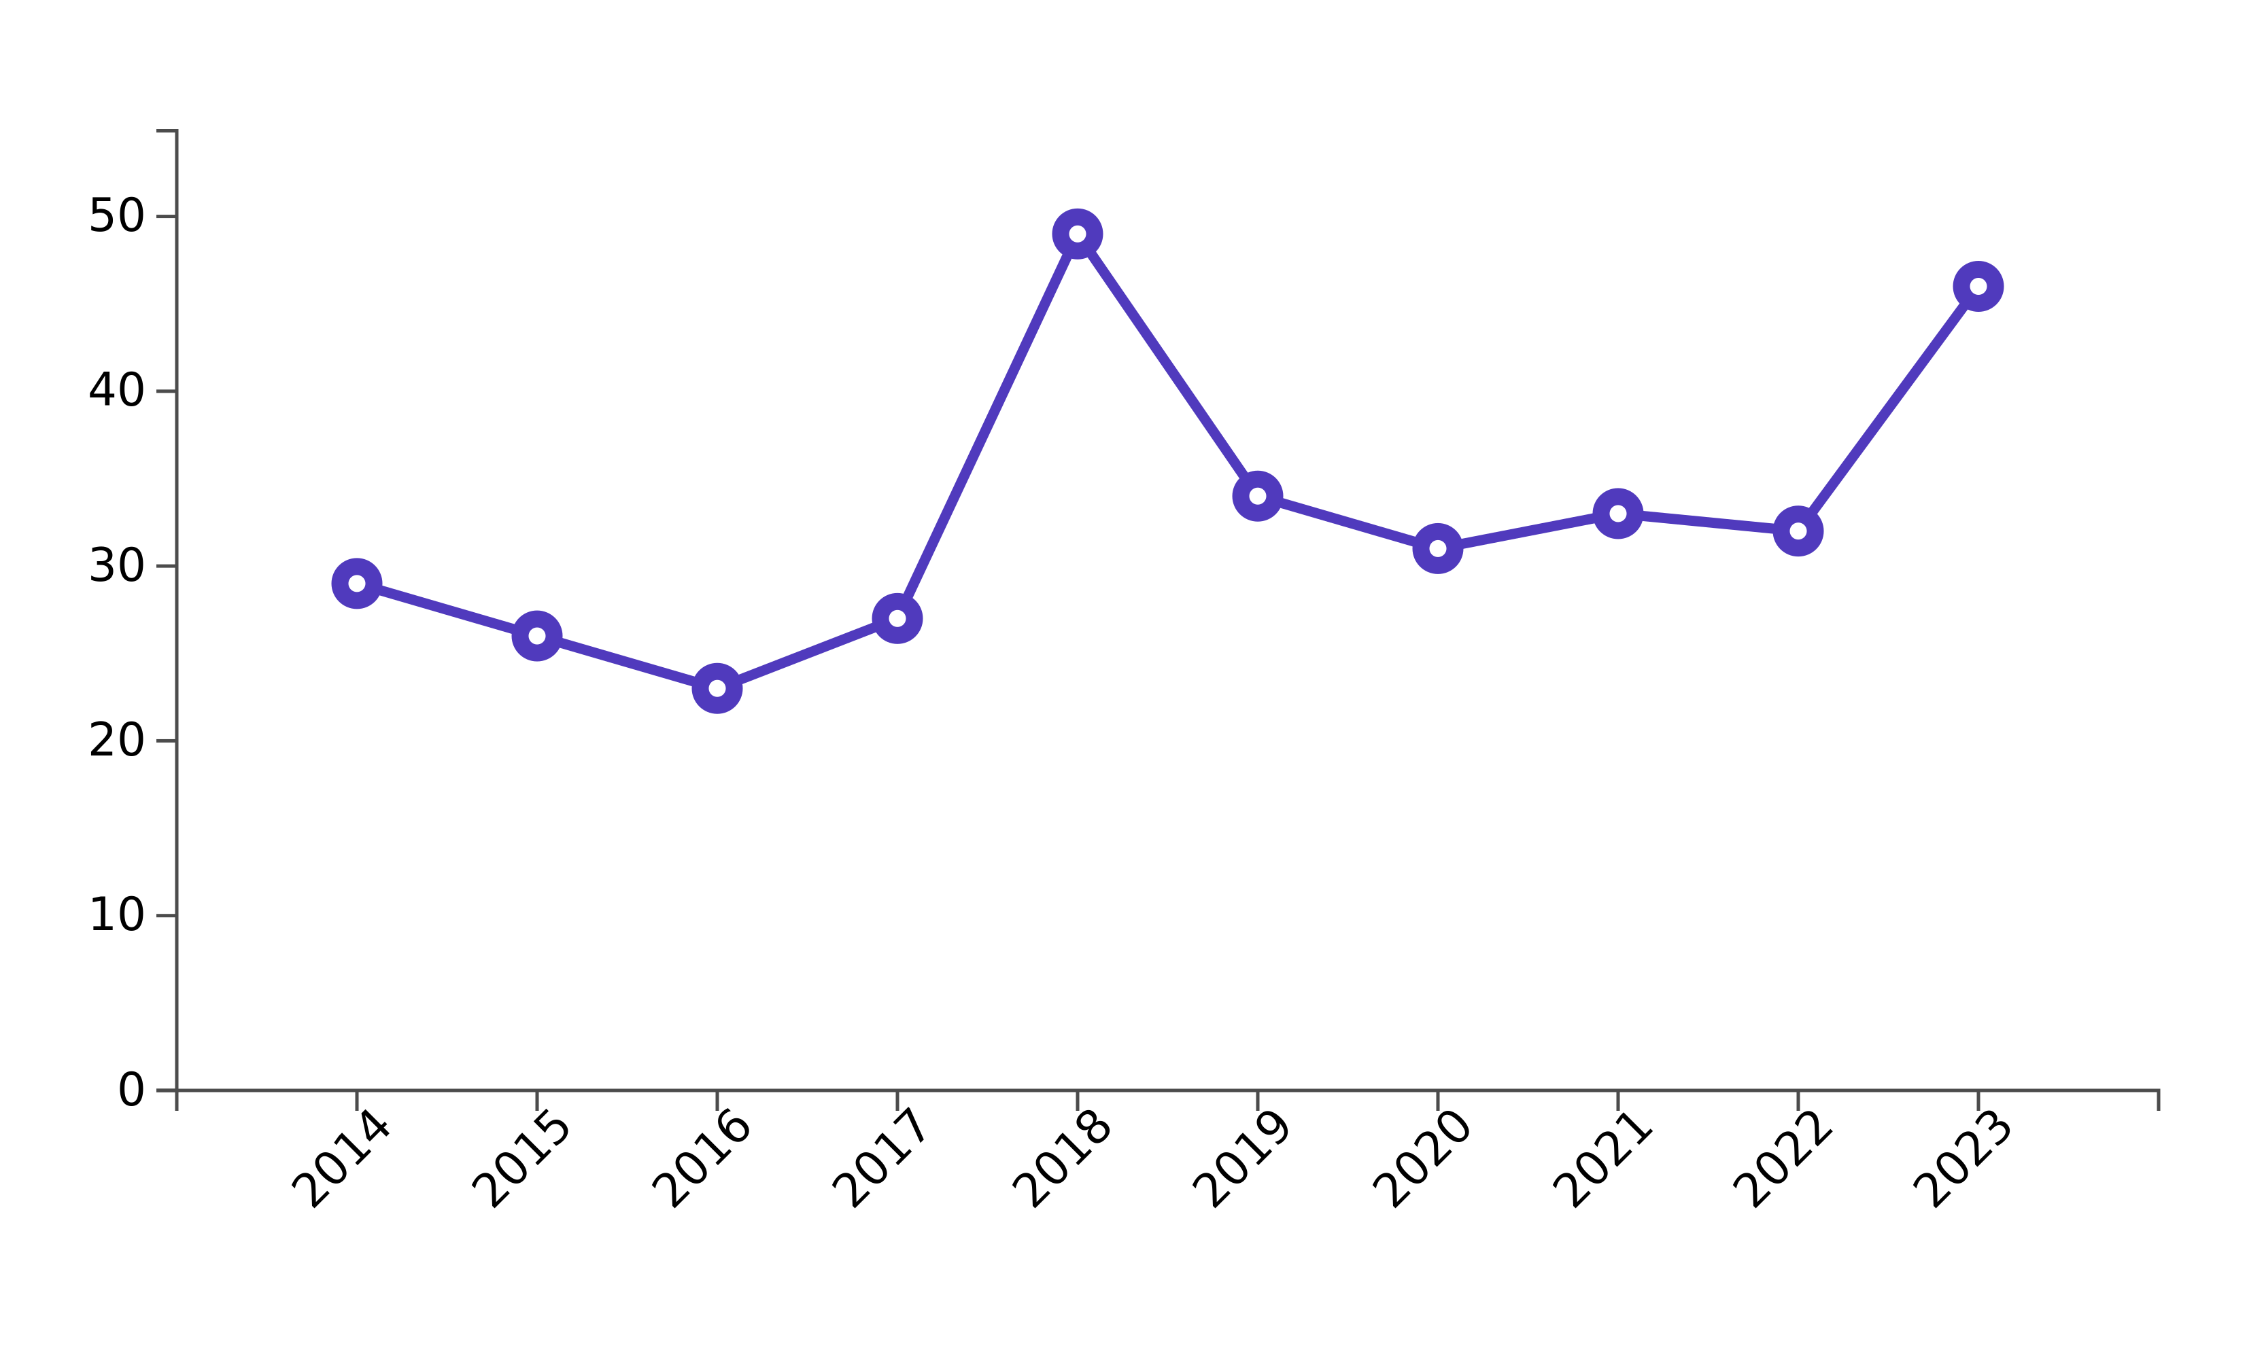
Florida – The past decade at a glance
In 2023, there were 46 entrepreneurship-related bills introduced in Florida, which almost matches a peak of 49 in 2018
Legislation sponsorship is predominantly provided by the Republican party, though entrepreneurship remains a bi-partisan issue

Slide 18
Florida – Key issue areas in 2023
The 46 introduced bills covered a range of topic areas, including:
Intercollegiate Athlete Compensation – athlete rights, financial literacy, and entrepreneurship training
Student Outcomes and Educational Reforms – evidence-based instruction, early warning systems, updating standards, & providing scholarships
Public Records and Confidentiality for Veteran's Program – exemption of veteran's program data from public record
Support for Small Businesses – reduced-rate capital for businesses in underserved areas
Establishment of the Department of Labor – enforce labor laws & protect employee rights
Corporate Income Tax Revisions – revisions to definitions & calculations of federal income and tax filing requirements
Workforce Development and Education - alignment of workforce programs with market demands, enhancement of vocational training, support for apprenticeships

Slide 19
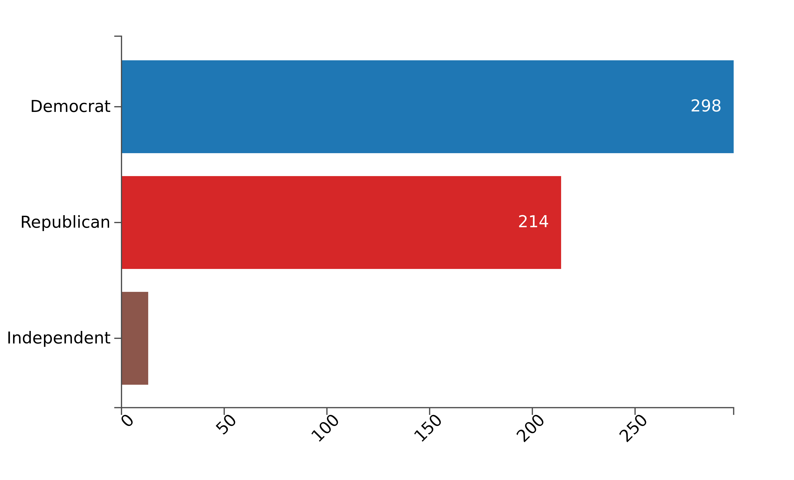
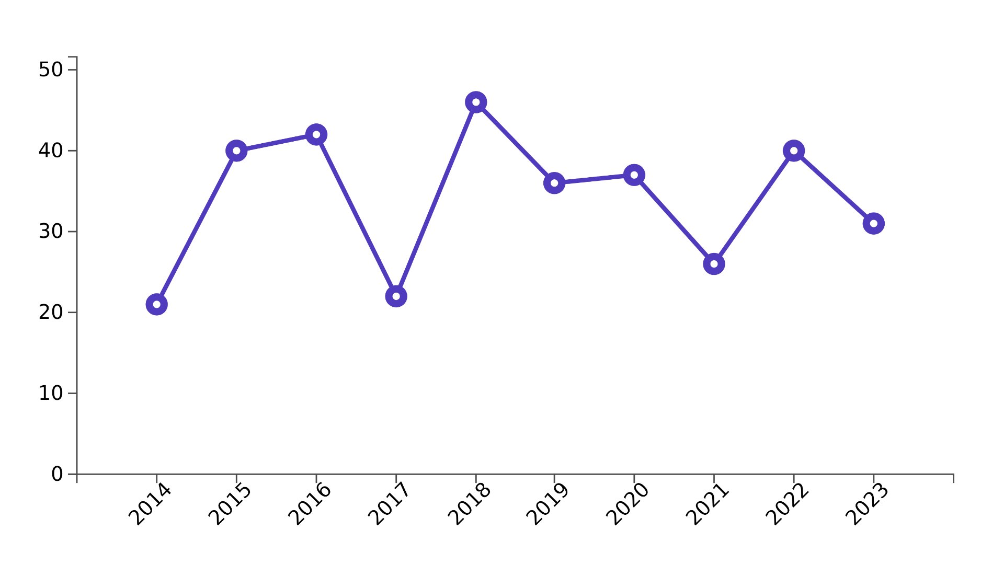
Georgia – At a glance
Georgia peaked in 2018, introducing 52 pieces of entrepreneurship legislation that year. In 2023, the state introduced 42
The Democratic party introduced the most entrepreneurship-related bills, but it's heavily a bi-partisan issue in Georgia

Slide 20
Georgia – Key issue areas in 2023 The 42 introduced bills covered a wide range of topics, including:
Tax Credits for Small Business Employers – for hiring certified workforce-ready graduates
Representation in State Procurement – inclusion of BIPOC, female, and Veteran owned businesses in state contracts
Economic Development HBCUs – HBCU Innovation and Economic Prosperity Planning Districts Commission to accept public & private funds
Healthy Food Access – provide resources for food retailers in underserved areas
Agribusiness Marketing and Promotion – specifically for BIPOC- and female-owned
Expanding Georgia's Workforce - creation of the Senate Study Committee to examine and improve workforce conditions

Slide 21
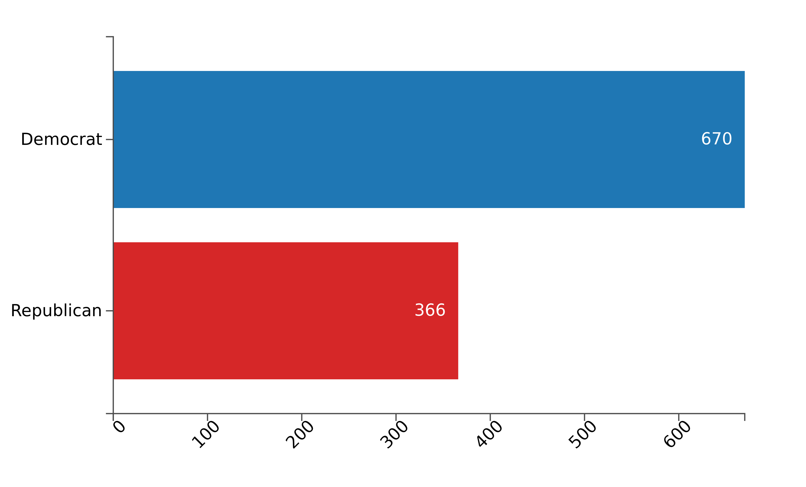
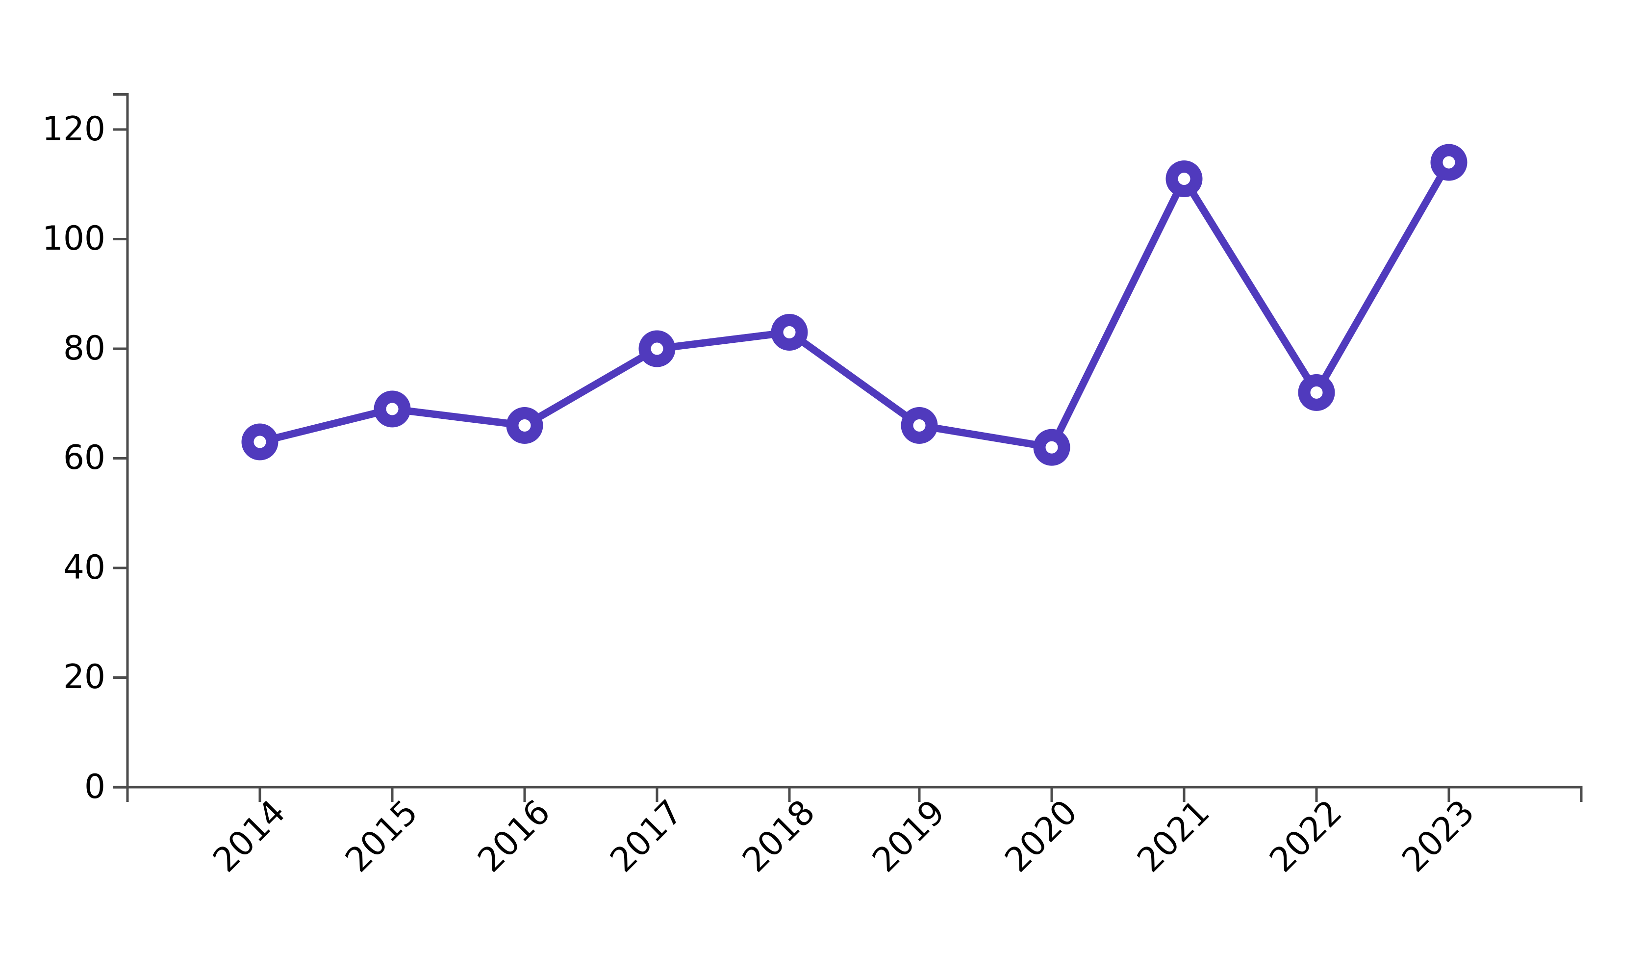
Illinois – At a glance
Illinois introduced peak amount legislation in 2023 (114)
Illinois Democrats introduced almost double the volume of entrepreneurship bills compared to state Republicans

Slide 22
Illinois – Key issue areas in 2023
Business Assistance & Permitting Reforms – streamline permits and regulatory processes
Internet Gaming Regulation – legalizing and regulating gaming industry through authorized licensing, data security, and mandating age/location
Economic Development Initiatives – launching the Job Zone Creation Pilot Program to provide tax incentives & mandate reporting
Environmental Protection & Compliance – regulation of power plant practices, setting penalties for violations, and offering assistance for compliance
The 114 bills introduced targeted a wide array of issues, including:
Renewable Energy – establishing Illinois Rust Belt to Green Belt
Paid Family & Medical Leave Insurance Program – provide benefits & insurance coverage, mandate premium payments for employees on leave
Income Tax Credits for R&D Expenditures – extending and increasing credits for quantum information science expenditures

Slide 23
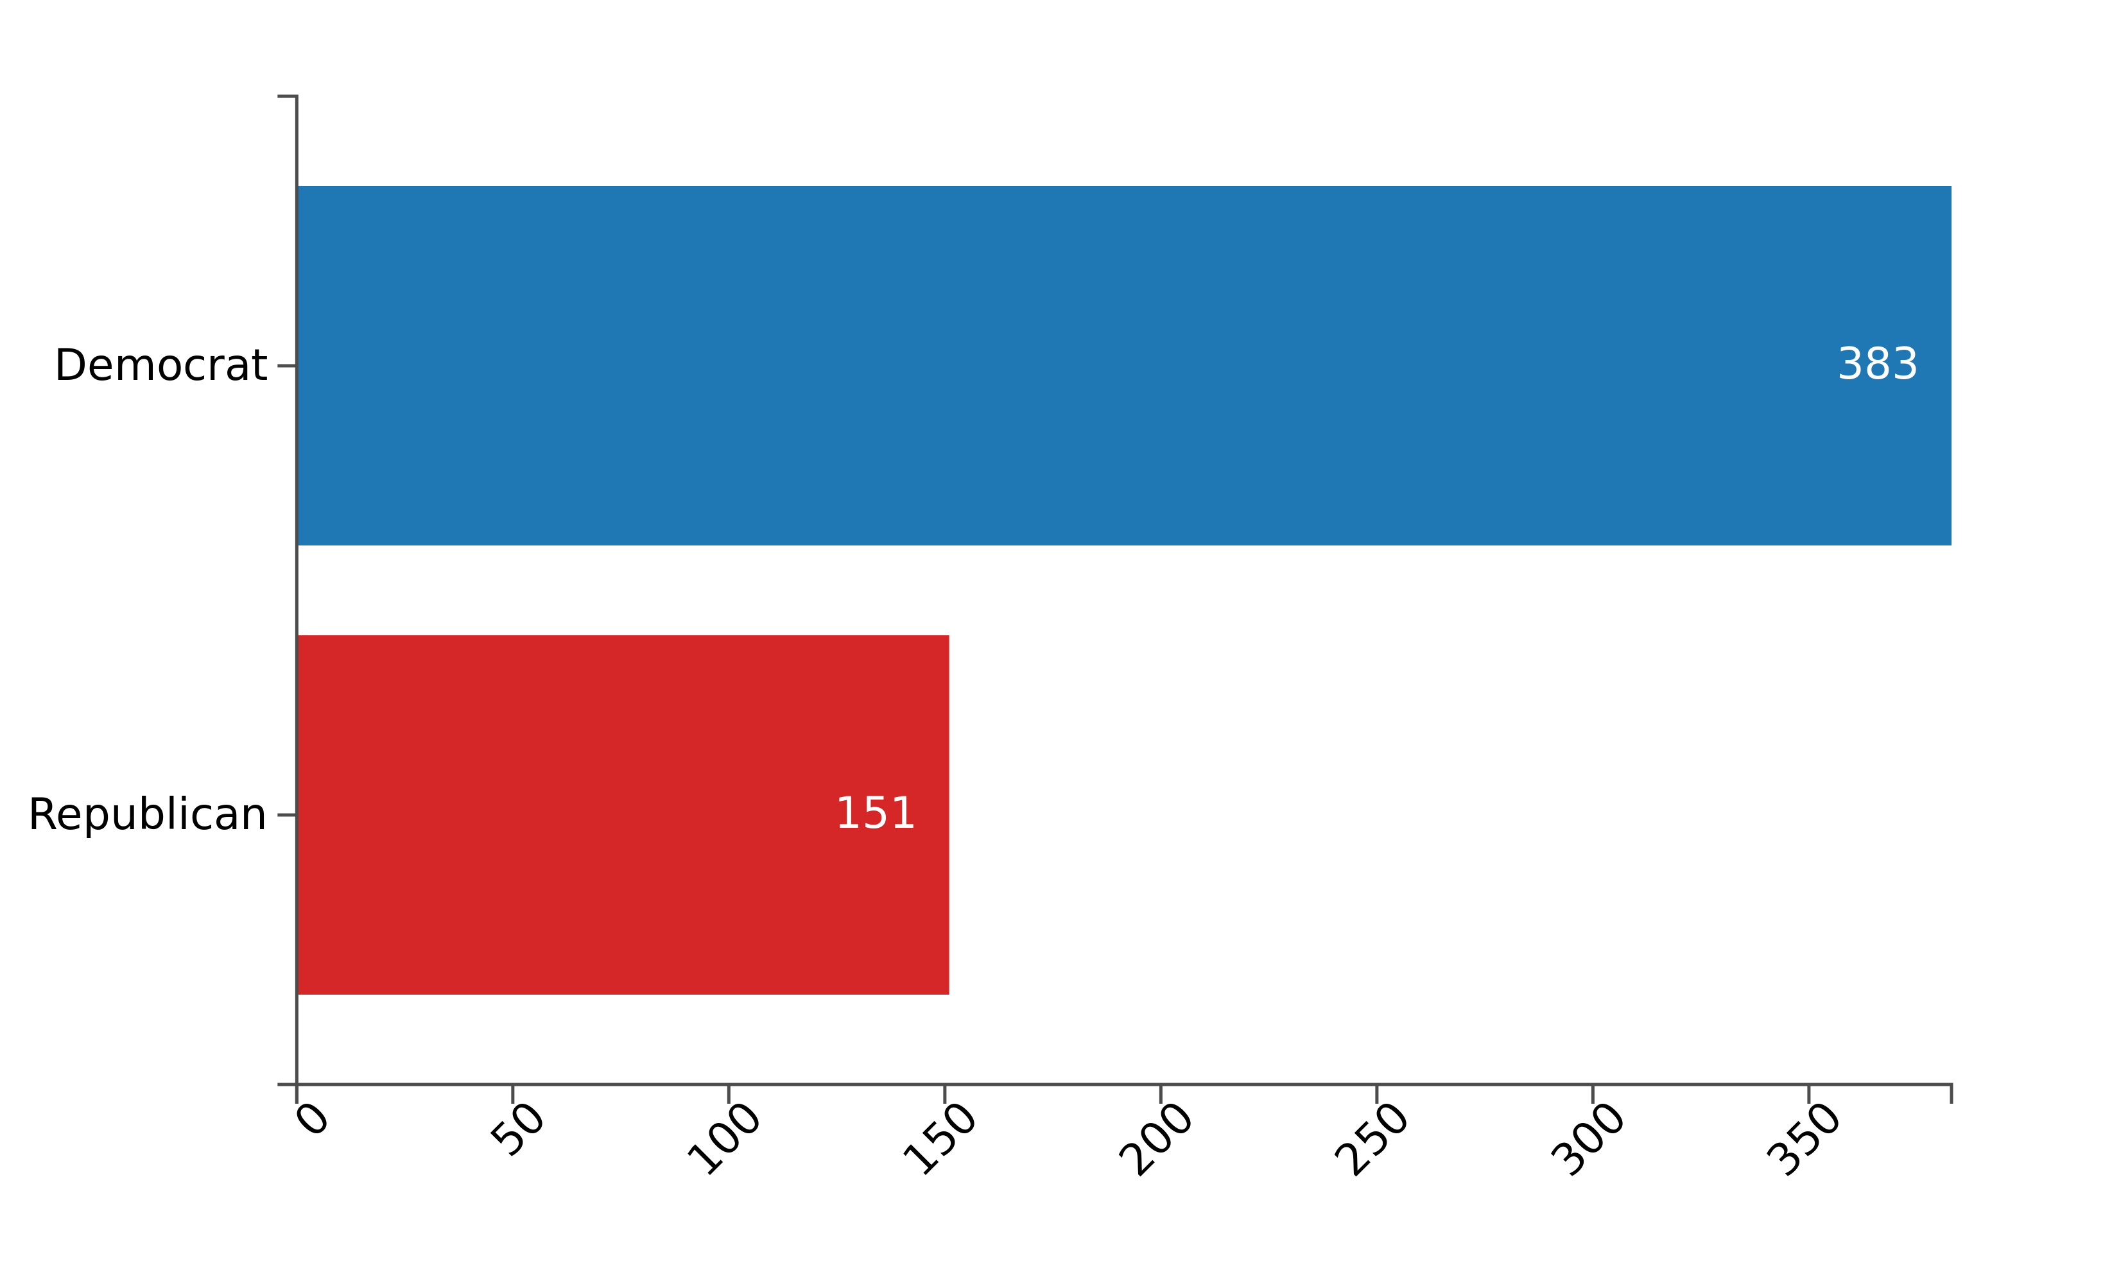
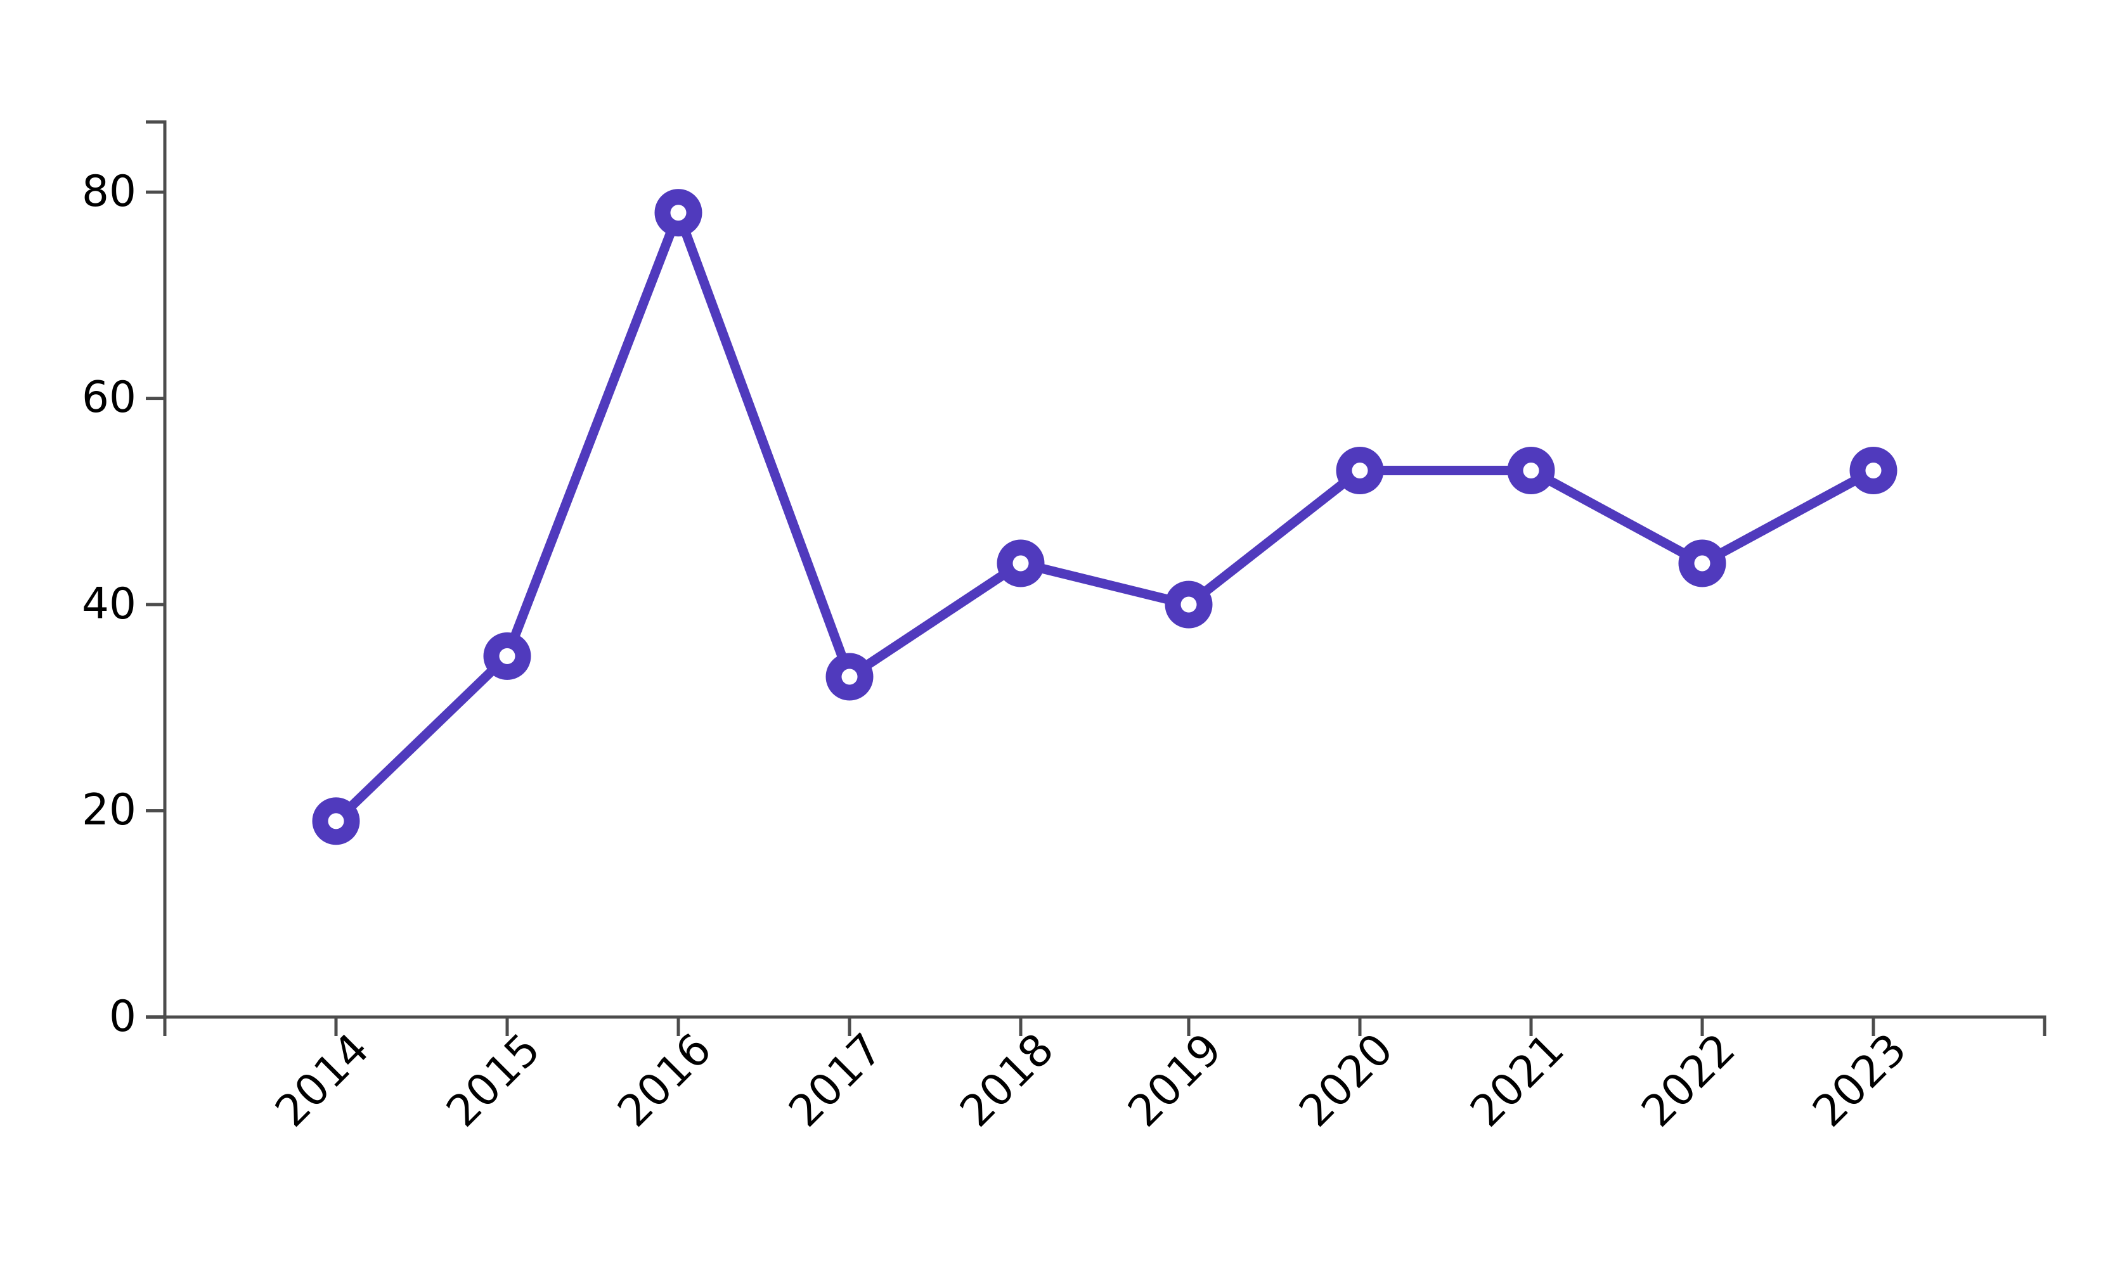
Maryland – The past decade at a glance
Maryland introduced 53 entrepreneurship bills in 2023, with a peak of 78 introduced in 2016
Maryland Democrats introduced just over 2.5x the volume of entrepreneurship bills compared to Republicans

Slide 24
Maryland – Key issue areas in 2023
Cannabis Reform – establishes a singular unit to regulate, license, and enforce laws for adult use cannabis
Healthy Maryland Program – provides universal healthcare for residents, ensuring transparency & accountability
Climate Change Adaption and Mitigation – establishes a payment program for corporations, and collected funds fuel infrastructure projects where at least 40% should be allocated to help at-risk populations
Economic Development and Nonprofit Support – establishes the Nonprofit Sustainability Fund to support regional economic development financial and operationally
Minority and Small Business Enterprise – benefits for procurement of minority businesses, and identification of opportunities for minority businesses
E-commerce & Small Business Protection – creates a task force to study and report on e-commerce practices and potential impact on local business

Slide 25
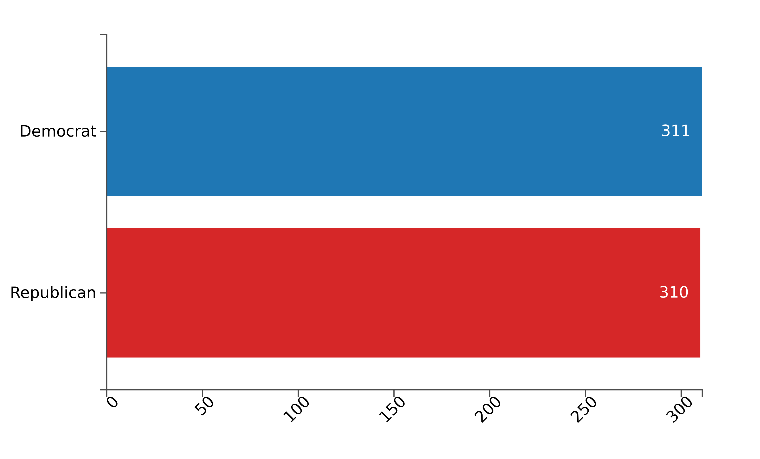
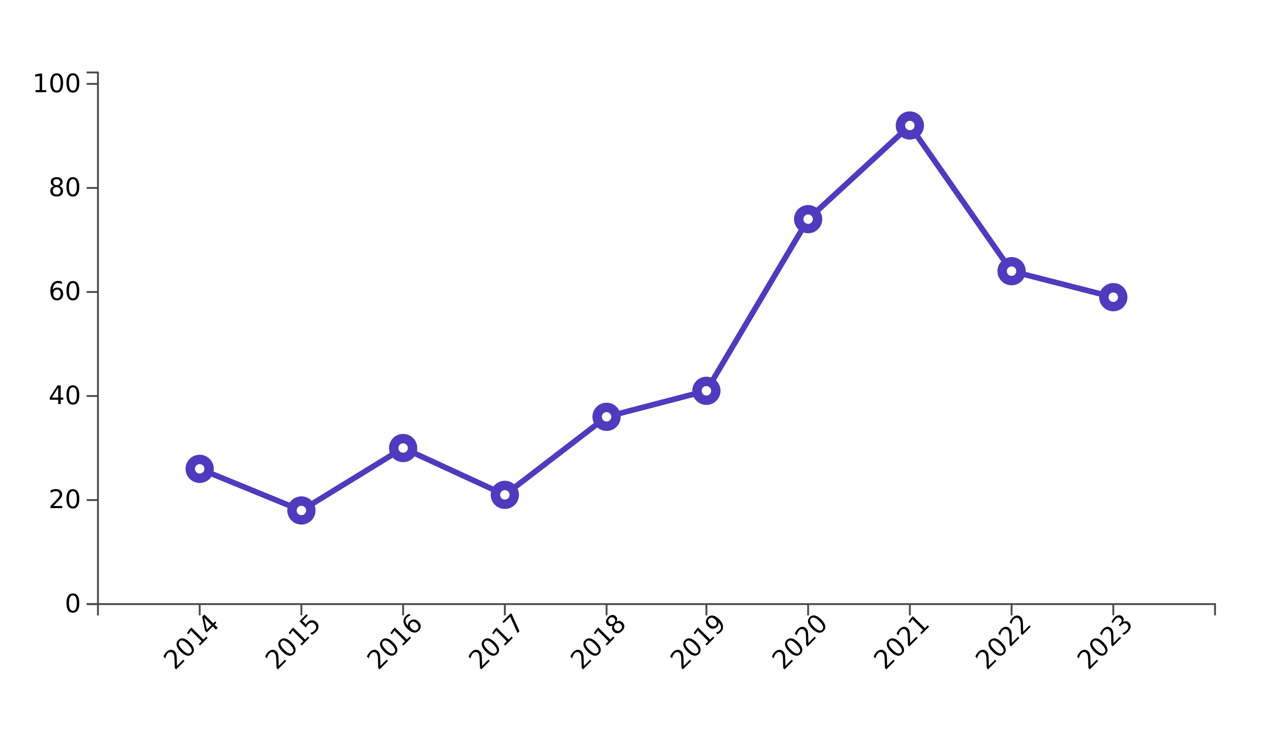
Michigan – The past decade at a glance
Michigan introduced 59 entrepreneurship bills in 2023, with a peak of 92 introduced in 2021
Democrats and Republican introduced virtually the same volume of legislation that considers entrepreneurship

Slide 26
Michigan – Key issue areas in 2023
Appropriations for Community College – allocates $500 million to community colleges for resources, support, and requiring transparency
Employment in Marijuana Establishments – allows individuals 19 years of age or older to work in marijuana establishments
Economic Development Assistance – the Michigan Fast Track Program to expedite economic assistance, provide education, & mandate reporting
Integrated Behavioral Health Services – reforming the Department of Health and Human Services to improve delivery of medical services and primary care access
Film and Digital Media Industry Support – provides incentives and professionalization to foster growth in Michigan's media industry
Tenant Protections & Supports – provides protections and resources for tenants, particularly those of underserved populations

Slide 27
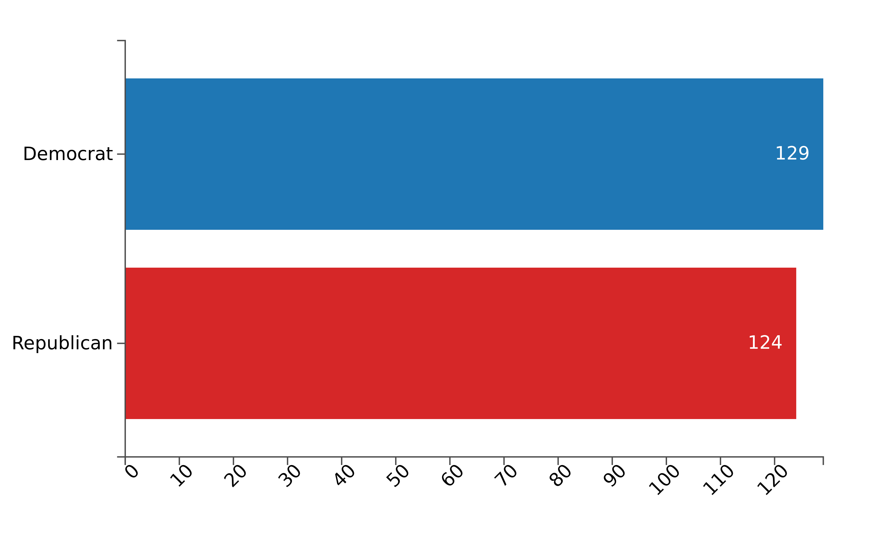
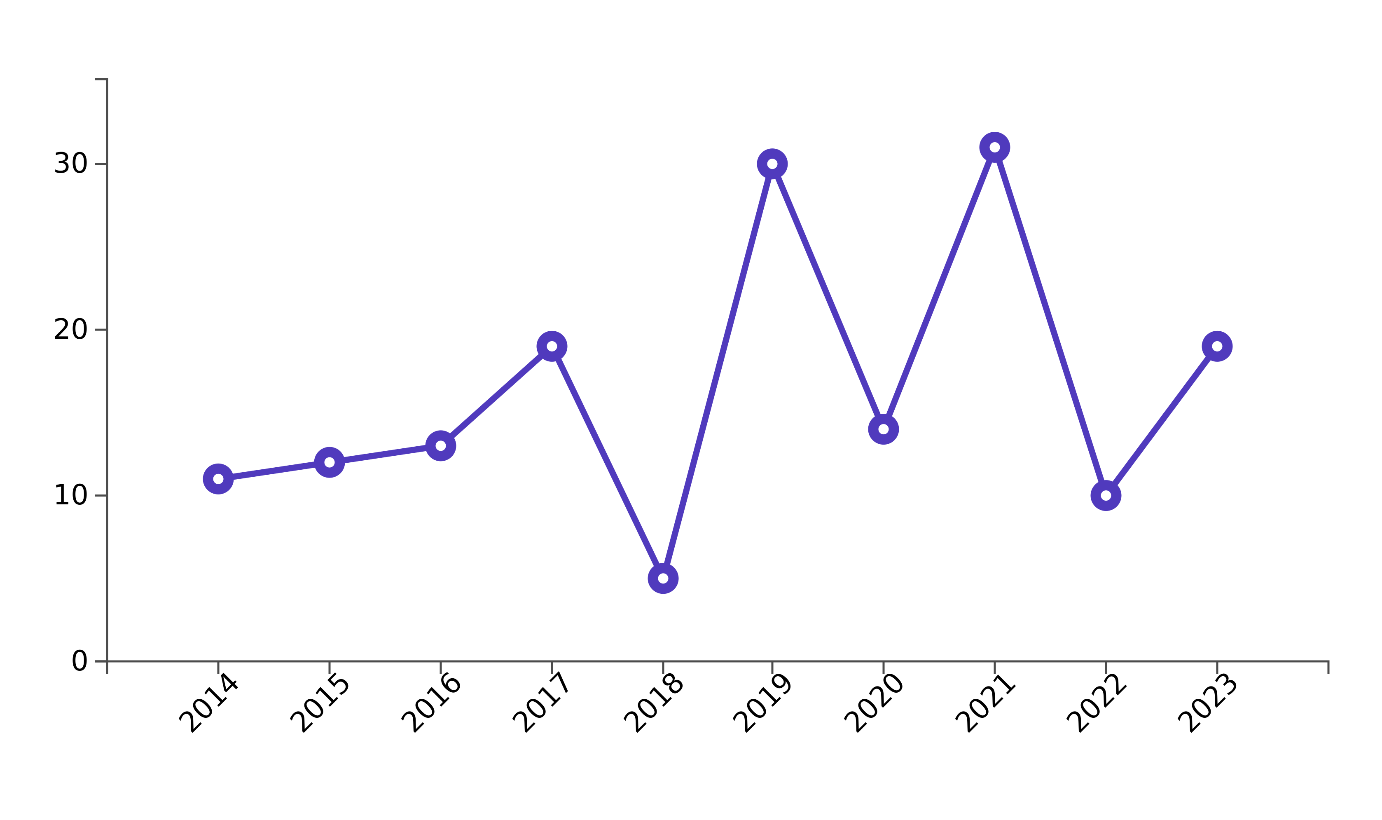
North Carolina – The past decade at a glance
North Carolina introduced 19 entrepreneurship bills in 2023, far less than their peak in 2021 of 31
Party sponsorship of entrepreneurship bills was almost identical over the decade

Slide 28
North Carolina – Key issue areas of 2023
Paid Sick Days – mandates sick hours and that hours can be used for personal or familial issues; enforces penalties for non-compliance
Economic Security – increases and enforces benefits for employees (income, benefits, and compensation)
Small Business Financing – transparency in commercial financing for small businesses, establishes requirements for providers
Retirement Savings – establishes the Small Business Retirement Savings Program, which offers retirement benefits
Clean Energy Grants – allocates $14.5 million for research and innovation in renewable energy

Slide 29
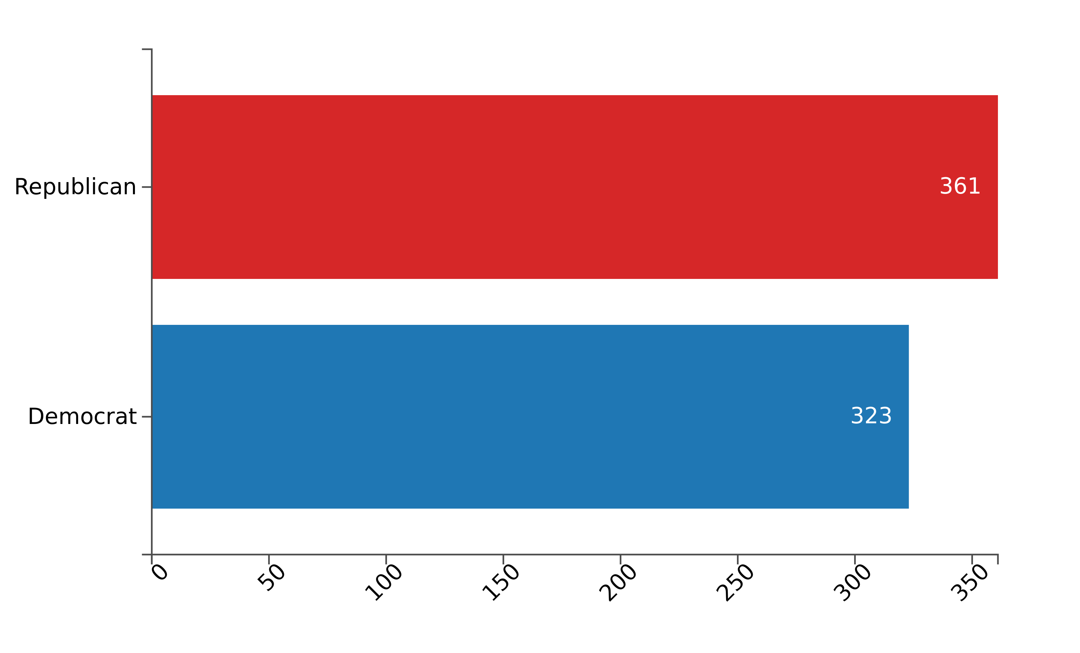
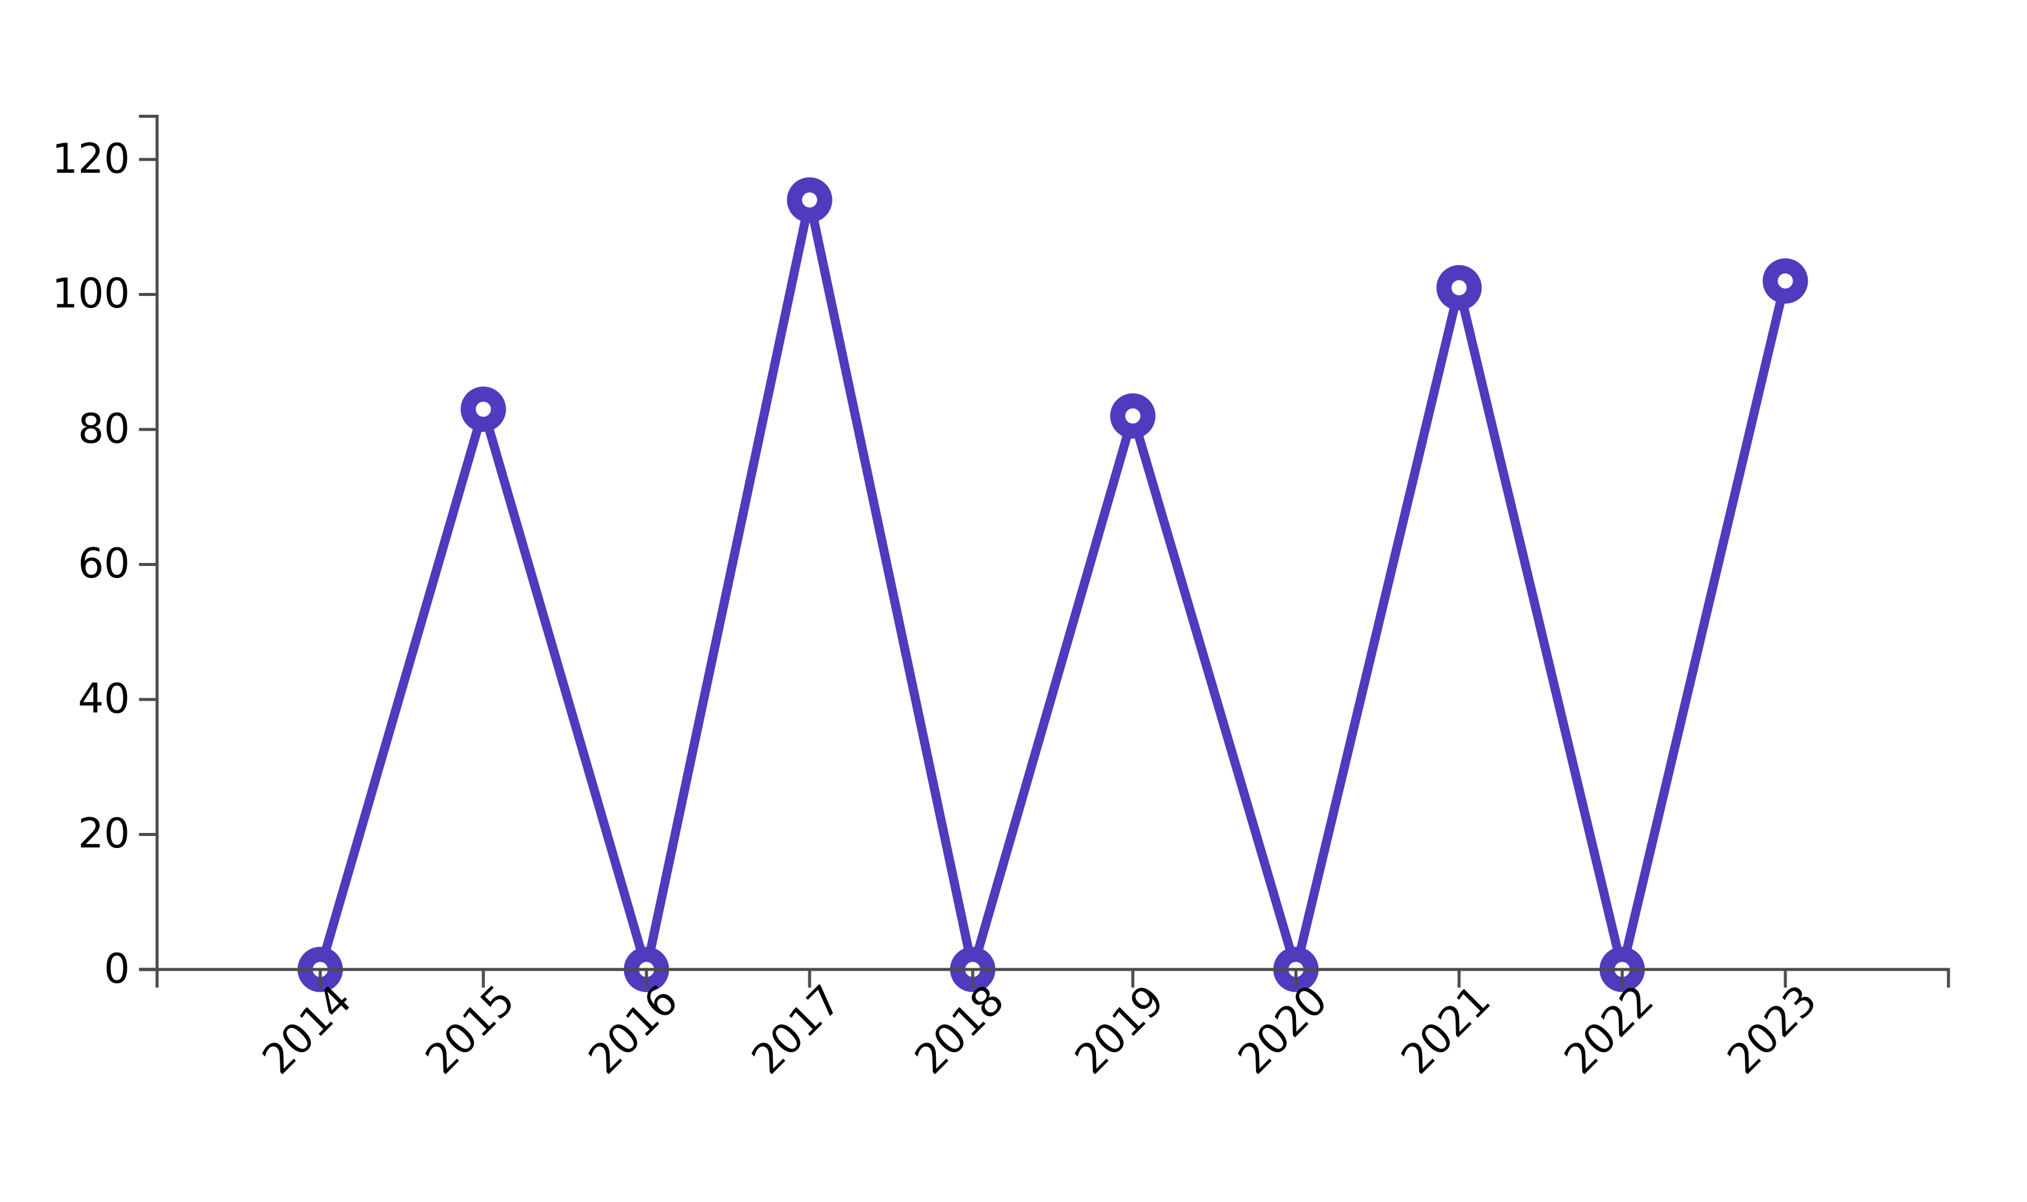
Texas – The past decade at a glance
Texas introduced 102 bills in 2023, not far off from the peak of 114 in 2017
Despite Texas being a predominately red state, both parties introduced similar volume of entrepreneurship bills over the last decade

Slide 30
Texas – Key issue areas of 2023
Protection of Minors Online – introduction of Securing Children Online through Parental Empowerment (SCOPE) Act, requiring transparency from digital service providers
Enviornmental Protection and Regulation – includes amendments to the Texas Commission on Environmental Quality, increasing regulations and transparency
Support for Small Business Innovation – establishes grant matching for businesses in SBIR and STTR programs
Small Business Recovery Funds – establishes funds for small businesses and provides tax credits for investment into funds
Economic Development and Tourism – extension of the Texas Economic Development and Tourism Office functions until 2035
Immigration and Workforce Management – establishes the Texas Commission on Immigration and Migration to facilitate the legal migration of workers
Primary Care Access Programs – implements primary care access, preventative care, and fair payment rates
Prohibition of Race & Ethnicity Considerations – introduces legislation that prohibits consideration of race and ethnicity in employment, education admissions, and contracting decisions

Slide 31
Common Themes – All States 2023
Labor laws and employment
Tax incentives and financial support
Education and workforce development
Small business and economic development
Healthcare and social support
Environmental protection and sustainability
Consumer and business protections
Technological and digital regulation

